Slide 1
Contributor Support Services
Federal Geospatial Platform
Martin Mimeault

Slide 2


FGP flow overview
FGP-Open
Data
Public
Search / Discover
L2 approved metadata
via Open Canada Web page
GCGeo.gc.ca
Publication L2
Content Reviewer L2
Work-spaces
FGP-Internal
Search / Discover
L1 approved metadata
via GCGeo Web page
Editor
Create / Load
Metadata
Publication L1
Content Reviewer L1

Slide 3
FGP user roles and responsibilities
Type of users | Roles and responsibilities
FGP Representative | Responsible for the organization of the workspace and official point of contact with the FGP.
User Administrator | Responsible for actively managing FGP workspace accounts and user roles.
Content reviewer L1 | Review and approves (Branch level DG sign-off required) metadata records published on the FGP (accessible on the government network only).
Content reviewer L2 | Review and approves (Chief Information Officer sign-off required) metadata records published on Open Map (and the Open Science and Data Platform).
Editor | Edit/Delete/Import draft metadata record within a specific workspace.
Registered user | Discover/Visualize draft metadata records for a specific workspace.

Slide 4
SERVICES PROVIDED
Data Group
Contributor
Other
ADVANCED SUPPORT
- Basic support +
BASIC SUPPPORT
WORKSPACE AND ACCOUNTS CREATION
Support to provide good knowledge of the FGP publication workflow
Support for metadata creation, validation and loading
Support on how to use the FGP Data Catalogue and Viewer
Contributor
Support team
METADATA CREATION AND EDITION
DATA ANALYSIS
DATA CONDITIONING
Feature Manipulation Engine (FME)
DATA DISSEMINATION REPOSITORY (DDR)
Web service creation (English and French)
Data export (any format) and file hosting
REQUEST MANAGEMENT
Redmine
Monitoring Tables
  Contributors
  Workspaces
METADATA COMPLETION
PUBLICATION

Slide 5
Services not provided
For both the Basic and Advanced support, here are items the service offer do not cover.
Services not provided
Creation or editing of the contributor’s dataset Unless minor editing is required to resolve FGP database loading constraints (Advanced support only) Translation of data and metadata content where bilingualism is required Getting official approval for gcgeo.gc.ca publishing Getting official approval for open.canada.ca publishing Support to FGP users on data content Technical support (Catalogue, viewer, systems, infrastructure)

Slide 6
FGP web services requirements
Type of service
OGC Web Map Service (WMS) |  | x
OGC Web Feature Service (WFS)
OGC Web Feature Service (WMTS) |  | x
ESRI REST Feature Service |  | x
ESRI REST Map Service (Feature Layer) |  | x
ESRI REST Map Service (Raster layer) |  | x
ESRI REST Map Service (Group Layer) |  | x
ESRI REST Map Service - with Dynamic Capabilities |  | x
ESRI REST Image Service |  | x
ESRI REST Tiled Map Service |  | x
Coordinate reference system
  EPSG:3978 - NAD83 / Canada Atlas Lambert
  EPSG:3857 (or EPSG:102100 for ESRI) - WGS84 Web Mercator

Slide 7

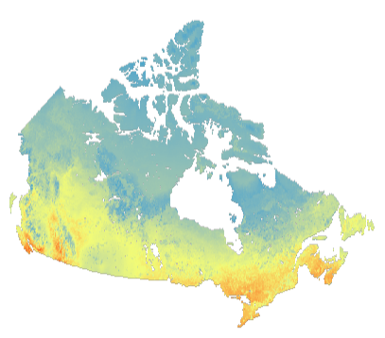








Data Dissemination Repository (DDR) Workflow
FGP Contributor
FGP
Contributor
Support
Team
@
Raw Data
FGP Viewer
MXD +
WEB
SERVICES
Have
Have Not
FGDB
MXD +
SERVER
FGDB
Data
Source
DFS
FGP Catalog
DDR
Download
Site
FTP

Slide 8







Automatic conditioning and updating
Raw data
Manual/Scripted file deposit
FME Server automatic data conditioning and input package preparation
FTP
FGP Viewer
WEB
SERVICES
File available on the internet
Scheduled task
SERVER
Data
Source
DFS
FGP Catalog
DDR
Download
Site
FTP

Slide 9

© Her Majesty the Queen in Right of Canada, as represented by the Minister of Natural Resources, 2019
Thank you!
Contact us:
fgpcontributorssupport-pgfsupportcontributeur@nrcan-rncan.gc.ca

