Slide 1

Data Dissemination Repository (DDR)
April 2017 release

Slide 2

High level view of the DDR System
DDR System
Input
Store
Publish
Database
Download
Products
Data from Providers
Folder
Public vector data only
Web Services
standardized environment

Slide 3
DDR Processing Model
Old Main Flow
Three use cases
  Geo Expert Contributors
  Non Geo Expert Contributors
  Large Data Volume Contributors
Metadata
Input
Validate
Transform
(if required)
Register
Store
Publish
Services
Files
All three use cases share the same processing model in their main flow

Slide 4
DDR Processing Model
Old Main Flow
Three use cases
  Geo Expert Contributors
  Non Geo Expert Contributors
  Large Data Volume Contributors
Metadata
Input
Validate
Transform
(if required)
Register
Store
Publish
Services
Files
All three use cases share the same processing model in their main flow

Slide 5
DDR Processing Model
Revised Main Flow
First release targets only
Non Geo Expert Contributors
Register
Link
Metadata
Input
Validate
Transform
(if required)
Publish
Link
Services
Store
Files

Slide 6
Three Main Services
1 – Publish
  Allows the publication of inexistent services
    As long as what you want to publish does not exists in the DDR, you can use the publish service call
    The service call can create a totally new DDR entry or add a missing element (a new map service or download file) to an existing entry

Slide 7
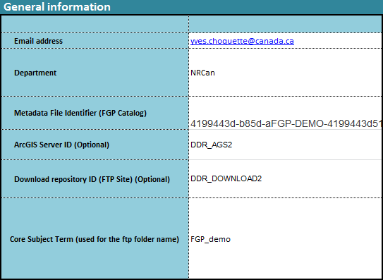
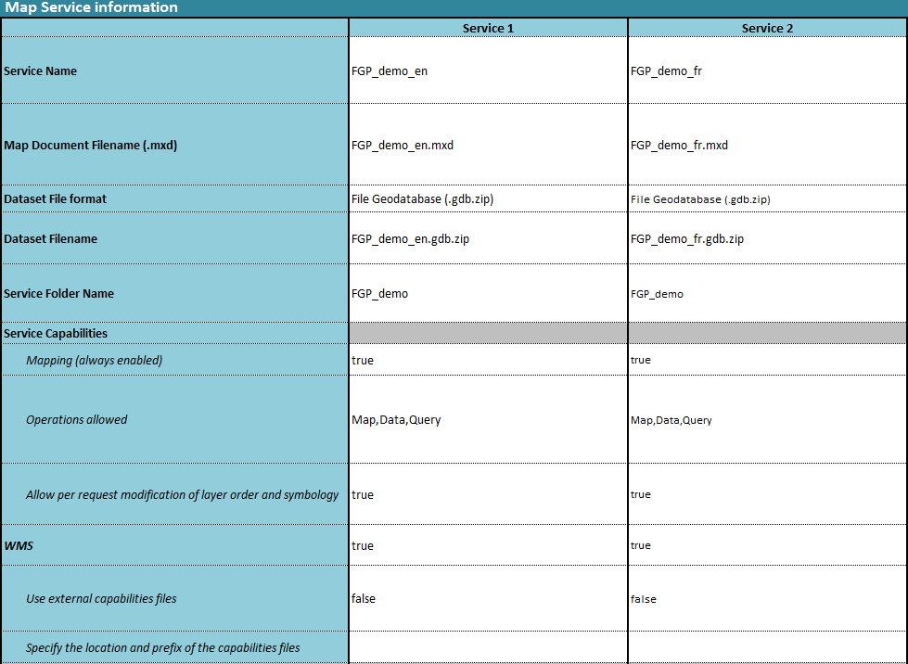
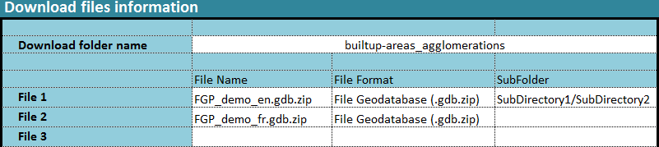
Three Main Services
1 – Publish
  The service use a control file to guide its execution
The control file can be replace by a JSON string passed to the service as a parameter or via the REST input stream

Slide 8
Three Main Services
1 – Publish
  The service receives an input package containing:
    A control file
    One or two MXD with the needed FGDB
    A set of files to be used by the download service
To create the input package we need the value of the metadata UUID
All this information is put in a ZIP file
ZIP
UUID

Slide 9
Three Main Services
1 – Publish
  The service receives an input package containing:
    A control file
    One or two MXD with the needed FGDB
    A set of files to be used by the download service
ZIP
Register
Metadata
Input
Validate
Transform
(if required)
Publish
Services
Store
Files

Slide 10
Three Main Services
1 – Publish
  The service receives an input package containing :
    A control file
    One or two MXD with the needed FGDB
    A set of files to be used by the download service
Register
Link
Metadata
Input
Validate
Transform
(if required)
Publish
Link
Services
Store
Files

Slide 11
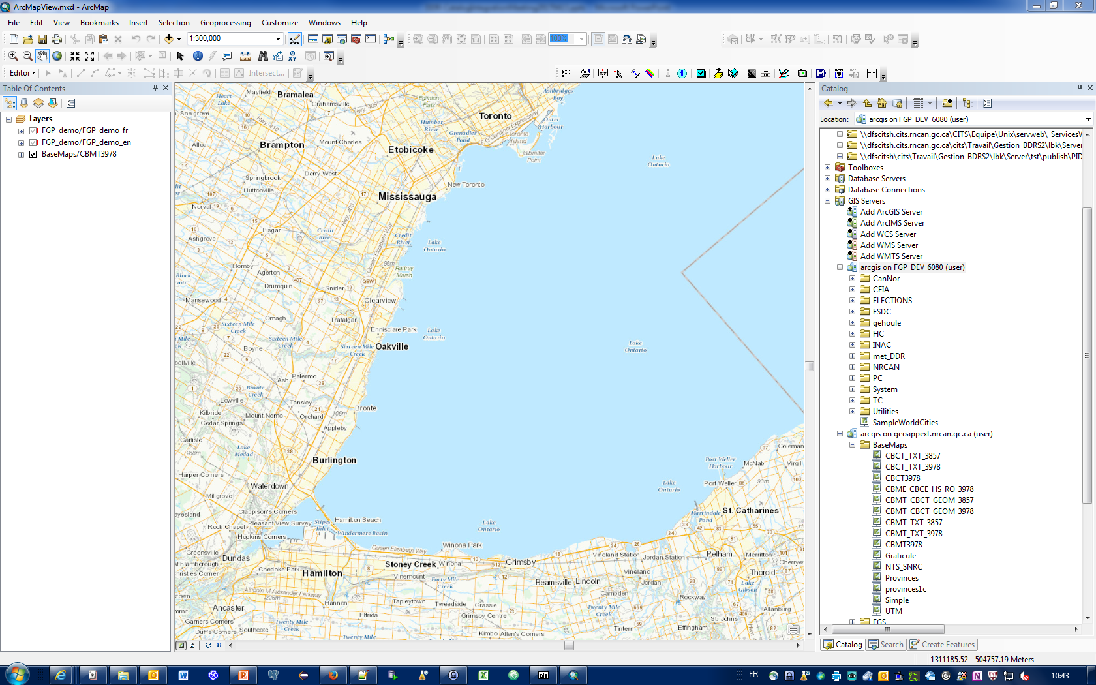
Three Main Services
1 – Publish (before the service call)

Slide 12
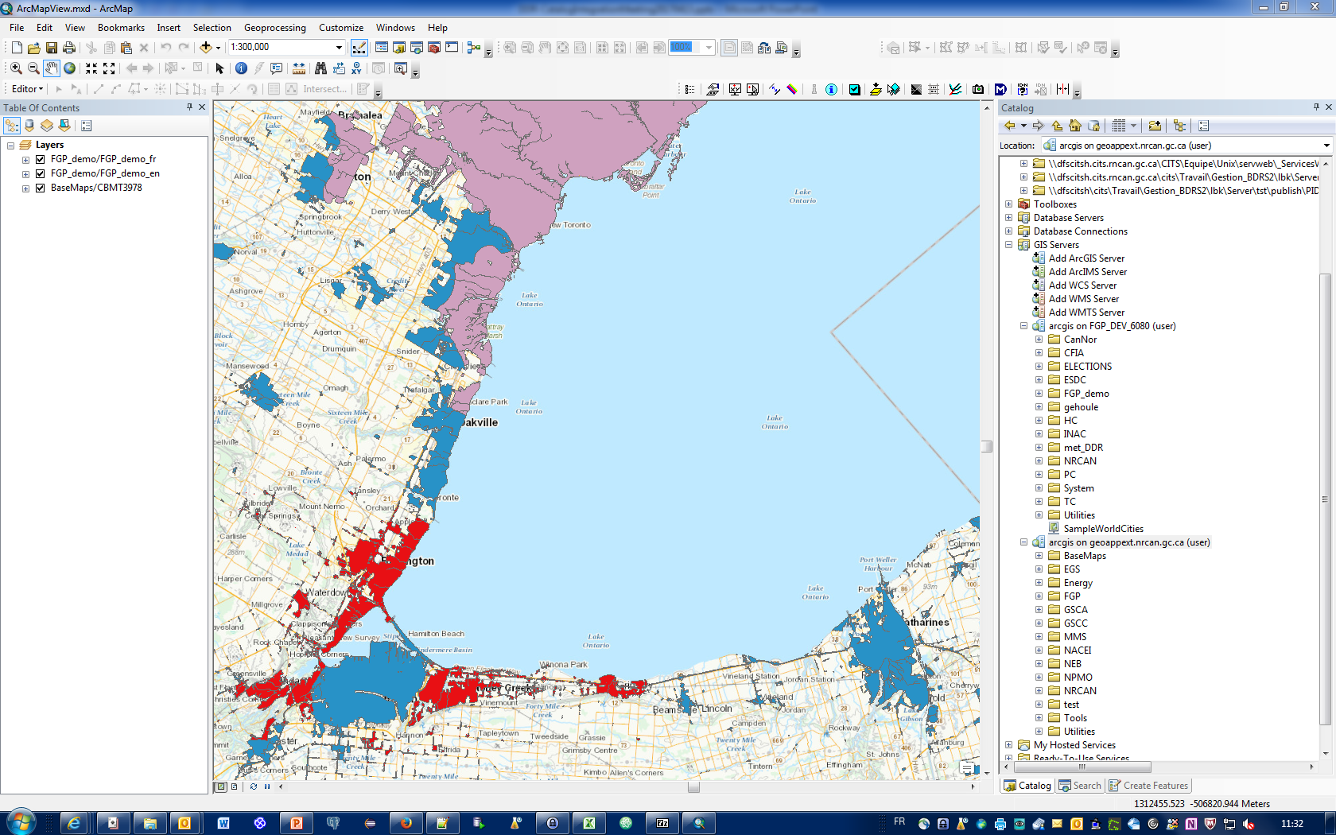
Three Main Services
1 – Publish (after the service call)

Slide 13
Three Main Services
2 – Update
  Allows to update any existing elements of the DDR
    As long as what you want to update exists in the DDR, you can use the update service call
    Depending on the way you call it, the service can update the MXD file, the FGDB file or both files at the same time
    Any download file can be individually updated
  The services to be updated are hibernated until the publication of their new version
  If an error occurs, the old service version is restored

Slide 14
Three Main Services
2 – Update
  The Update service use a control file similar to the publish service to guide its execution
To update only the MXD, leave
the dataset filename blank
To update only the FGDB, leave
the map document filename blank
Specify only the download
files you want to update

Slide 15
Three Main Services
2 – Update
  Receives an input package containing:
    A control file
    One or two MXD with the needed FGDB
    A set of files to be used by the download service
To create the input package we need the value of the metadata UUID
All this information is put in a ZIP file
ZIP
UUID

Slide 16
Three Main Services
2 – Update
  Receives an input package containing:
    A control file
    One or two MXD with the needed FGDB
    A set of files to be used by the download service
Sequencer
Validate
Stop
and
Delete
Register
Link
Metadata
Input
Link
Services
Validate
Transform
(if required)
Update
Store
Files

Slide 17
Three Main Services
2 – Update (before the service call)

Slide 18
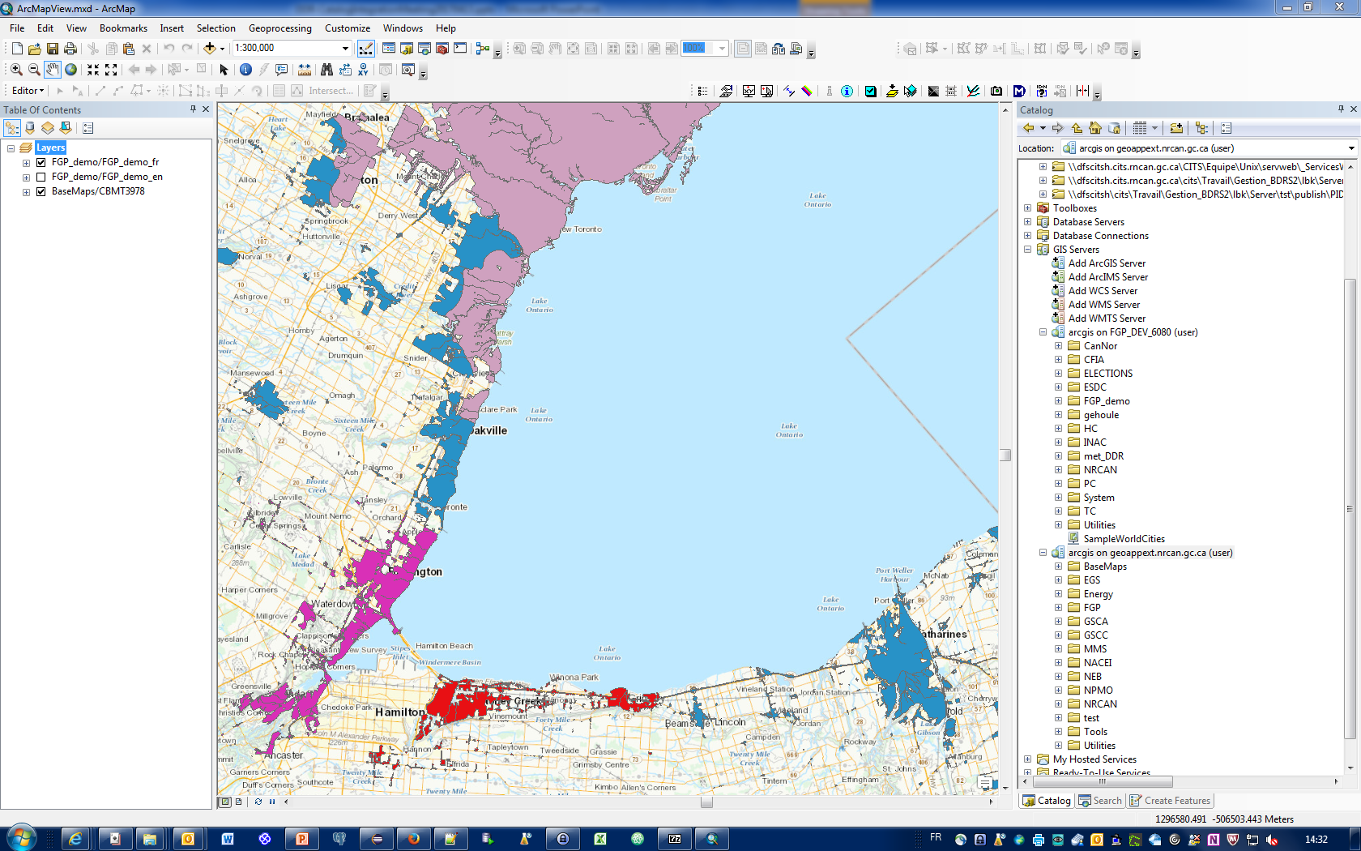
Three Main Services
2 – Update (after the service call – FGDB file update only – French dataset)
Polygon deletion

Slide 19
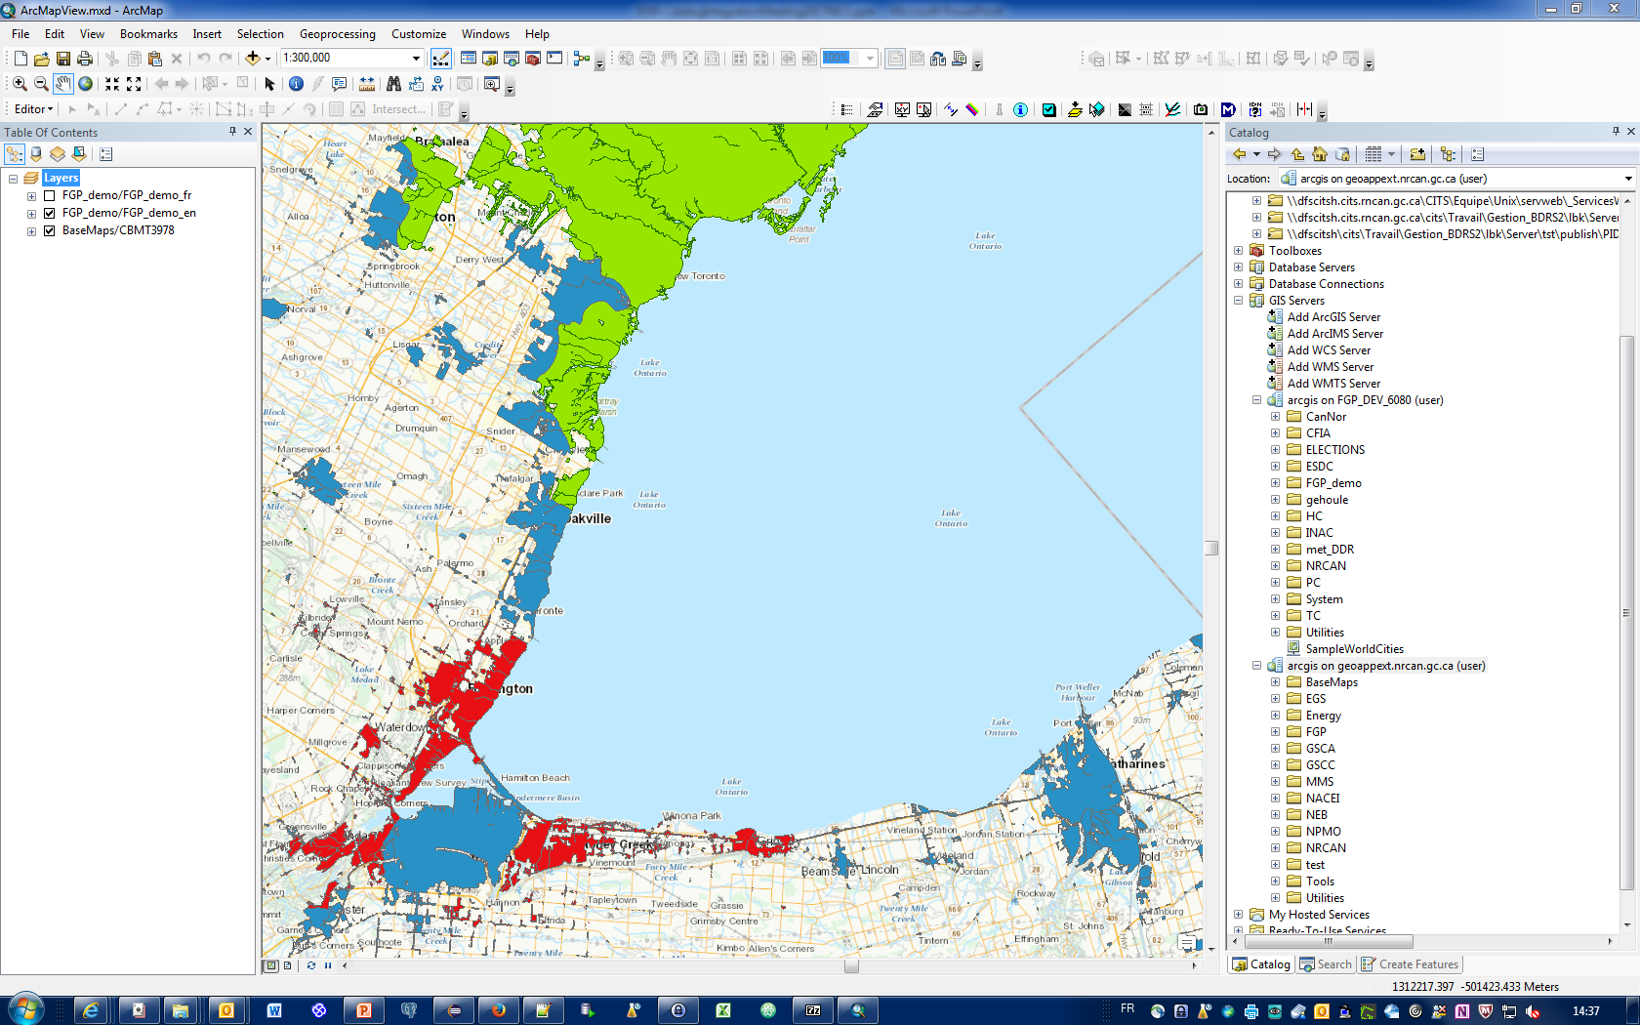
Three Main Services
2 – Update (after the service call – MXD file update only – English dataset)
Representation changed

Slide 20
Three Main Services
3 – Unpublish
  Receives a control file containing:
    The publisher email address (considered as the username)
    The metadata UUID
    Other parameters to identify the components to delete

Slide 21
Three Main Services
3 – Unpublish
  Receives a control file containing:
    The publisher email address (considered as the username)
    The metadata UUID
    Other parameters to identify the components to delete
  The control file can be replaced by a JSON string passed to the service
Register
Link
Metadata
Input
Validate
Unpublish
Link
Services
Store
Files

Slide 22
Development strategy
The DDR has been developed so that we can easily integrate it with other components
  It is based on the Rest design pattern for
  implementing networked systems
Three methods have been tested
  Using the FME Server API
  Via a HTML page using embedded JavaScript code
  With the Directory watcher feature of FME Server

Slide 23
Development strategy
All three main services (publish, update, Unpublish) can use an Excel control file inserted in an input package to simulate a graphical user interface or communicate via a JSON input stream to start the service using a JavaScript WEB form
Services determine the method used by the user using an introspection algorithm
The DDR services can be called by any languages that have a library which allows to send HTTP calls (Python, Java, etc.)

Slide 24
Registry API
A Rest API has been developed to read, write update and delete information in the registry
This API is internally used by all the DDR services
It will be used by the contributor support team via the FME Server API to view the registry content
It could also be used by a WEB API to populate drop down lists and edit the registry information

Slide 25
Features of the DDR release
Manual metadata publishing
Partially automated publish, update and unpublish DDR services
Minimal validation of input data and parameters
Minimal user experience (waiting for FGP integration)
  Excel File as GUI or Javascript WEB forms
  FME Server API or REST HTTP calls to trigger the services
  Directory watcher for automatic input packages processing

Slide 26









Use Case Scenario
First DDR release
Catalog
DDR
Contributor
Metadata
Update
Online
Resources
UUID
Help
Desk
Contributor
Support Team
WEB Services
Team

