Slide 1


Naming Convention
Notes:
In this module, we will discuss the naming convention and best practices that apply to the naming of metadata titles and metadata resources.

Slide 2
Naming convention and best practices
Follow the recommended naming conventions for the title of the metadata:
Use the official name of the resource, while respecting the following rules
Use plain language
Avoid the use of acronyms
Make sure the first 70 characters of the title are unique
Ensure that the most information-rich text occurs in the first 70 characters
Do not include the name of the organization/originator
Do not start with an article such as The or A and avoid special characters
Concatenation of complementary information can be used
    Place name
    A date or date range, in compliance with ISO 8601 (YYYY, YYYY-MM, YYYY-MM-DD)
    Scale (e.g., 1:50 000)
FGP Dataset Naming Guidelines
Notes:
The naming convention helps contributors step back and question themselves in order to choose a representative name for the data while considering the data user’s point of view. The more meaningful the name, the easier the users can find the data.
Here are the rules and best practices for naming data.
If the dataset or resource you are describing already has an official name, you should use that name, but still consider the following guidelines:
- Use clear language;
- Avoid using acronyms; if you use an acronym, make sure that the abstract includes the non-abbreviated version;
- The first 70 characters of the title must be unique;
- Make sure to put the title’s significant information at the beginning;
- Do not include the name of the organization in the title, it is easily accessible in the metadata;
- Do not start a title with an article such as “The” or “A”;
- Avoid special characters.
The naming convention allows the concatenation of complementary information in a title such as:
- the place name, a date, a data report scale.

Slide 3
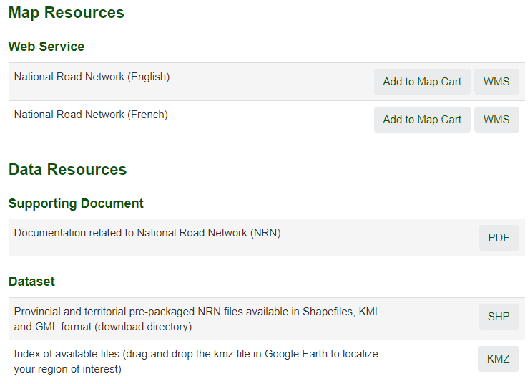
Resource name
The naming convention also applies to the names of online resources such as:
  Data files,
  Web map services,
  Applications, APIs and supporting documents
Accessible in the “Map Sources” and “Data Resources” sections
Notes:
The naming convention also applies to the names of online resources, such as data files, Web services, APIs, applications or supporting documents that are accessible through a URL link.
The names of the online resources are displayed in the “Map Resources” and “Data Resources” sections on the metadata record page.

Slide 4
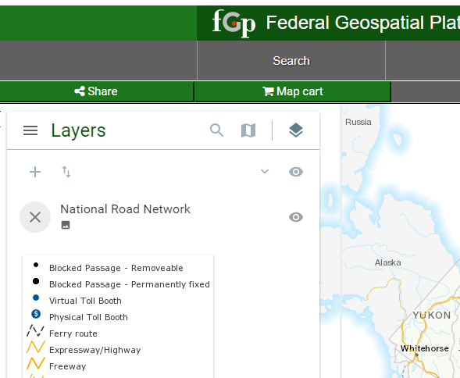
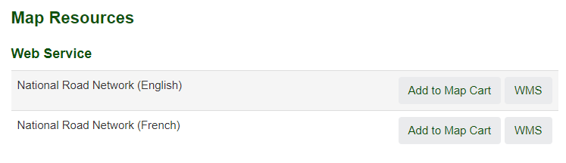
Special rules for naming Map Resources
Catalog
Viewer
Notes:
For the map resource that will be associated with the “View on Map” button, the title of the resource will be entered in the viewer’s legend. Use short and meaningful terms. Avoid adding the service format and language. This information is automatically displayed on the catalogue page.
When multiple metadata use similar map resource names, make sure the names that appear in the viewer can be distinguished.

Slide 5
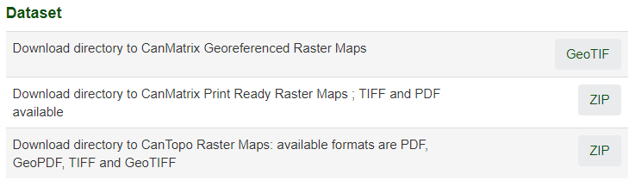
Special rules for other resources
The ZIP format can be used in the following two cases:
when the compressed file has multiple data formats
when the format is not in the list of allowed formats
Include the formats in the resource name
when the ZIP format is used.
Notes:
For other resources, make sure to use meaningful terms.
The Zip format can be used in the following two cases:
- when the compressed file has multiple data formats;
when the format is not yet recognized in the FGP.
When the ZIP format is used, in the name of the resource include the significant format(s) contained in the compressed file.

Slide 6
Want to know more?
Contact the Customer Service Team
NRCan.fgp-pgf.RNCan@Canada.ca
Notes:
If you would like to know more about this topic, please contact the FGP customer service team

