Slide 1


What is the HNAP ?
Notes:
In this module, we will describe the metadata information required by FGP according to the Harmonized North American Profile Standard.

Slide 2
What is the HNAP ?
The Harmonized North American Profile
It is the metadata standard for the FGP data catalogue.
Based on the North American Profile ISO 19115-1:2014 (NAP)
Specifies the required elements
Presents the rules and guidelines
Official standard: Guide to Harmonize ISO 19115:2003 / North American Profile, Metadata for Government of Canada, Geospatial Data
Notes:
The Harmonized North American Profile, or HNAP, is the metadata standard used in the FGP. The HNAP is based on ISO 19115 – North American Profile. It is the result of the collaboration of five departments, hence the term “harmonized.”
The HNAP presents the required metadata elements of ISO 19115 – North American Profile, with rules and guidelines, allowing contributors to create consistent metadata.
The HNAP standard is described in the above-mentioned document and is available in the “Quick links” section on the For Contributors Help page.

Slide 3
HNAP compilation file
A Guide to facilitate the understanding of the HNAP
Provides the list of minimum required fields to complete to create the metadata
Includes the HNAP business rules
Indicates when bilingualism is required
Presents the domain values
The information is offered
  according to the order of appearance in the catalogue
  according to the order of entry into an xml file for import
Compilation file:
https://gcgeo.gc.ca/doc/HNAP_Metadata_Minimum_Information.xlsx
Notes:
A compilation file has been created to facilitate the understanding of the HNAP.
It provides detailed information on the standard’s required elements, business rules and best practices. It indicates the information that must be provided in both official languages, as well as the permitted values for the information submitted to a domain.
This is a very useful reference when creating a new metadata record from the Catalogue or for creating an XML metadata file that is ready for import into the catalogue.
This document is also available in the “Quick links” section on the For Contributors Help page.

Slide 4
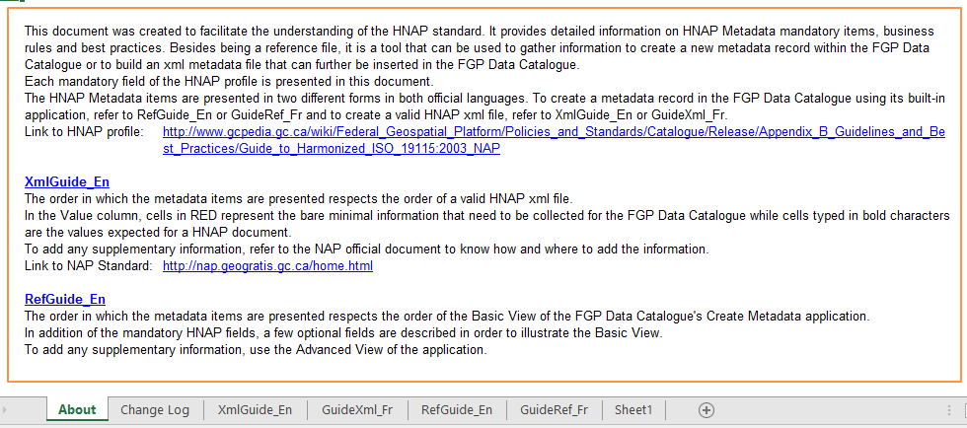
HNAP compilation file
Notes:
The compilation file is in Excel format.
Under the XmlGuide_En tab, the HNAP metadata items are presented in order of entry into an xml file for import.
Where as, under the RefGuide_En tab, the HNAP metadata items are presented in order of appearance in the catalogue.

Slide 5
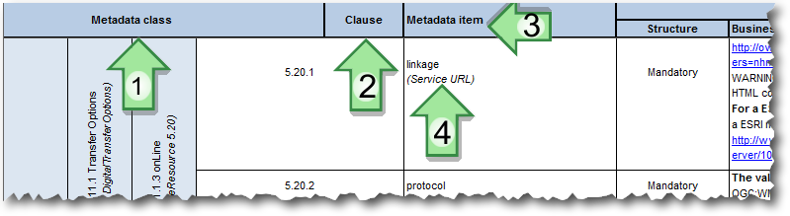
Compilation file
XmlGuide_EN sheet
Metadata class is the name of the corresponding metadata class in the NAP standard.
Clause is the corresponding clause in the NAP standard.
Metadata Item is the name of the metadata element in the NAP standard.
(Item) is the name used in the catalogue when the item differs from the NAP element.
Notes:
We will use the compilation file to present the required HNAP information.
So, to briefly present this worksheet, under the XmlGuide_EN tab, we find:
The Metadata class, Clause and Metadata Item that relate to the NAP standard.
The item name is also that which is used in the catalogue. When the catalogue uses a different name, it will be written in brackets.

Slide 6
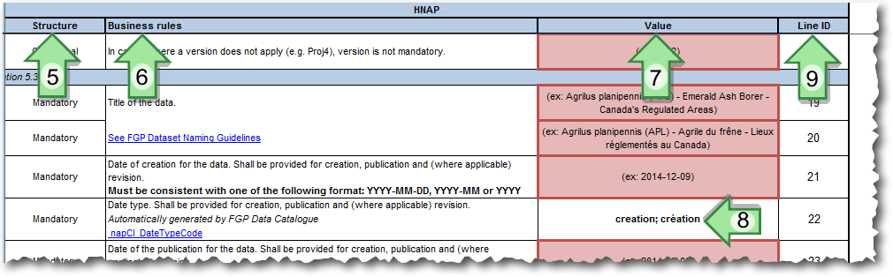
Compilation file
XmlGuide_EN sheet
Structure: required, optional or conditional field, and whether it is repeatable.
Business rules: description of the required values. When there is a hyperlink, a value must be chosen from the pre-established list offered.
Value: The value to add.
The records entered in bold in the Value field are the expected values for a HNAP document.
Line ID: Reference to this field in the HNAP_Metadata_Minimum_Information.xml template.
Notes:
The Structure column indicates whether the field is mandatory, optional or conditional, and whether it is repeatable.
The Business rules column contains the description of the required values. When there is a hyperlink, a value must be chosen from the offered pre-established list with a link.
The Value column contains the value to add.
The data written in bold in the Value field are the expected values,
while for fields highlighted in red or pink, you must follow the instructions listed in the Business rules.
The Line ID column contains an identifier referring to an xml file template.

Slide 7
The HNAP
The HNAP is divided into three sections:
  Metadata
  Data
  Distribution
One contact per section that includes:
  Organization name
  Email address
  Organization’s role
Compilation file:
https://gcgeo.gc.ca/doc/HNAP_Metadata_Minimum_Information.xlsx
Notes:
The metadata information specified by the HNAP standard is divided into three sections, each providing metadata information, data information, and information on data distribution.
For each section, a contact is required: the metadata manager, the data manager, and the data distribution manager.
The required fields for a contact are summarized in the name of the organization, the email and the role of that organization.
We will now see the detailed content of the HNAP standard for each section. For this part, we recommend that you print the information from the “XmlGuide_EN” tab of the compilation file.

Slide 8
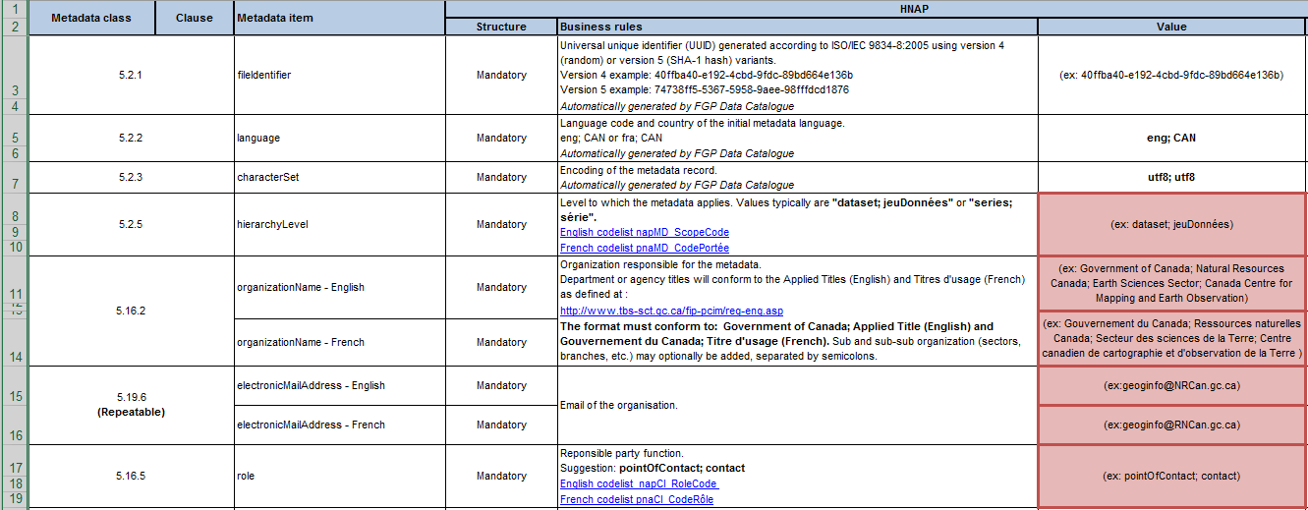
Section 1: Metadata (1/2)
Notes:
We will start with the metadata information.
The file identifier is associated with the metadata record. This identifier is generated automatically when creating the metadata from the catalogue.
The metadata language, is the first input language for information. This information is also generated automatically when creating the metadata from the catalogue
The character set, is used for encoding the file, which is still automatically generated from the catalogue
The hierarchy level, which is typically “dataset; jeuDonnées” or “series; série” will be selected, with series being selected for a collection.
The first contact, is the one associated with the editor or person responsible for the metadata, which is defined by
- the name of the organization in English and French
- the email address
- The role of this contact, with the suggested value being the “contact”
Note that the name of the organization is the corporate title of the federal organization, preceded by the “Government of Canada” label. You can add sub-organization names separated by the “;” character to indicate the sector, branch or division.

Slide 9
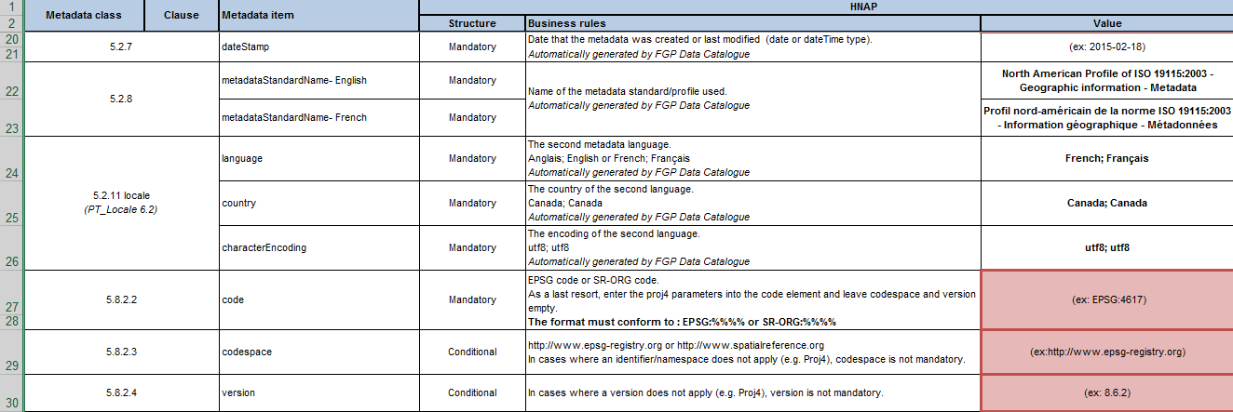
Section 1: Metadata (2/2)
Notes:
The metadata date stamp, is generated automatically when creating or editing the metadata from the catalogue.
The metadata standard name, is automatically integrated when creating or editing the metadata from the catalogue.
The second metadata language is accompanied by the country associated with this second language and the character encoding for the second language.
This information associated with the second language is also generated automatically when creating the metadata from the catalogue.
This section is completed by the reference system(s) associated with the geospatial data.
The description of a reference system is done through:
the reference system code, usually an EPSG or SR-ORG code;
a link to the organization responsible for the reference system; and
the version.
All reference systems in which geospatial data are available for download must be listed, as well as the web map service reference system through which the data is accessible without remapping.

Slide 10
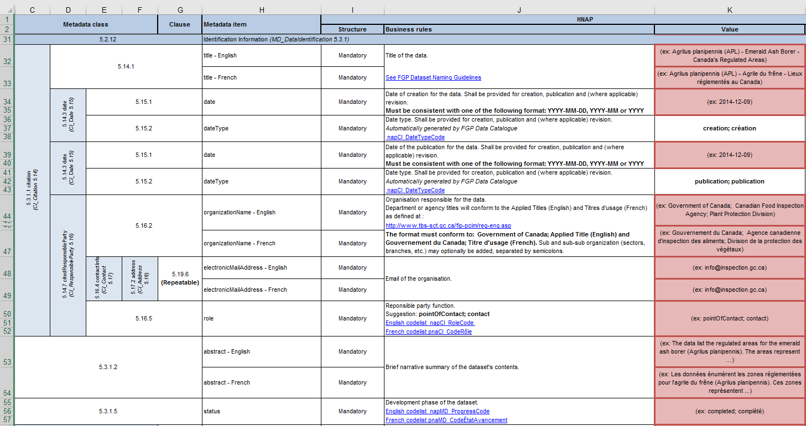
Section 2: Data identification (1/3)
Notes:
We will now start the second section that presents information on the data.
First, there is the title corresponding to the record name. This field is important since it allows FGP users to find the data. To help create the title of your data, follow the naming convention we saw earlier. Please note that it is necessary to include both an English title and a French title.
Next, the date information includes the date of creation of the data, the publication date and, where applicable, the revision date. The creation date and the publication date are mandatory.
We then have the required second contact, the one associated with the data.
As with the previous contact, the name of the organization, the email address and the role associated with this contact must be provided.
Then there is the abstract; it gives information on the data. To be effective, the first lines of the abstract must describe the data effectively so that the reader can quickly get a clear idea of the content of the dataset involved.
The status gives the development phase of the dataset: is it completed, archived, in production, etc. ?

Slide 11
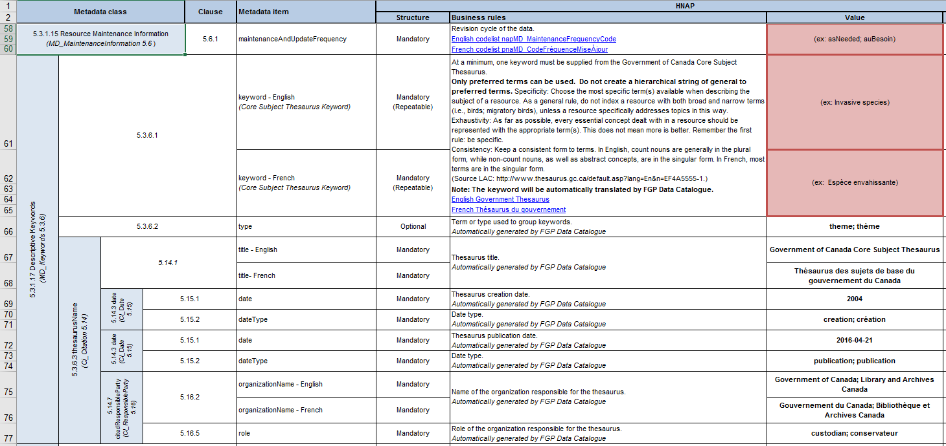
Section 2: Data identification (2/3)
Notes:
For the maintenance and update frequency: you indicate whether the data is updated as needed, continuously, annually, or if updating is unplanned?
Now we are going to the keywords. At a minimum, one keyword must be supplied from the Government of Canada Core Subject Thesaurus.
By selecting a keyword from the drop-down list in the catalogue, all of the following mandatory information will automatically be entered:
The keyword in English and the equivalent in French
The type of keyword that the topic is
The name of the thesaurus
The dates of creation and publication of the thesaurus
The organization responsible for the thesaurus
The role of this organization
Choose all the keywords that identify the essential concepts of the data.
Although not required, additional keywords not included in the thesaurus may be added.

Slide 12
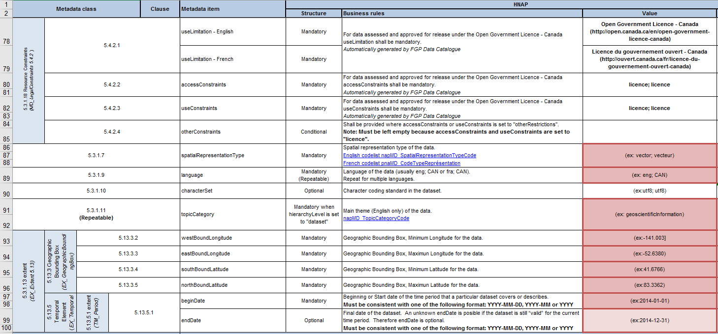
Section 2: Data identification (3/3)
Notes:
The data currently published on the FGP must meet the Open Government Licence.
The use limitation, access constraints and use constraints fields will be populated with the appropriate values when the metadata are entered from the catalogue.
The spatial representation type must be specified. We usually find “vector” values for vector data or “grid” for raster data.
In the next field is the language of the data. If the data are available in both official languages, this field will be repeated to mention both languages. If the data do not contain any linguistic content, such as an image, the value "zxx" must be entered.
The main topic category of the data must be selected from a list of 19 values. Several topics can be selected as needed.
To complete this section, the geographic bounding box and temporal extent must be provided.
The geographic bounding box is the box that encompasses the data. It will be defined by both maximum and minimum, latitudes and longitudes
The temporal extent is the period covered by the data content, which is defined by a start date and an end date. The end date is not required when the dataset is still valid.

Slide 13
Section 3: Data distribution (1/5)
List of data distribution formats
Information about the distributor
Access to online resources
  Map services
    associated with the “Display on Map” button
    associated with the “View on Map” button
  The data made available for download
  Any additional resources such as back-up documents, applications that use geospatial data, indexes
Notes:
We will begin the third and final section of the metadata that contains the information on data distribution.
This section lists the distribution formats, describes the distributor and lists the resources put online, whether for web map services, downloadable geospatial data or any other complementary resource such as supporting documents, applications, API applications and indexes for data searches.

Slide 14
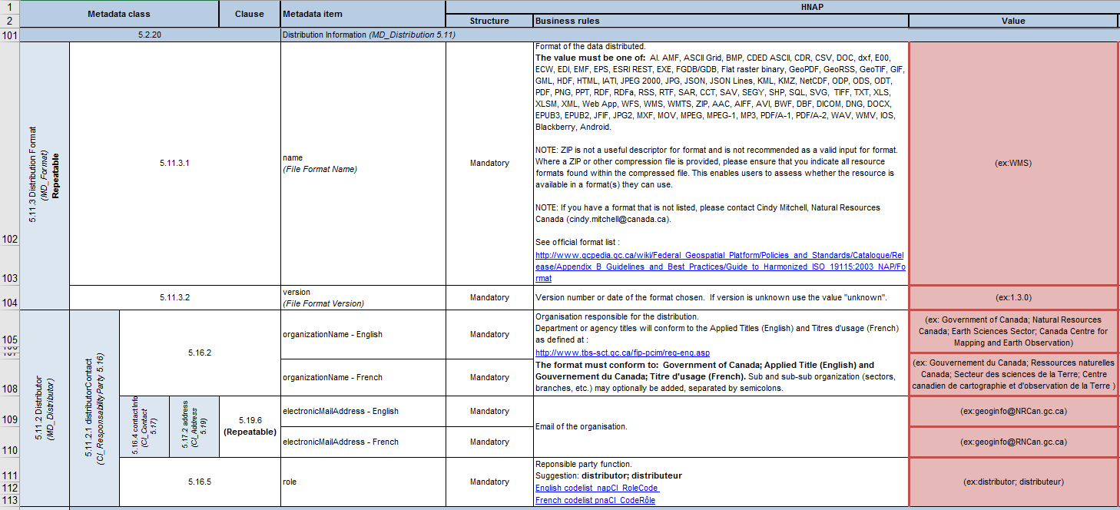
Section 3: Data distribution (2/5)
Notes:
For distribution formats, all formats associated with online geospatial data must be listed. Choose the format from the list of allowable values and enter the version associated with this data format. If the version is unknown, enter “unknown.” If your format is not on the list, contact Cindy Mitchell at the FGP office or FGP Customer Service for this format to be added.
We then see the information on the distributor. This is the last required contact for which the organization, email and role must be provided.

Slide 15
Section 3: Data distribution (3/5)
The types of resources put online:
  Map services
    associated with the “Display on Map” button
    associated with the “View on Map” button
  Geospatial data made available for download
  Any other complementary resource such as:
    supporting documents (guide, specifications, index, data dictionary, etc.)
    applications that use geospatial data
    the APIs
Notes:
Finally, we see information related to the online resources, whether for Web Map Services, geospatial data available for download or additional documents, applications, and APIs.

Slide 16
Section 3: Data distribution (3/5)
Information required for online resources:
URL linkage
Protocol
Name
Description (concatenation of the three types of information below)
  The content type
  The format
  The language(s)
Notes:
All of the online resources being described have the same fields: the linkage, the protocol, the name and the description, with particularities when it comes to a Web Map Service.
In general,
- The linkage is the URL address that gives access to the resource.
- The protocol is the type of communication that is expressed by the characters preceding the “:” in the URL address
- The name is the title associated with the resource
- The description is the concatenation of three information elements: the type of content, the format and the language. This field is used by Open Maps.

Slide 17
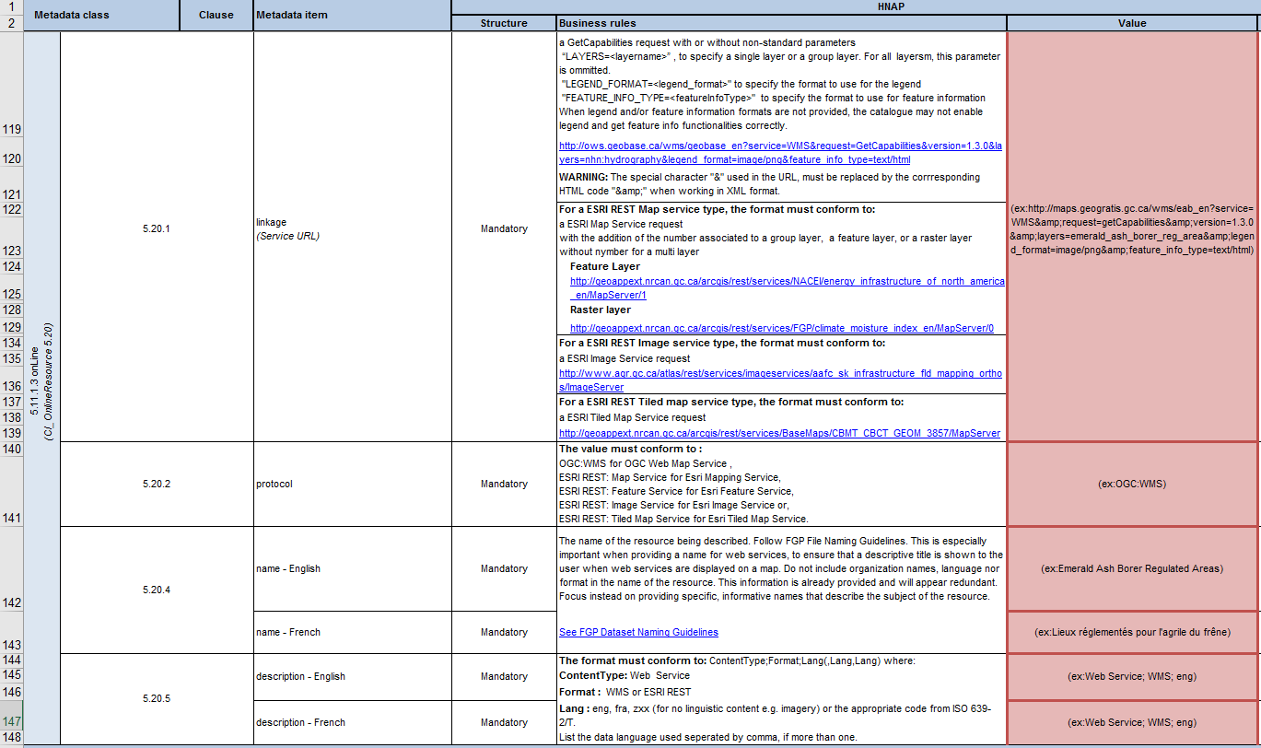
Section 3: Data distribution (4/5) – Map services
Notes:
The first resources you will need to provide are the Map Resources that allow the operation of the “Display on Map” and "View on Map” buttons.
That means you have to create records for two services. And when the service is bilingual, you have to record it twice to have an instance for the English-speaking viewer and an instance for the French-speaking viewer.
Each service record is comprised of the URL linkage, the communication protocol, the name and the description.
The linkage is the URL completed by the data layer and, optionally, in the case of a WMS service, the display format for the caption and the display format for the item information.
For the protocol, specify the type of service is specified: ESRI REST or OGC:WMS
For the name, write the title that will appear in the viewer’s legend
As for the description, it is composed of three of the following information elements:
“Web Service” for the type of content,
WMS or ESRI REST for the format, and
For the service language, “eng” for service in English only, “fra” for service in French only, and “eng, fra” for bilingual service

Slide 18
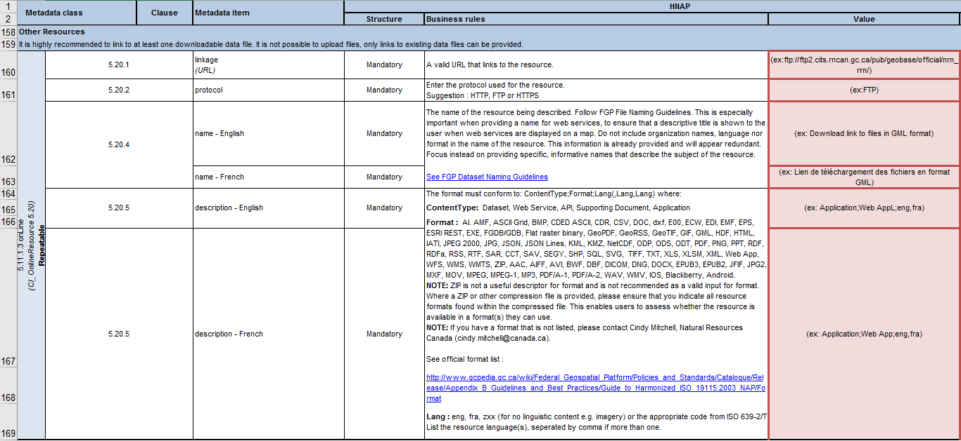
Section 3: Data distribution (5/5) – Other resources
Notes:
Finally, you need to enter information for other data resources such as geospatial data files, product specifications, indexes, applications and APIs that use the data.
Repeat the information for each additional resource by providing the following:
The linkage: by URL address to access the resource
The protocol: the characters that precede the “:” in the URL address
The name of the resource
The description, which is the concatenation of the content type, format and language of the resource
If the format is not in the list of allowed formats, or if the compressed format has multiple geospatial data formats:
use the ZIP format
indicate the data format or formats in the resource name to indicate the geospatial data format to the user
and contact us to have the missing format added to the list of allowed formats

Slide 19
Questions or need help?
NRCan.fgp-pgf.RNCan@Canada.ca
Useful links
Help – HNAP metadata standard:
  https://gcgeo.gc.ca/en/hnapMetadata.html
Compilation file:
  https://gcgeo.gc.ca/doc/HNAP_Metadata_Minimum_Information.xlsx
HNAP standard:
  http://www.gcpedia.gc.ca/gcwiki/images/f/f5/HNAP_v2.4_20160715.docx
XML metadata template:
  http://www.gcpedia.gc.ca/gcwiki/images/7/7d/HNAP_Metadata_Minimum_Information.xml
HNAP GcPedia page: http://www.gcpedia.gc.ca/wiki/Federal_Geospatial_Platform/Policies_and_Standards/Catalogue/Release/Appendix_B_Guidelines_and_Best_Practices/Guide_to_Harmonized_ISO_19115:2003_NAP
Notes:
This completes the module on the HNAP standard.
Here are some links to additional documents for this training.
If you require further information, please don’t hesitate to contact the FGP Contributor Support Team.

Slide 20
Want to know more?
Contact the Customer Service Team
NRCan.fgp-pgf.RNCan@Canada.ca
Notes:
If you would like to know more about this topic, please contact the FGP customer service team

