Slide 1


How to Register
Notes:
In this module, we will see how to register for the Federal Geospatial Platform catalog.

Slide 2
Why register?
An account is required to publish geospatial data in the FGP and in Open Maps
IMPORTANT: YOU DO NOT NEED AN ACCOUNT TO USE THE CATALOGUE.
IF YOU REQUEST AN ACCOUNT AND HAVE NO DATA TO SAVE IN THE CATALOGUE, YOUR REQUEST WILL BE DENIED.
Notes:
You must have an account to publish datasets in the FGP. An account will be created when you register.
It is important to note that: YOU DO NOT NEED AN ACCOUNT TO USE THE CATALOGUE. IF YOU REQUEST AN ACCOUNT AND DO NOT HAVE ANY DATA TO SAVE IN THE CATALOGUE, YOUR REQUEST WILL BE DENIED.

Slide 3
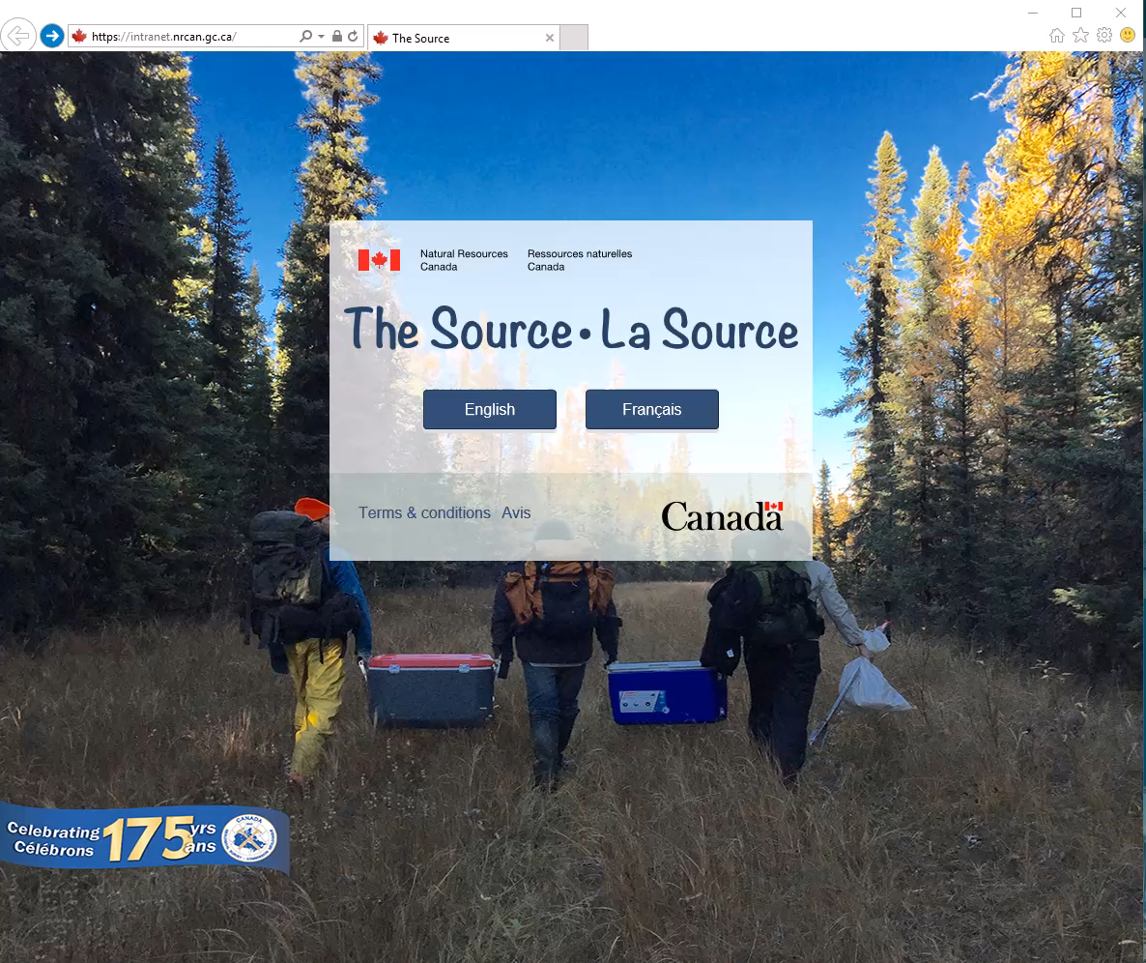
Demo: How to register
Notes:
Since we don't have an account, we will proceed with the registration of an account.
From a web browser, go to gcgeo.gc.ca. Choose English as the Catalogue language
Choose the "Sign In" tab.
Click on "Register“
Fill in the required mandatory fields: First Name, Last Name, Email, Password, Role and the workspace to which your account will be associated.
Note that:
1) Your email is your username. It is recommended that you use the one that corresponds to your government e-mail address, ideally ***@canada.ca, although a private address such as *@hotmail.com or @ gmail.com will do the trick. The registered email address is lowercase while the password is case sensitive.
2) The Editor role will allow you to:
- Create a metadata record
- Edit existing records in the workspace that your account will entitle you to
- and send publication requests
3) The Reviewer role will allow you to :
- approve / reject FGP publication requests
- Recommend Publishing Requests on Open Maps
4) The workspace is a collaborative environment, and anyone with an account associated to the workspace will be able to create, review, edit, and destroy the metadata in it, whether authored or not. Select the workspace that fits your organization.
If among the listed workspaces your organization does not appear, you can request the creation of a new workspace.
Enter a meaningful name for your organization (English and French)
Your request will be forwarded to the FGP Contributors support service team for verification. If so, the workspace will be created and the account is activated.
For demonstration purposes, we will use the existing workspace: FGP-Training
Submit your request. You will receive an email confirmation of your request. The workspace administrator will also receive your account request by email.
Here is the email received by the applicant. It states that Diane Lapierre asked to join the FGP-Training workspace as an editor and that the request was submitted to the workspace administrator.
Here is the email received by the workspace administrator. It states that the administrator has received an account verification request for Diane Lapierre as editor for the FGP-Training workspace, and that they must take action to activate the account.

Slide 4
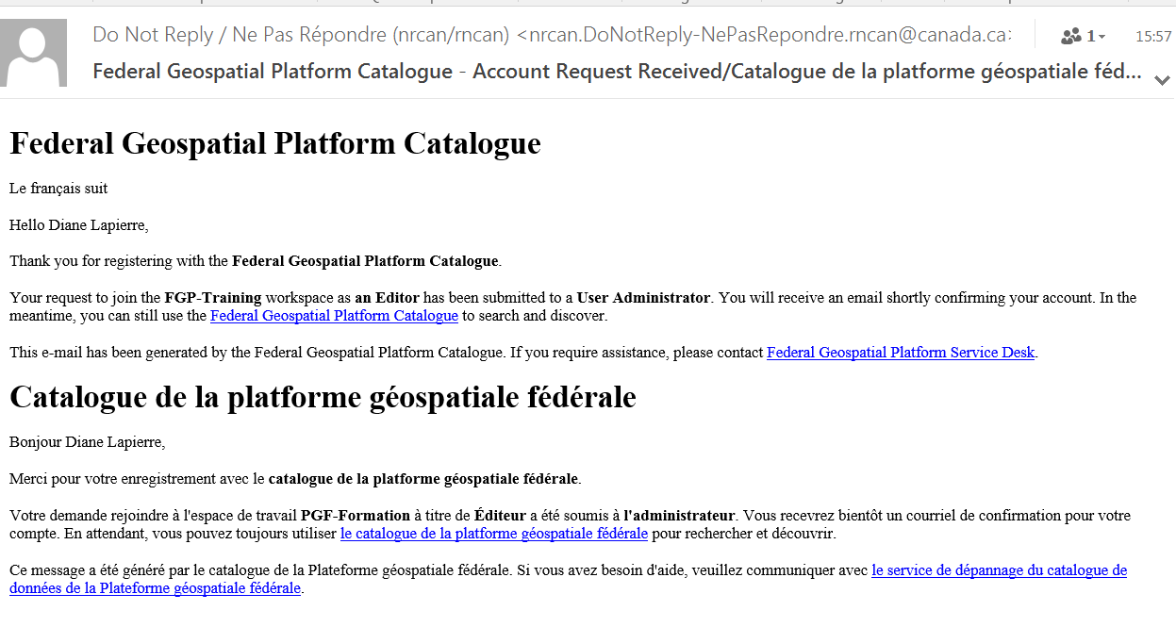
Email received by the applicant

Slide 5
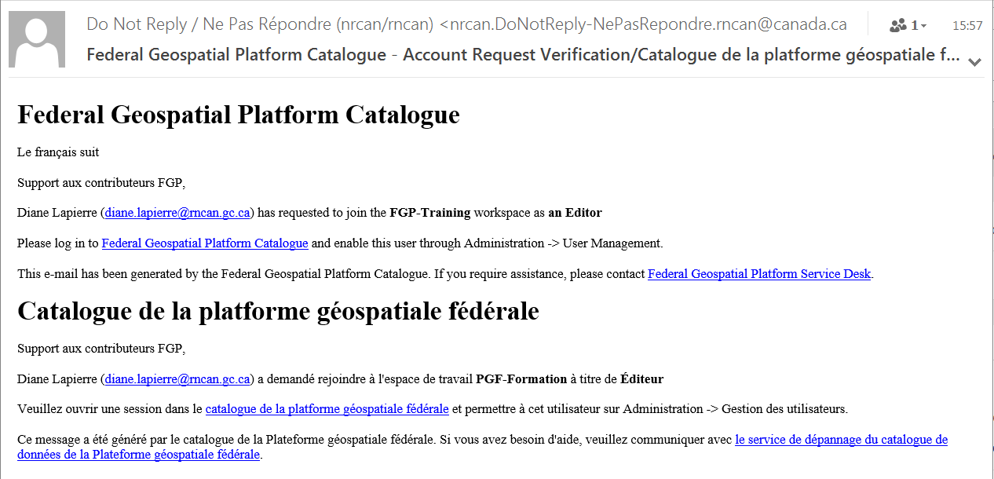
Email received by the administrator

Slide 6
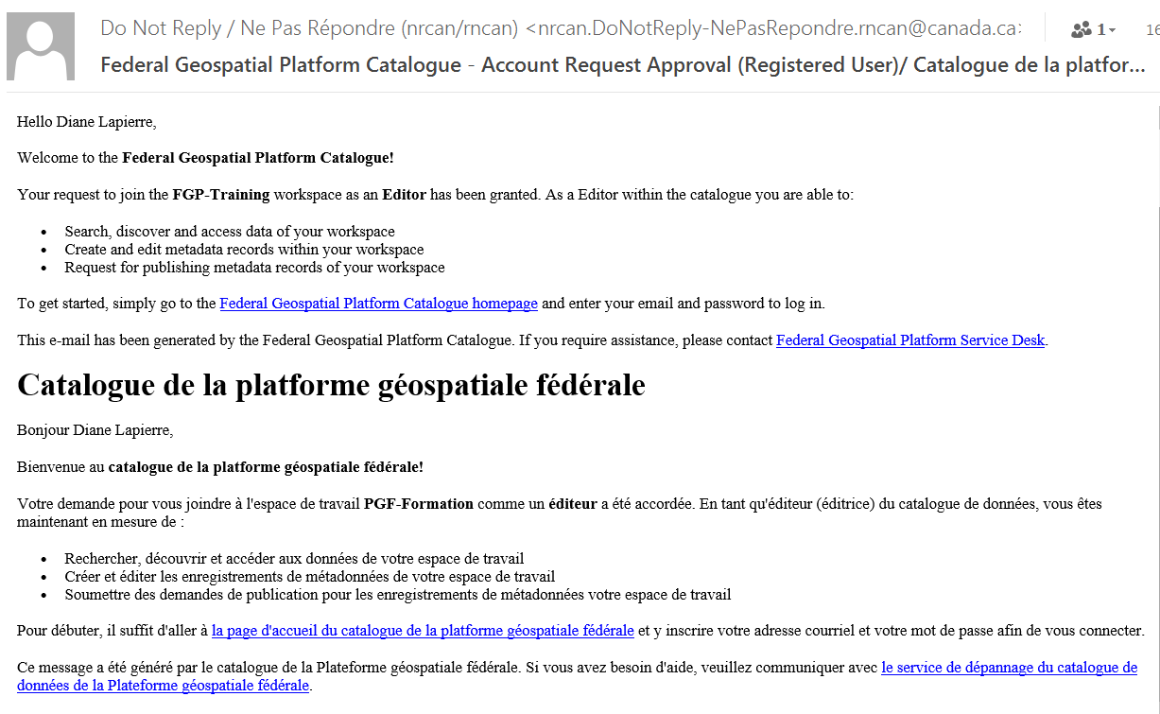
Welcome email received by the applicant

Slide 7
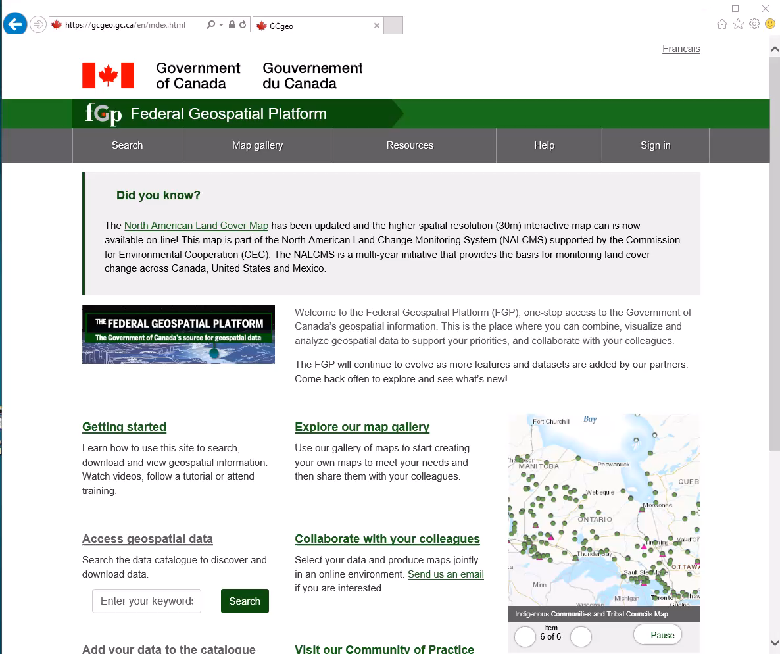
Open a work session
Notes:
Now that your account is activated, simply log in using your email address and password.

Slide 8
You have an account!
Now that you have an account as an editor or reviewer,
You can create metadata records
You also have write access to all records in your workspace. Be careful!
Notes:
You can now create metadata records in the catalogue. You also have write access to all records in your workspace.

Slide 9
Want to know more?
Contact the Customer Service Team
NRCan.fgp-pgf.RNCan@Canada.ca
Notes:
If you would like to know more about this topic, please contact the FGP customer service team

