Slide 1


Status and Privileges
Additional Record
Management Information
Notes:
In this module, we will discuss the additional information available when a user connects to the catalogue.

Slide 2
Additional information
Record status
Record management information
Editing privileges
Publication rights
Editing the author of a record
Additional filters
Notes:
Some operations will be offered depending on the status of the record and the privileges granted to the user. It is necessary to be able to distinguish the various types of record status, the privileges, the author of the record and the owner of the editing session.
Additional filters are also available.

Slide 3
Status
Draft: Review in progress, never published
Published: Publication in the FGP and Open Maps
Published and Draft:
Editing in progress of an existing record
Publishing in progress
Notes:
Status is the state linked to a metadata record.
Draft status indicates a record that is being written. Only the owner of the editing session can edit the metadata.
Published status indicates that the record is available to all federal government employees with access to the FGP catalogue (gcgeo.gc.ca) when the publication location is FGP-Internal. The record is available to the general public at open.canada.ca when the publication location indicated is Open Maps.
Published & Draft status indicates that changes have been made to the record since its publication and that these changes have not yet been published. The owner of the specified edit session is the last user to edit the metadata.
The presence of the yellow arrow indicates that a publication request is pending approval. The record is read only.

Slide 4
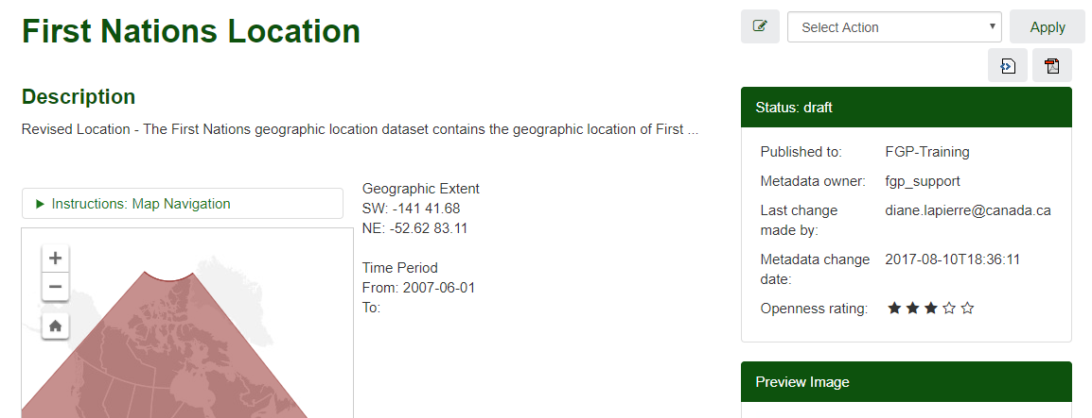
Record management information
Status: Record status
Published at: Workspace or Publication Location if already published
Author: Creator User account for the metadata and authorized for publication
Last change made by: User account authorized to edit the record
Notes:
Management information is accessed by viewing the record.
It includes:
the record status,
the publication location if the record has already been published, otherwise it will be the workspace associated with the record,
the author of the metadata, the one authorized to publish the record,
and the user authorized to edit the record.
The information associated with the openness rating is currently not significant.

Slide 5
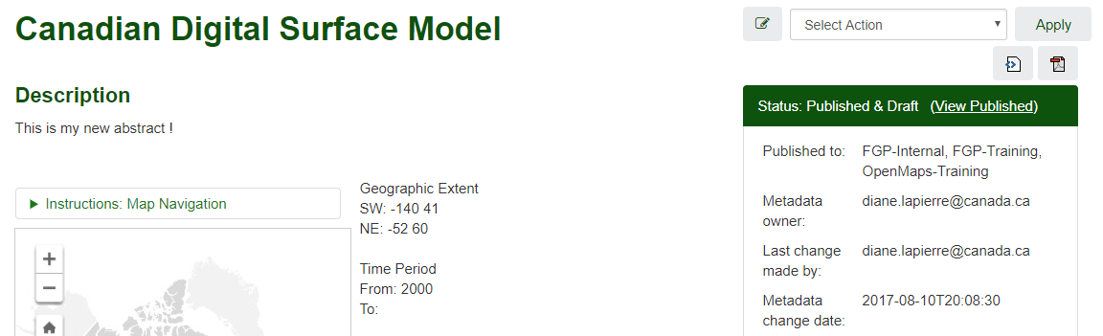
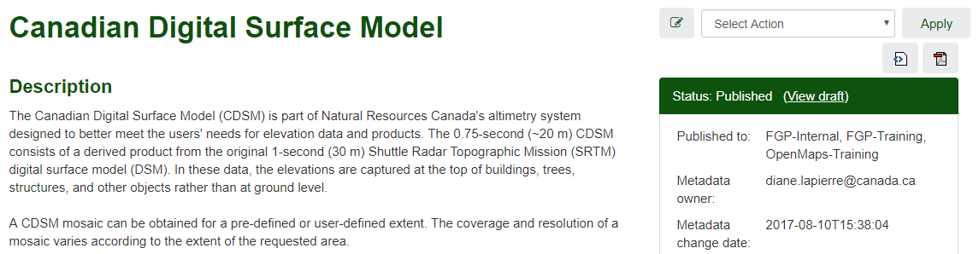
Draft versus Published record content
For a record with Published & Draft status, the content for each status can be viewed.
Edits
in progress
Already published
Notes:
For a given record, the published version and the version being edited can be viewed in alternating modes.
On the record page, Click on View Published to view the published record, then Click on View Draft to return to the current version.

Slide 6


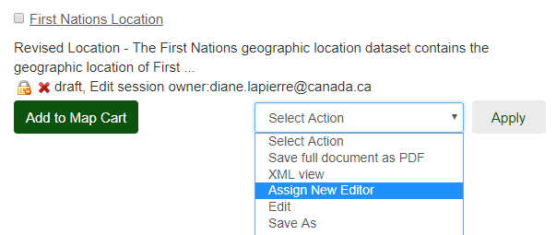
Editing privileges
Editing allowed for the logged-in user
Editing prohibited for the logged-in user
For the right to edit, the logged-in user must:
Have an account associated with the workspace where the record resides
Designate him/herself as the owner of the editing session
Notes:
The lock symbol indicates the editing privileges on the record for the logged-on user.
The editing privileges are reserved for the owner of the editing session.
The Edit operation is not available to the logged-on user if they are not the owner of the edit session or if their account is not associated with the record’s workspace.
If the record and the logged-in user share the same workspace, the logged-in user will be able to get editing rights by using the Assign New Editor operation.
The logged-in user will then become the owner of the editing session.
This protection ensures that only one authorized user in the workspace at a time has write access to a particular record.

Slide 7
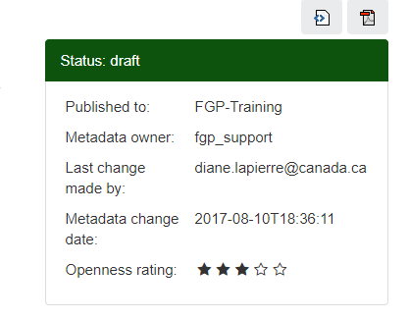
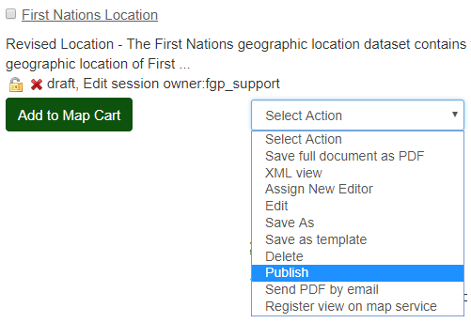
Publication rights
To get publication rights,
the logged-in user must be the author of the metadata or have a Reviewer account for the workspace
Record must be in Draft or Published and Draft status
Notes:
The owner of the metadata, and the Content Reviewer in the workspace, are the ones who are allowed to request publication. If the Publish operation does not appear in the list of operations, you are neither the owner of the metadata nor a Content Reviewer for this workspace.
The record must be in either Draft or Published and Draft status for the Publish operation to be available.

Slide 8
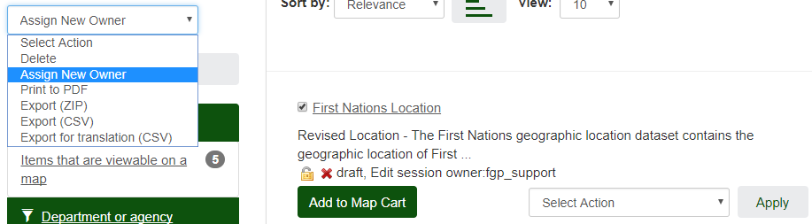
To become the author of the record
For publishing rights, the logged-in user must become the author of the record.
Only the workspace administrator can modify the author of a record.
2
1
Attention: The Assign New Owner function in the Administration menu performs an author change for all records from the original author to another user.
Notes:
To modify the owner of a record, you must make a request to the workspace administrator. Only the workspace administrator can modify the owner of a specific record. The administrator must select the record, choose the “Assign New Owner” operation, and choose the new owner from the drop-down list as well as the workspace.
Pay attention to the Transfer ownership function in the administration menu. This function performs an owner change for all records from one user to another. This function is used especially when a user will no longer have to create, modify or publish metadata in the FGP catalogue.

Slide 9
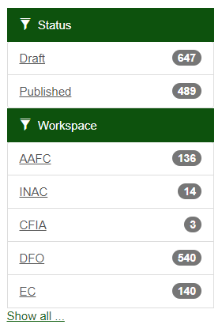
Filters: Status and Workspace
Status: Allows the selection of Draft and Published status records only. Attention: The Published and Draft status is absent.
Workspace: Allows the selection of records by workspace.
Notes:
Additional filters are also available:
- Status and
- Workspace
For the Status filter, only the Draft and Published status types are displayed. You will notice that the “Published & Draft” status does not appear on the screen. The absence of this status explains the count which does not always correspond to the total number of records.
With the Workspace filter, it is possible for the Editor to make a quick selection of workspace records.

Slide 10
Want to know more?
Contact the Customer Service Team
NRCan.fgp-pgf.RNCan@Canada.ca
Notes:
If you would like to know more about this topic, please contact the FGP customer service team

