Slide 1


Creating a Record
Part 1: Using the Catalogue
Notes:
In this module, we will see how the FGP catalogue interface works for the interactive creation of metadata.

Slide 2
Objective
How the FGP catalogue works for the interactive creation of metadata
Record creation methods
Interactive creation from the catalogue
Importing an XML file
Programming with an API call
Notes:
Various methods are available to create a record in the FGP.
You can:
- create a record from the FGP interface
- import a metadata file in XML
- call an API file from a user application
As mentioned, In this module, we will see how the FGP catalogue interface works for the interactive creation of metadata.

Slide 3
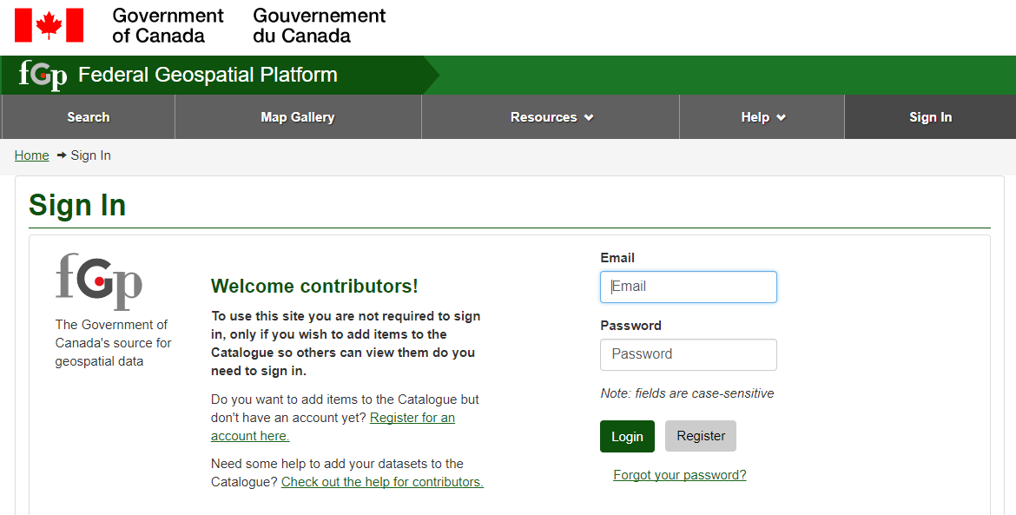
Prerequisite
Have an Editor account (or a Content Reviewer account)
Log in
1
2
3
Notes:
To create a record, you must have an account with an Editor role.
Then you need to Sign In:
Open a work session.
Enter the email address with which your account was created and your password.
Press “Login”

Slide 4
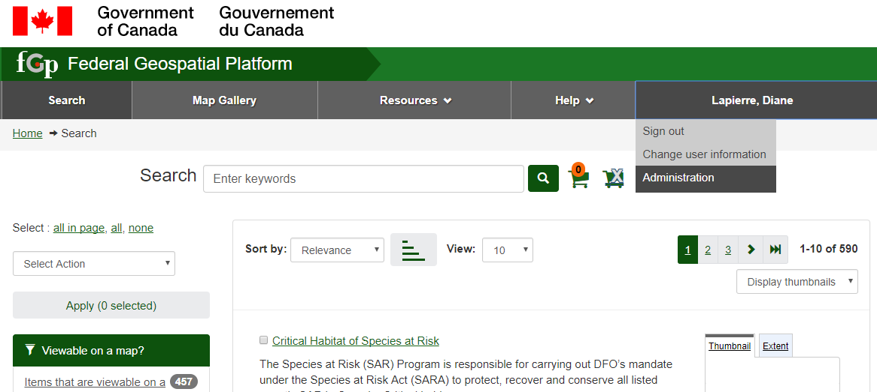
Access the Administration menu
1
2
Notes:
Access the list of functions authorized by your account under the Administration menu.

Slide 5
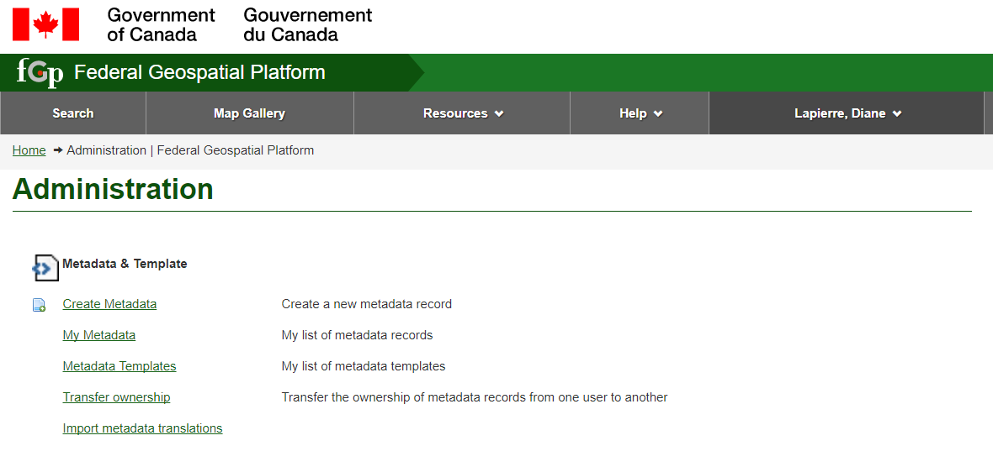
Access the Create Metadata operation
1
Notes:
Select “Create Metadata”

Slide 6
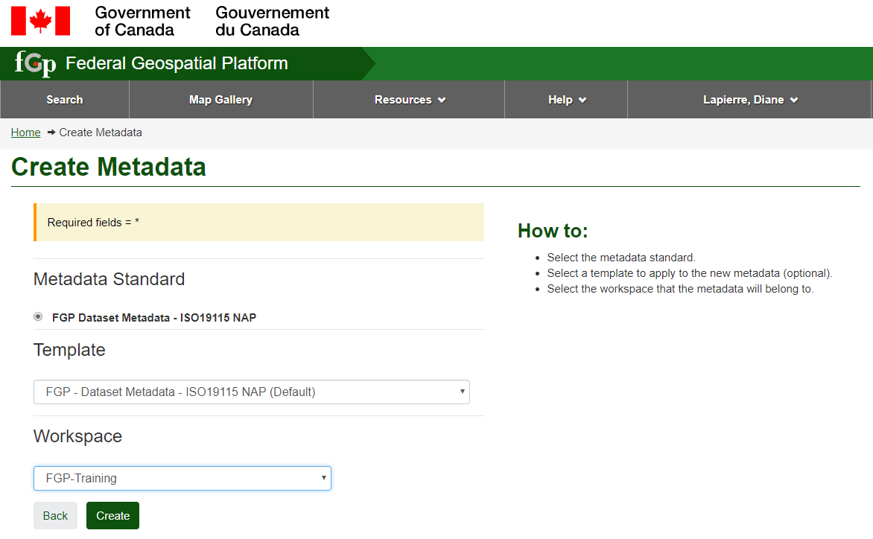
Notes:
The FGP – Dataset Metadata template is the default template. It allows you to provide the HNAP-required information.
Select the workspace in which your metadata record will be created.

Slide 7
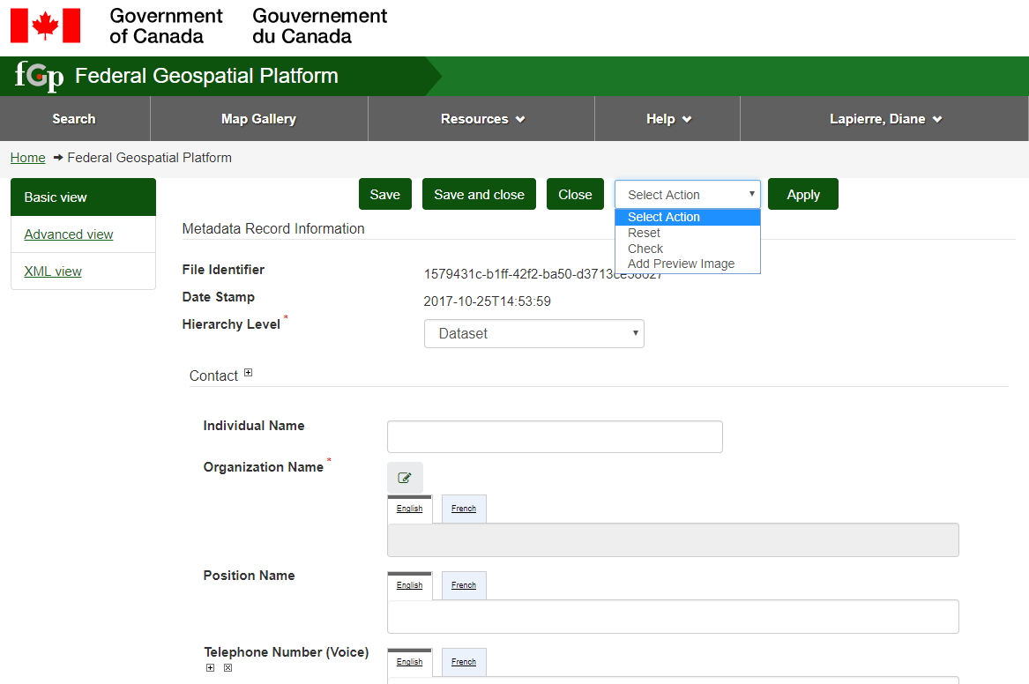
Views, operations and features
Notes:
Various input views are available.
1- The Basic View is the input view for the required fields and some of the more frequently used optional fields.
The “Advanced View” allows complete input according to ISO-19115 NAP. It will allow you to add information of interest to you and your users but which is not required by the HNAP standard. This might include a thumbnail that resides on a site external to the FGP, or information about the quality of the data or the production process. Since the information entry in this advanced view is based on the ISO-19115 NAP, you need to have an idea of which section to access.
The XML view allows metadata to be edited in XML format. However, please note that an edit error in this view could render the XML format invalid and corrupt the record.
The view displayed is always the one that was used for the previous version.
2- The three buttons that follow allow you to save or close the record.
3- Three operations are available on the record:
The Reset operation re-enters the values of the last backup
The Check operation validates the fields according to the HNAP standard
The Add Preview Image operation loads a thumbnail and assigns it to the current record
The + symbol is used to add fields. This symbol appears for all repeatable fields.
The x symbol deletes fields.
The red asterisk symbol indicates a mandatory field.

Slide 8
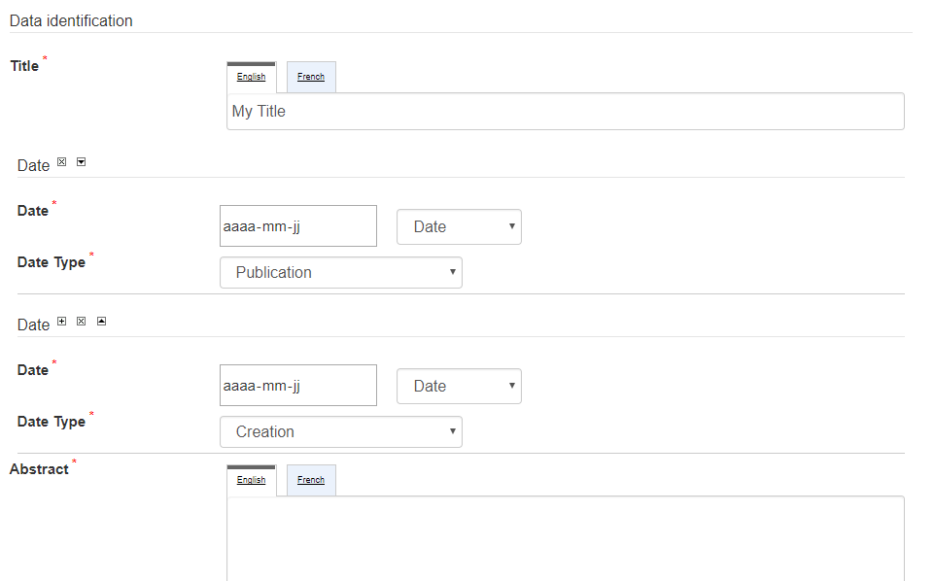

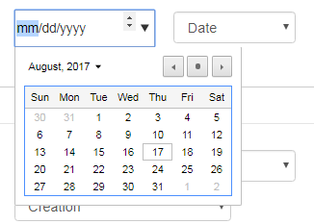



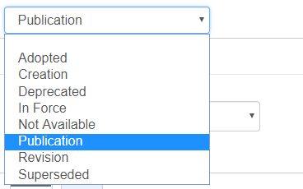
Bilingual fields, date and drop-down list
Notes:
The English and French tabs indicate the bilingual fields. If that element is required, be sure to provide the translations.
Date fields allow selection from a calendar.
The drop-down lists allow you to choose a value from those offered.

Slide 9
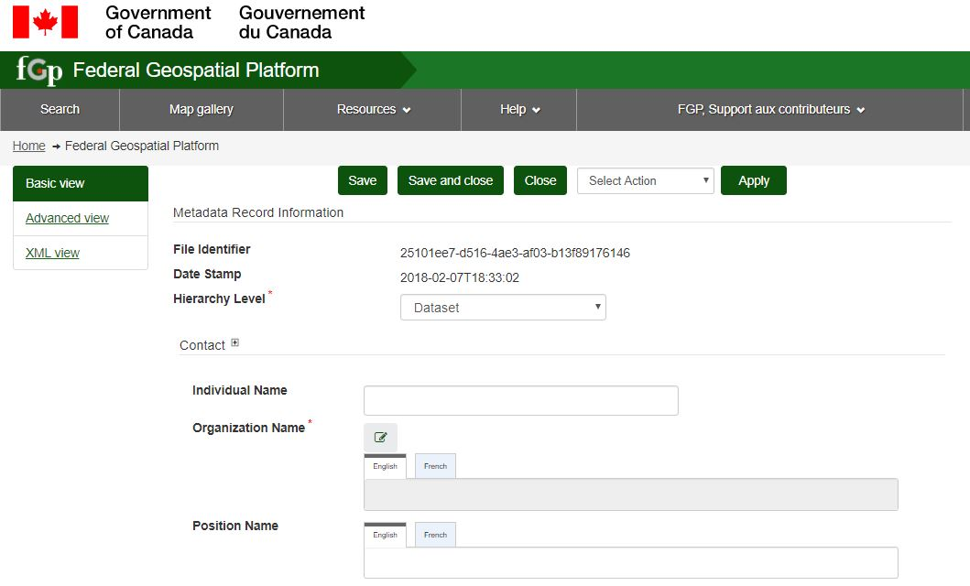
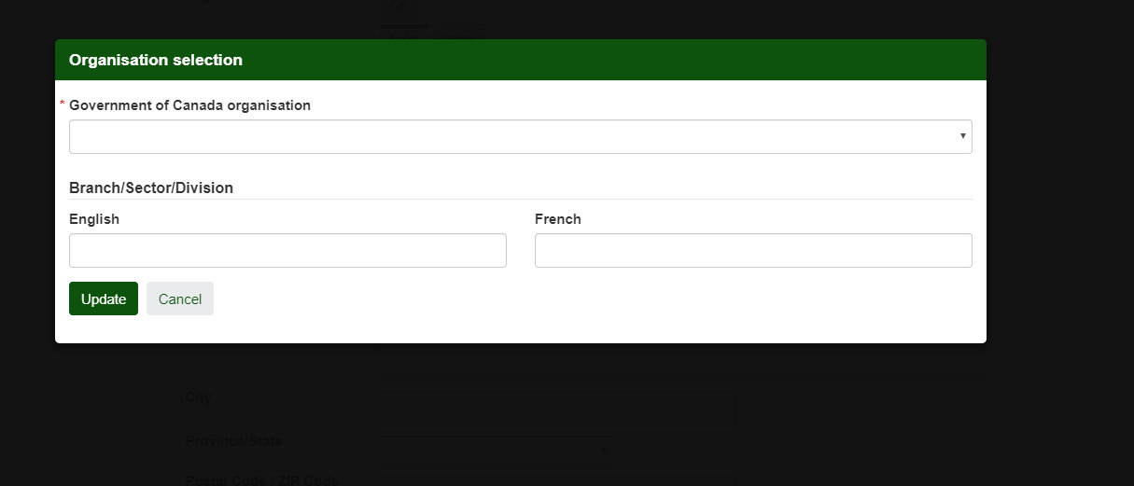
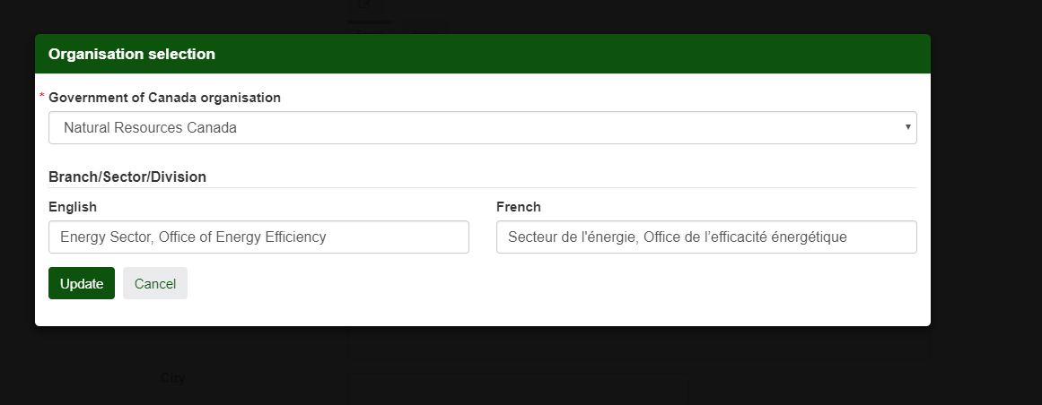
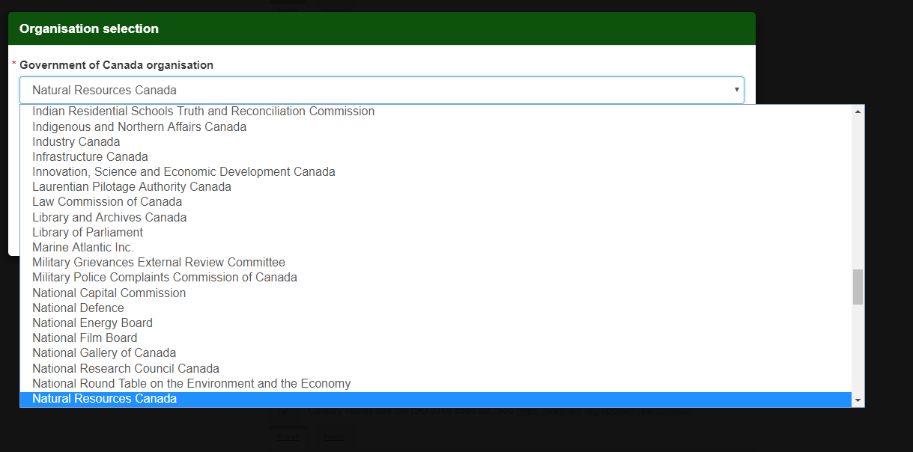
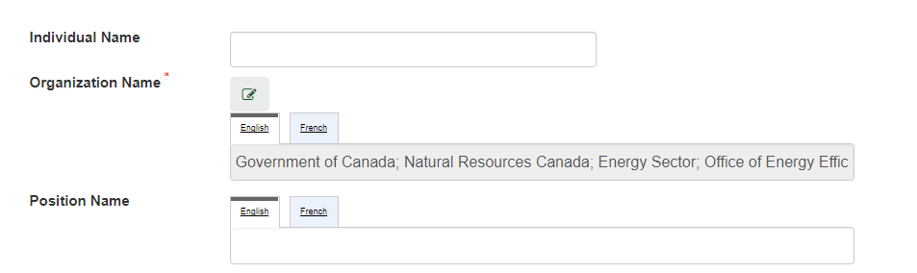
Sub-menu: Organization
Notes:
To register your organization, use the edit menu.
1- Select your organization from the drop-down list.
2- This list contains all federal organizations in the Government of Canada’s Registry of Applied Titles.
3- You can register sub-organizations such as sectors, directorates and divisions.
4- When the record is updated, you will notice that the name of your organization is preceded by the Government of Canada label.

Slide 10
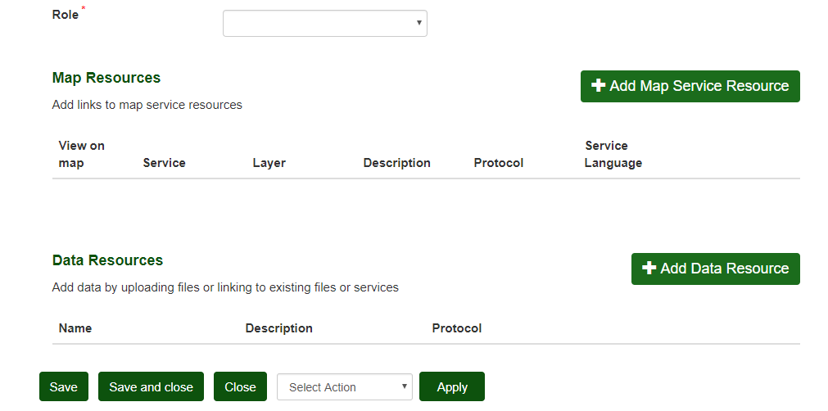
Sub-menus: Adding resources
Notes:
The “Add Map Service Resource” sub-menu allows you to save the map services that will be associated with the “Display on Map” and “View on Map” buttons.
The “Add Data Resource” sub-menu allows you to add links to geospatial data, back-up documents, applications and APIs.

Slide 11
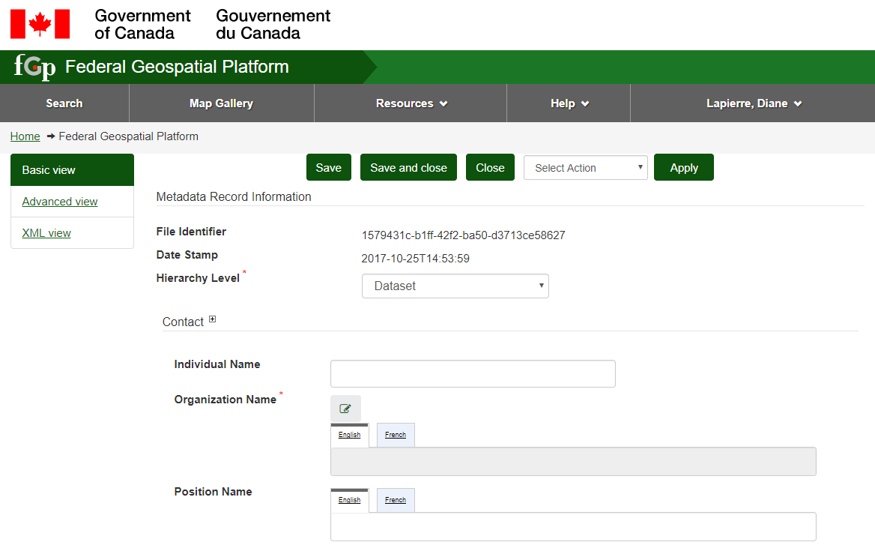
Tooltips
Notes:
1 - When the cursor hovers over the name of the item in bold type,
2- Additional information will usually be displayed.

Slide 12
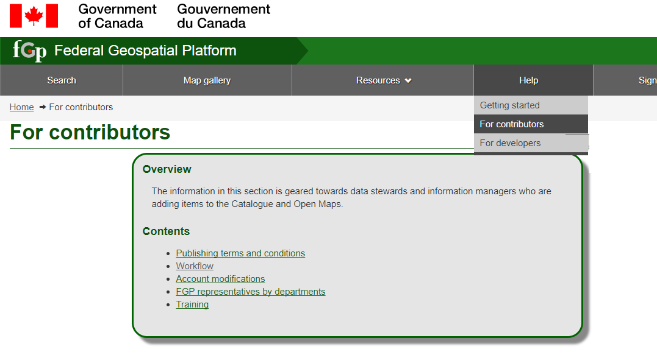
Help for contributors
Notes:
To get relevant and complete help for each field, open another window with gcgeo.gc.ca and refer to the Metadata reference guide in Help, for contributors, in the Workflow section.

Slide 13
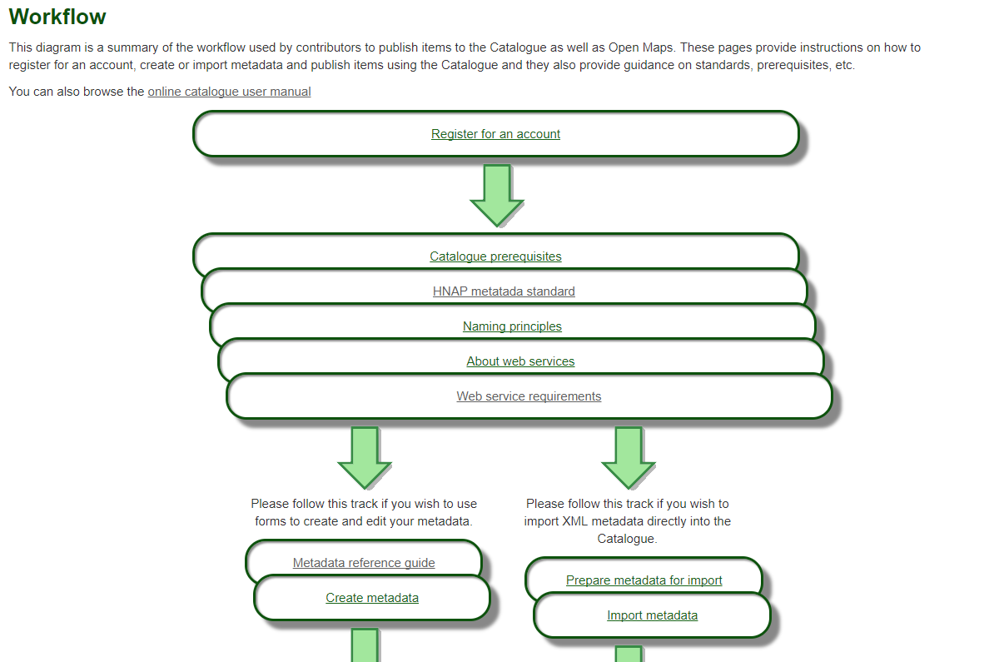
Notes:
The “Metadata Reference Guide” document shows you the business rules for each field, with the same name and in the same order as they appear in the catalogue.

Slide 14
Want to know more?
Contact the Customer Service Team
NRCan.fgp-pgf.RNCan@Canada.ca
Notes:
If you would like to know more about this topic, please contact the FGP customer service team

