Slide 1


Creating a Record
Part 2: Entering Metadata
Notes:
In the following demonstration, we will create a simple metadata record while explaining the best practices that apply to each field. We will provide mandatory information as required by the HNAP metadata standard. The entry of Web map resources is the subject of a separate module and can be found in Part 3 of Creating a Record.

Slide 2
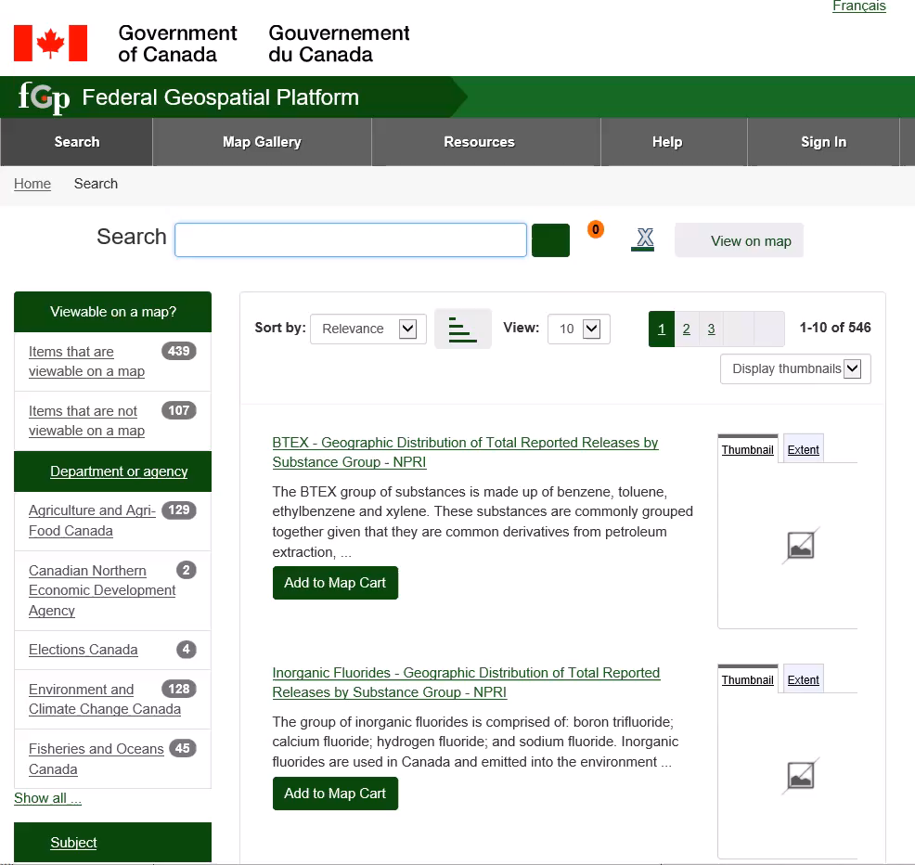
Demo: Creating a Metadata Record
Notes:
To start, you must open a work session and create a metadata record from the Administration menu.
The first section deals with information related to metadata.
In this section, we must choose the hierarchy level for a data set to keep the value entered. For a collection, choose series. Otherwise, choose Dataset.
The first contact requested is the one who is responsible for the metadata. The organization, its email and its role must be provided at minimum.
Choose from the drop-down list the organization responsible for the metadata. If necessary enter a sub-organization, such as sector, management, and division separated by a semicolon.
Enter the email in the French and English tab Choose the role of the contact from the drop-down list. Contact is suggested.
The second section deals with the data identification.
In this section, the title of the metadata must be provided. This title will match the one displayed in the catalog search page. Be sure to follow the FGP naming rules.
Provide the creation and publication date for this data.
For the summary, the first words and sentences should be used to determine if the dataset is relevant to the catalog user. So, write the essence of the description in the first lines. Continue with the details.
Select the status of the data set.
For the language element that is found in this section "Data identification", it is the language of the data.
If the data does not contain any linguistic content, which would be the case for an image or digital elevation model, choose "No linguistic content".
If the data is bilingual, repeat the field to specify both languages.
In the example, we will simulate data available in both official languages.
Choose the thematic category that best represents the dataset. If more than one category represents your data, repeat the field with the appropriate categories.
Select the Update Frequency that applies to your data Select the type of representation that applies to your data.
Enter a contact who is responsible for the data. The organization, its email and its role must be provided at minimum.
For keywords, select at least one keyword from the Government of Canada Core Subject Thesaurus drop-down list. Select all the keywords that accurately describe your data.
Additional keywords are added to the section "Add free-text keywords". Be sure to include all the keywords that accurately describe your dataset.
For Resource Constraints, the open government licence is registered by default.
If special restrictions apply, write them under "Other Constraints", and choose "Other Restrictions" under "Access Constraints" or "Use Constraints", as applicable.
For the Temporal extent, indicate the time period covered by the dataset. The End Date is not required, if the dataset is maintained continuously.
Provide the geographic extent corresponding to the data coverage.
Provide all reference systems in which data is made available.
We are now in the last section, the distribution section.
Provide all formats in which data is distributed.
Provide the distribution contact, which is the organization, its email and its role.

Slide 3
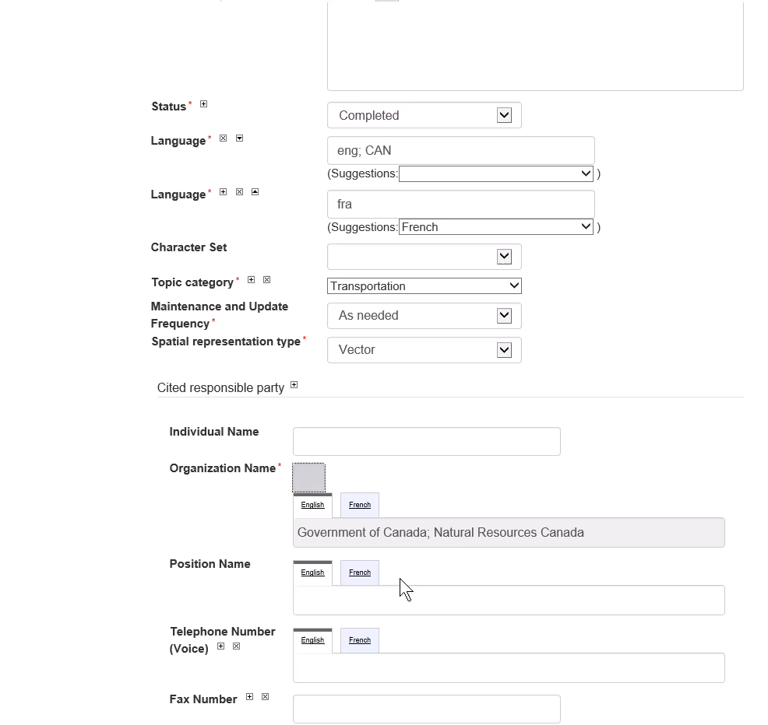
Demo: Creating a Metadata Record
Notes:
Adding map services is essential to display data in the FGP Viewer.
This section is subject to more frequent updates, a separate module is granted. See the module titled "Creating A Record - Entering Map Services".
Under Add Data Resource, you can register all the other resources available for download, whether they are data, extra documents, applications and APIs or other map services not compatible with the FGP viewer.
Whatever the resource you need to register, you must provide the access point, or the URL address .
Enter the English and French name corresponding to the resource.
Enter the protocol. The protocol corresponds to the characters preceding the colon of the URL.
Select the type of content: Web Service, Dataset, Support Document, API or Application. Be careful not to confuse Application with API. An API is a program serving as an interface, it is called by an application. The API is usually in JSON or XML format.
Select the format of the resource.
Select the language of the resource. When the resource is in both official languages, select both languages using the Control key.
You now have to complete the metadata entry.
Validate the metadata record.
Select the "Check" operation and submit.
A message will display a summary of errors, if any. Correct errors and validate until validation is successful.
Save the metadata record by clicking Save and Close.

Slide 4
Want to know more?
Contact the Customer Service Team
NRCan.fgp-pgf.RNCan@Canada.ca
Notes:
If you would like to know more about this topic, please contact the FGP customer service team

