Slide 1


Creating a Record
Part 3: Entering Map Services
Notes:
In this module, we will add web mapping services to a record being created. We will also discuss frequently encountered errors when registering map services in the catalog.

Slide 2
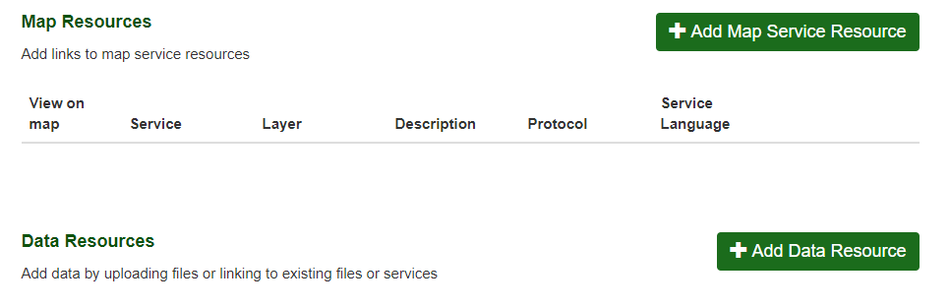
Conditions
Two registrations required:
  for the English-speaking viewer
  for the French-speaking viewer
  Two registrations are recommended even if they use the same map service.
Register compatible map services (see the “What Types of Web Map Services are Compatible?” module)
Notes:
Adding map services to the metadata is essential for data to be displayed in the FGP Viewer. At least two entries must be entered: one that will allow the operation of the viewer in English and the other that will allow the operation of the viewer in French. You must register two entries even if you only have one service.
Make sure the map services are compatible with the FGP. For further information, refer to the module titled “What Types of Web Map Services are Compatible?”. Non-compatible map services should be registered as a data resource.

Slide 3
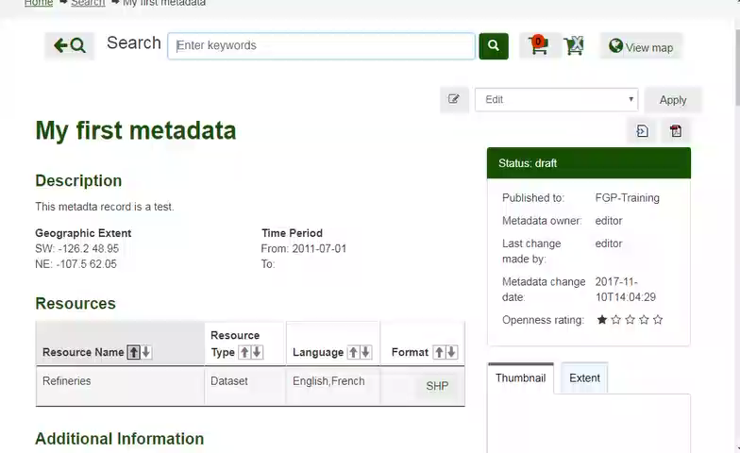
Demo: Adding ESRI REST Map Services – Part 1
Notes:
In this demonstration, we will register two entries for ESRI REST services and two entries for WMS services.
Let's start with ESRI REST services.
Edit in an existing metadata record.
Go to the section Add a Map Service Resource and click Edit
Setting the language to English for the service ensures the operation of the viewer in English.
Copy the URL address corresponding to the English service.
The catalog will attempt to detect whether the type of service is compatible.
When successful, the protocol updates automatically.
The "Cannot register this type of service" message usually indicates a non-accessible address.
In this case, the address is wrong.
Check if the URL is accessible by copying the service address into a WEB browser.
In this case, the provided address has a syntax error. A typo correction is needed to access the service.
For an ESRI REST service, you can register a layer by adding the / parameter and the layer number; in this example it is /0.
The message "Can not register this type of layer, please provide a detailed URL" indicates an incompatibility with the current version of the catalog.
Refer to the module titled "What Types of Web Map Services are compatible?".
Copy the service address into a WEB browser.
In this case, the identified layer is a "Group Layer" type, which is not accepted in the current version of the catalog.
Go back to the Add Map Service Resource screen. Next go to the end of the service URL and ensure there are no numbers after the last forward slash. Do no press enter, but simply click on the white space outside the box.
Selecting a layer from this drop-down list is the best way to choose a compatible layer.
We will now provide a URL for an ESRI REST service, by selecting a layer from the drop-down list.
Notice that the English and French Name fields will fill automatically.
Check the registration. This English name will be displayed as the layer name in the legend of the English viewer. Modify these names as needed to best represent the data. Click on test Service, then click on Add.
We will now repeat the same sequence and for "service language" we’ll specify French to ensure the service will be displayed in the French viewer.
Click Add Map Service Resource
This time, select French for the Service Language
Add the corresponding French Web Map service URL
Check the Name field. This name in French will be displayed as the layer name in the legend of the French viewer. Modify these names as needed so that they best represent the data.
In the description section, check the default language and make sure that the language listed matches the data presented by this service.
Test the service and then Add the service.

Slide 4
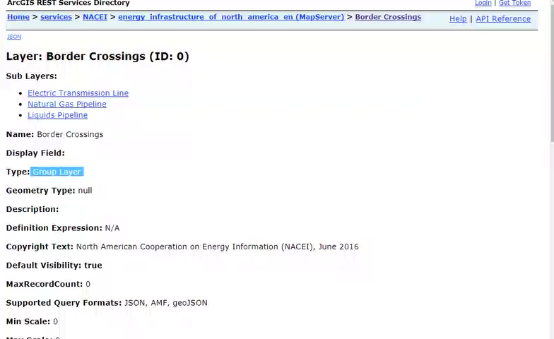
Demo: Adding ESRI REST Map Services – Part 2
Notes:
Go back to the Add Map Service Resource screen. Next go to the end of the service URL and ensure there are no numbers after the last forward slash. Do no press enter, but simply click on the white space outside the box.
Selecting a layer from this drop-down list is the best way to choose a compatible layer.
We will now provide a URL for an ESRI REST service, by selecting a layer from the drop-down list.
Notice that the English and French Name fields will fill automatically.
Check the registration. This English name will be displayed as the layer name in the legend of the English viewer. Modify these names as needed to best represent the data. Click on test Service, then click on Add.
We will now repeat the same sequence and for "service language" we’ll specify French to ensure the service will be displayed in the French viewer.
Click Add Map Service Resource
This time, select French for the Service Language
Add the corresponding French Web Map service URL
Check the Name field. This name in French will be displayed as the layer name in the legend of the French viewer. Modify these names as needed so that they best represent the data.
In the description section, check the default language and make sure that the language listed matches the data presented by this service.
Test the service and then Add the service.

Slide 5
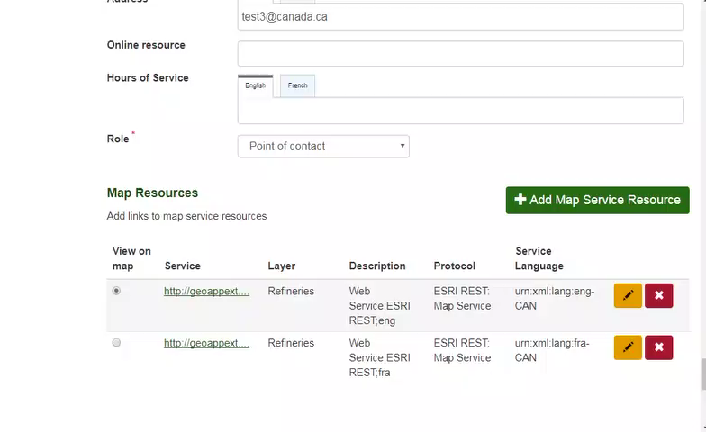
Demo: Adding WMS Map Services
Notes:
We will continue with the registration of WMS services
Click Add Map Service Resource
Provide the URL for a WMS service.
Non-standard WMS settings allow you to specify the layer, the format for the legend, and the format for displaying the characteristics of the elements.
The Layer drop-down list allows you to select the layer name to display.
Note that the drop-down list for choosing the layer name does not allow you to select a layer that has sublayers. To force the use of such a layer, add to the URL the parameter LAYERS = followed by the name of the layer.
In our case, we will select a layer from the drop-down list.
A drop-down list for the legend format will appear if the service has a legend.
A step-by-step list for the item characteristics display format will appear if the service allows queries on items.
The English and French Name fields will automatically populate.
Check the registration.
This English name will be displayed as the layer name in the legend of the English viewer.
Modify these names as needed to best represent the data.
In the description section, the value "Web Service" is automatically selected for the Content type, as well as the format that corresponds to the service. The pre-selected language is the language of the service. We must select the language (or languages) corresponding to the data presented by the service.
Test and Add the service.
We will now repeat the same sequence and specify French for "service language" to ensure the service will be viewed in the French viewer.
Click Add Map Service Resource.
Select French for the Service Language.
Add the corresponding French WMS service URL.
Be sure to specify the layer name, legend format, and display format for the feature characteristics.
Check the Name field. This name in French will be displayed as the layer name in the legend of the French viewer.
Change the names if needed so that they best represent the data.
In the description section, check the default language and make sure that the language listed matches the data presented by this service.
Test the service, and then Add the service.

Slide 6
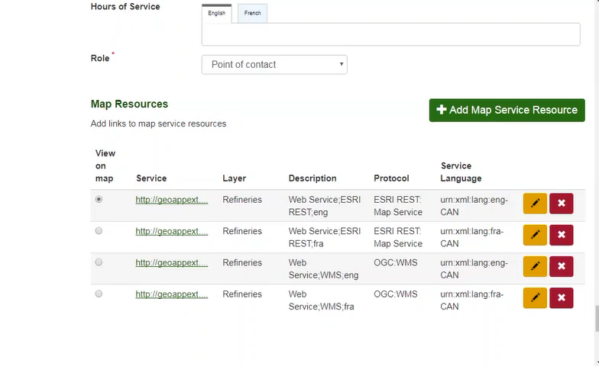
Assigning the type of Web service for visualization
Notes:
In this demonstration, we will explain how to specify the type of service that will be used by the viewer.
As in this case, when more than one service type is provided, you can force the use of one of the types, WMS or ESRI REST.
Make sure the radio button is pressed for one of the services whose protocol corresponds to the desired service type.
Do not worry about the language.
In this record, we prefer to keep the ESRI REST protocol.
We see that the button "Add to Map Cart" is assigned to the requested protocol.
When the record is saved, the service information is also saved in an intermediate register, called RCS, which will be accessed by the FGP viewer.

Slide 7
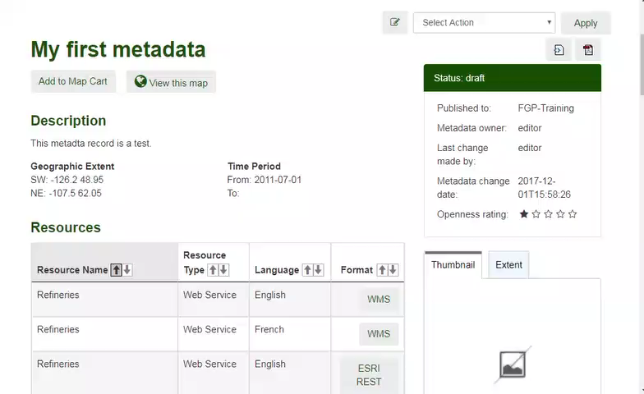
Checking the service display
Notes:
We will now check the performance of the map service in the viewer.
Add the service in the Map Cart by clicking on the "Add to Map Cart" button.
The language of the service does not matter. Then click on "View on map".
Click on the layers icon.
If no layer name appears in the legend, it is because the registration in the intermediate register (RCS) used by the viewer has not been filled-out.
Therefore, the viewer is unable to find the display instructions.
Check your service's access and compatibility, and contact FGP Customer Service if necessary.
If the layer name is displayed but the visibility setting is off, then the service is not compatible with one of the two default base map reference systems; the Lambert Conformal Conic projection, or the Web Mercator projection.
If the layer name is displayed and the visibility setting is active, but you do not see the data, choose the "Zoom to Layer Boundary" option to locate your data.
You can check the service associated with the other language by switching the language of the viewer. We now have the information displayed in French.

Slide 8
Want to know more?
Contact the Customer Service Team
NRCan.fgp-pgf.RNCan@Canada.ca
Notes:
If you would like to know more about this topic, please contact the FGP customer service team

