Slide 1


Creating a Template
Notes:
In this module, we will explain what a template is, how to create it, and how to use it.

Slide 2
What is a template?
What is it?
A metadata record partially filled with information common to several metadata records
What is it used for?
Accelerating the creation of multiple records that have common information.
Notes:
A template is a pre-populated metadata record with information that will repeat for multiple records.
When creating a record, the Editor will select the template and only provide the missing information. All editors with access to the workspace will be able to use the template.

Slide 3
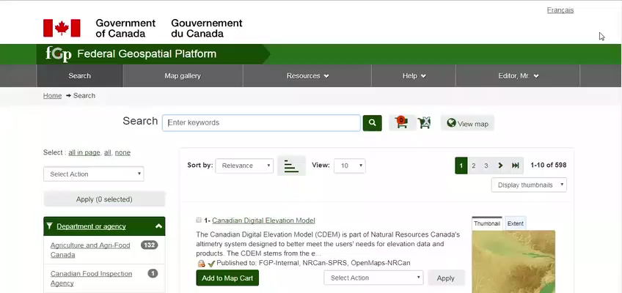
Demo: How to create a template
Notes:
We will create a template, considering the contact metadata as the repetitive information to save in the template.
Create a record with the default template.
In the Administration menu, click Create Metadata, select the default template, select the workspace and click Create.
Add the contact for the metadata.
Now that the contact information has been added, save and close the record.
Reselect the last record created and choose the "Save As Template" operation.
Give a meaningful title to the record to indicate the purpose of the template and click Save and Close.
To see all the metadata templates that you have access to and what they contain, go to Administration> Metadata Templates.

Slide 4
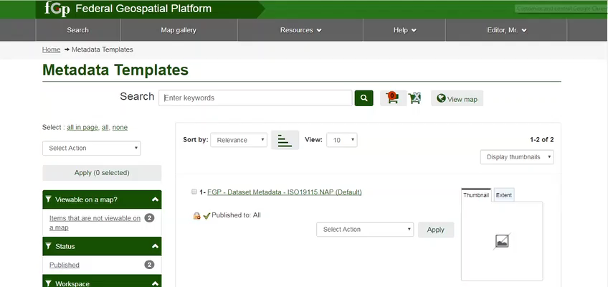
Demo: How to use a template
Notes:
We will use the template to create a new metadata record. This template can be used by all editors in the workspace.
Go under the Administration menu and select Create metadata.
The template just created now appears in the drop-down list.
Select the template and the workspace and click Create. You now have a record with the pre-filled template information.
All you have to do is complete the Metadata record, validate and save it.

Slide 5
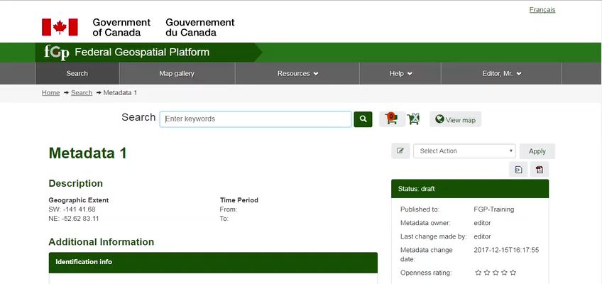
Demo: How to destroy a template
Notes:
We will delete this template so that it is no longer accessible to other editors in the workspace.
You can delete the template by selecting it and activating Delete.
It then no longer available when creating metadata.

Slide 6
Want to know more?
Contact the Customer Service Team
NRCan.fgp-pgf.RNCan@Canada.ca
Notes:
If you would like to know more about this topic, please contact the FGP customer service team

