Slide 1


How to Insert a Thumbnail
Notes:
In this module, we will explain the two methods for associating a thumbnail with a record.

Slide 2
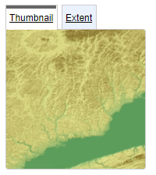
What is a thumbnail?
A thumbnail is a visual overview of the available geospatial information. It is associated with the record.
Two methods:
Load an image file (PNG or jpeg) into the catalogue
Insert a link to the image file into the metadata record
Recommendation:
A square image
Notes:
The thumbnail provides a visual overview of the available geospatial information.
Although the thumbnail is not a required element, it is strongly recommended that you add this image to your metadata records.
There are two ways to assign a thumbnail. The first is to load the thumbnail in the catalogue. The second is to insert a link to an image included in the metadata record.
A square image is recommended for the image ratio to be respected.

Slide 3
First method: Loading the thumbnail
The image is loaded in the catalogue. The metadata record accesses the image that is now on the catalogue server.
Notes:
The first method, loading the thumbnail, is the easiest. A copy of the image will be saved to the catalogue server when the record is created.

Slide 4
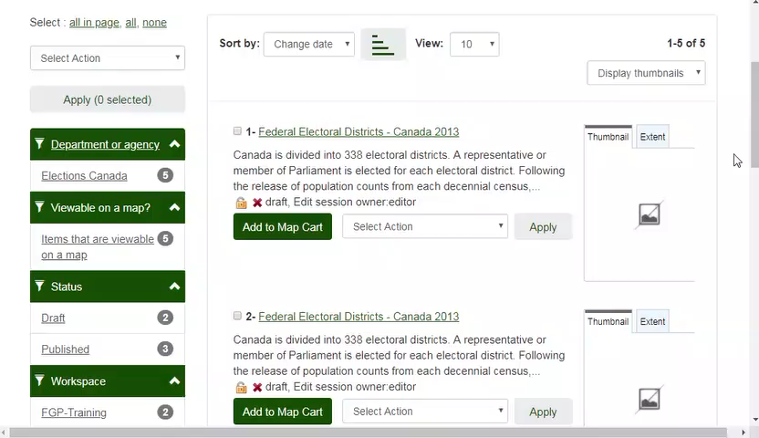
Demo: Loading the thumbnail
Notes:
Select the record and choose the Edit operation.
In the edit mode, Select the Add Preview Image operation.
For the small thumbnail specify the image file and click Add.
It is not necessary to provide information for the Large thumbnail.
Also, if the same image can be used in French and English, provide only the information for the Small thumbnail for one of the languages.
Click Back to Editing and Save Record.
The thumbnail appears on the right side in the Preview image section of the Metadata record page.
It will also appear in the search page under the Thumbnail tab.

Slide 5
Second method: Insert a link to the image
The link to the image is inserted into the metadata. The image remains on the Editor’s server and must be visible to the public.
Recommended:
For contributors who load their metadata from an xml file.
Note:
If the image is moved or destroyed, the record will still be accessible, but the thumbnail will not be displayed.
Notes:
The second method is to write a link to an image file into the metadata.
With this second method, the image resides on the contributor’s server, usually in an FTP directory accessible to the public. This method is particularly useful when loading metadata from an XML file or API. This link is included in the xml file, and will avoid interactive editing of records once loaded.
But be careful! If the image is moved or destroyed in the directory, the record will still be accessible in the catalogue but the thumbnail will no longer be displayed.

Slide 6
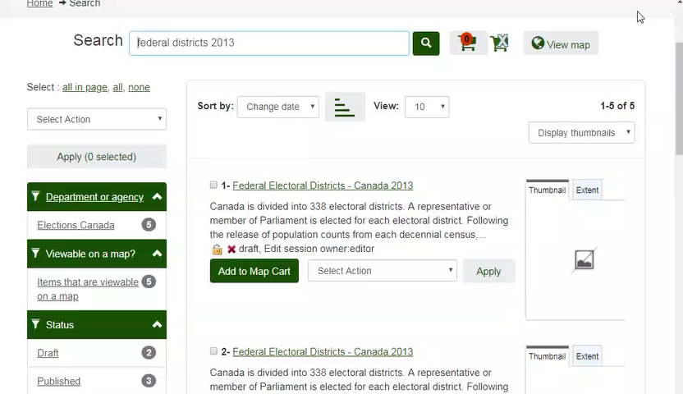
Demo: Insert a link to the image
Notes:
Edit the record.
Choose the Advance view layout.
Select the Identification section.
Scroll down and just before the Descriptive keywords , you will find Graphic overview in bold.
Click on the add symbol (+).
Insert the URL that points to the image.
The file must be publicly accessible and the communication protocol must be HTTP.
There may be problems if the protocol is FTP, depending on the server configuration.
Save the record.

Slide 7
Want to know more?
Contact the Customer Service Team
NRCan.fgp-pgf.RNCan@Canada.ca
Notes:
If you would like to know more about this topic, please contact the FGP customer service team

