Slide 1


How to Create a Collection
Notes:
In this module, we will explain how to create the link between a collection metadata record and the other records that compose it.

Slide 2
How to create a parent-child link
The parent metadata (of the collection) must exist
The child metadata will link to the collection metadata by providing the parent’s identifier*
The ISO Complete view in the catalogue will be used to add this information (not required according to the HNAP)
Attention: The parent-child concept is not propagated to Open Maps
*This information is in the ISO 19115: 2003 NAP standard, MD_Metadata section of the Parent identifier element (5.2.4).
Notes:
To create a link between a collection record and other metadata records, the collection record must first exist.
Child records will contain the link to the parent by providing the collection identifier.
Since this information is not mandatory according to the HNAP standard, it is in the ISO Complete view that this hierarchical link can be established from the child records to the parent record.
Note that the parent-child link does not appear in the Open Maps catalogue.

Slide 3
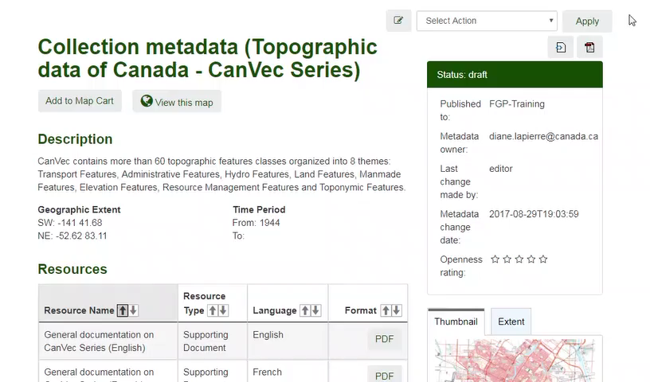
Demo: Creating a link between a collection and the datasets that comprise it
Notes:
Here is an example of metadata for a collection whose hierarchical level is set to Series.
Here is an example of metadata for a dataset whose hierarchical level is set to Dataset.
In an edit session for a child record, select the Advanced View tab.
Select the Metadata Package tab.
Locate the Parent identifier item.
Add the item by clicking on the plus icon (+).
If you know the UUID of the Metadata collection, add it. Otherwise use the nearby utility to search for a metadata record to set as the parent of the current record.
Click Create Relation.
Save and close the record.
We will redo the same operation for a second child record
We will search for the second record to link to the collection.
In the edit session of the second child record,
select the Advanced View tab.
Select the Metadata tab
Locate the Parent identifier item
If you know the UUID of the Metadata collection, add it. Otherwise use the nearby utility to search for a metadata record to set as parent of the current record.
Click Create Relation.
Save and close the record.
We will now view the Child record.
The link to the Collection record is under Parent Collection.
Click on View to access the collection record.
From the collection record, the child records appear under Related Products.
Click on View to access the Child record.

Slide 4
Want to know more?
Contact the Customer Service Team
FGP-PGF@NRCan-RNCan.gc.ca
Notes:
If you would like to know more about this topic, please contact the FGP customer service team

