Slide 1


Record Operations Available
to the Editor
Notes:
In this module, we will discuss the possible record operations available to the Editor.

Slide 2
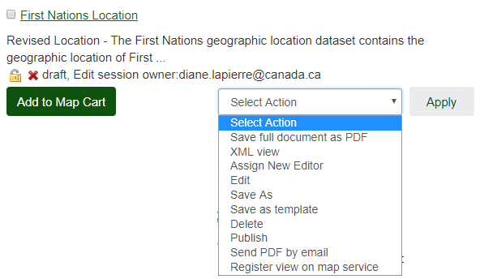
Operations
Notes:
These are the record operations available to the Editor. We will demonstrate the use of each of them.

Slide 3
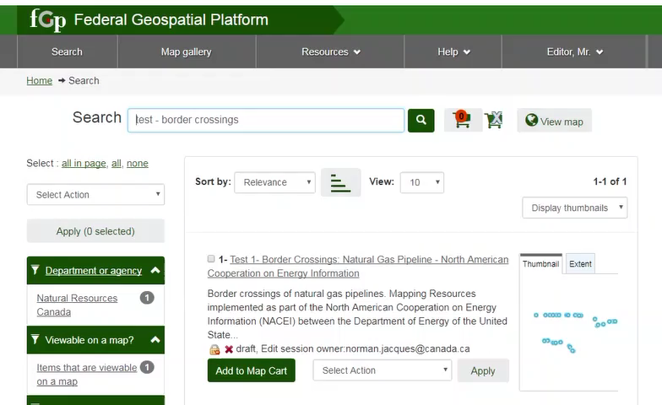
Demo: Record Operations
Notes:
Save as PDF, creates a PDF output of the metadata record.
XML view shows the metadata record in the xml format. The software that opens depends on the configuration of your work session.
When the Edit function is not available, assigning yourself as a new editor will allow you to access the Edit function.
"Assign New Editor" therefore transfers the right to edit the record to another publisher.
This avoids having two editors modifying the same record at the same time.
Edit allows you to edit an existing record.
The function "Save As" allows to duplicate a record. A new identifier will be assigned to this duplicate record.
Select the workspace from the drop-down Group List and click Create.
When using this operation, it is advisable to change the title to distinguish the two records. Click Save and Close.
“Save as template” creates a template that can be selected when creating a record. See the module titles “Creating a Template”.
Delete will destroy the record. If you delete the registration by mistake, it is always possible to recover it by making a request to the FGP Customer Service team.
Publish initiates a publication request in the FGP and Open Maps. See the “Publishing” module for more information.
The “Send PDF by email” operation is not functional.
The operation "Register view on map service" resets the information allowing the buttons "Add to Map Cart" and "View on Map" to work correctly.
This operation is necessary when the information related to the map service has not been correctly registered in the intermediate service register, called RCS, which is used by the viewer.
Also, you may want to choose a type of WEB service that is different from the one already registered. In this case, two ESRI-type mapping services are registered as well as two WMS-type mapping services.
For this example we will ignore the other data types. The services registered by default are ESRI services.
To force the use of WMS type services, choose one of the two services with the WMS protocol.
The language does not need to be considered.
When you add the record to the Map Cart and then View on Map, the WMS services will now be used.

Slide 4
Want to know more?
Contact the Customer Service Team
NRCan.fgp-pgf.RNCan@Canada.ca
Notes:
If you would like to know more about this topic, please contact the FGP customer service team

