Slide 1


Importing a Metadata File
in XML Format
Notes:
In this module, we will demonstrate how to import a metadata file in XML format.

Slide 2
Metadata creation methods
Interactive creation from the catalogue
Importing an XML file
Programming with an API call
Notes:
Various methods are possible to create a record in the FGP catalogue.
You can:
- create a record interactively from the FGP catalogue;
- import a metadata file in xml format;
- call an API from a user application.
In the following demo we will import a metadata file in XML format.

Slide 3
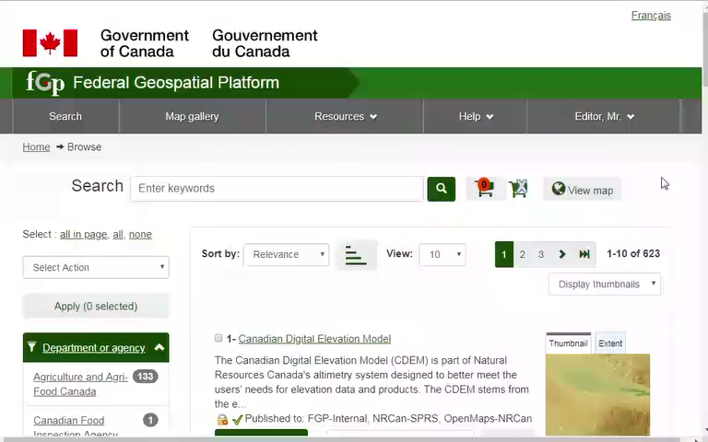
Demo: How to import a metadata file in a XML format?
Notes:
You can access the list of functions authorized by your account under “Administration”.
Select "Metadata insert".
The default file type allows for the import of a single xml file.
The selected Import actions will have an impact on the identifier provided in the XML file.
If we keep the default selection, i.e. No action on import, a new record with the identifier already provided in the xml file will be created.
If we choose “Overwrite metadata with the same UUID”, an existing record with the same identifier will be updated.
“Generate UUID for inserted metadata” can be chosen to assign a new identifier to the imported record.
This option makes it possible, among other things, to duplicate records.
Check Validate. If validation fails, errors will be reported and the metadata will not be loaded.
If we keep the box unchecked, the metadata will be loaded even if it contains errors.
Select the workspace in which you want to save the metadata.
Click Add Files and select all the metadata files to import.
Then start upload.
The presence of the comment "Metadata added with ID:" indicates that the record has been created.
The yellow message indicating "Error registering the map services in RCS. Review the service urls to verify that they are correct" indicates a registration error of the map service.
The metadata record has been created but the display of data in the viewer using the "View on Map" button will not work.
Refer to the training module titled "Validating A Map Service".
In the third case, the message "Error: duplicate key value violates unique contraint" indicates that a record already exists with this identifier.
According to the Editor's intention, the option "Overwrite metadata with the same UUID" will be chosen to update the record, or the option "Generate UUID for inserted metadata" will be chosen to force the record to have a new UUID.
In the catalog, we will have to find the two first records.
Click on Back.
Sort results by Change date.
The first two records are the ones that were imported.

Slide 4
Want to know more?
Contact the Customer Service Team
NRCan.fgp-pgf.RNCan@Canada.ca
Notes:
If you would like to know more about this topic, please contact the FGP customer service team

