Slide 1


Validating a Map Service
Notes:
In this module, we will see how to validate the compatibility of a Web map service in the FGP viewer.

Slide 2
Checking a service from the FGP viewer is useful for:
  determining the cause of a display failure
  Optimizing the map service
Refer to the module “What Types of Web Map Services are Compatible?”
Note: Currently, the viewer allows for a wider range of map services than the catalogue. A success in the viewer does not always imply success in the catalogue.
Notes:
The compatibility of a web map service with the different components of the FGP is sometimes difficult to obtain.
Validation through the FGP viewer is therefore very useful in determining the cause of a failure when displaying data or refining the online map service.
Refer to the module titled “What Types of Web Map Services are Compatible?” for a list of service types that are compatible with the current version of the FGP.
Note that the FGP viewer allows for a wider range of web map services than the catalogue currently allows. Therefore, a success in the viewer does not imply success in the catalogue.
During the demonstrations that follow, we will see how to check a service from the FGP viewer. We will discuss the most common errors for the various types of service.

Slide 3
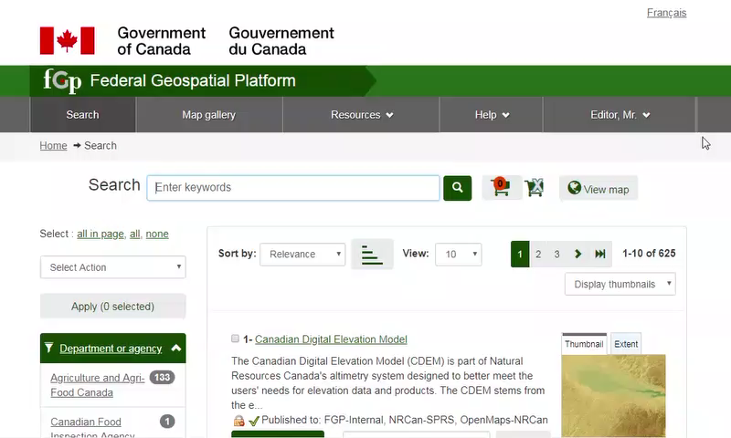
Demo: How to validate a ESRI REST web service from the viewer
Notes:
To check if your Map Service is compatible with the FGP viewer, open the viewer by clicking the "View on map" button while the Map Cart is empty.
The default projection is the Lambert Conformal Conic projection (LCC) .
If the basemap does not appear, notify the FGP customer service department.
Your organization may have a problem accessing the application hosted on the Shared Services Canada servers.
Click on the layer icon, located on the top left corner of the viewer.
Click on the + sign, to view the available options.
Then select "Import Service".
Enter the Map service URL to validate.
[Wrong address] The "Service layer URL * - Service does not respond" error message indicates an invalid URL.
Copy the URL into a web browser to confirm the cause of the error.
We notice that this address is wrong (error code:500).
In the following case, there is a typo error in the URL. Two extra character 9s at the end of the URL were introduced by mistake.
[Web service - ESRI REST - Feature layer] Here is a valid address that corresponds to an ESRI REST service - Feature layer type service that contains Point geometry features.
Use the URL of this service.
If the viewer recognizes the service, the compatible type will be selected.
Click Continue.
Choose the attribute value to display as a tooltip for each item.
Click on Continue.
Check the legend.
The legend will be displayed when the layer displays multiple symbols.
Check the Details information for a feature.
The characteristics of the features will be displayed when selecting an item on the screen.
Now let’s verify the map service compatibility with a Mercator projection.
If the data is not displayed there is good reason to believe that the service does not recognize this projection.
Choose a basemap with the Mercator projection and repeat the same process to make sure that the service is compatible with the two projections supported by the FGP.

Slide 4
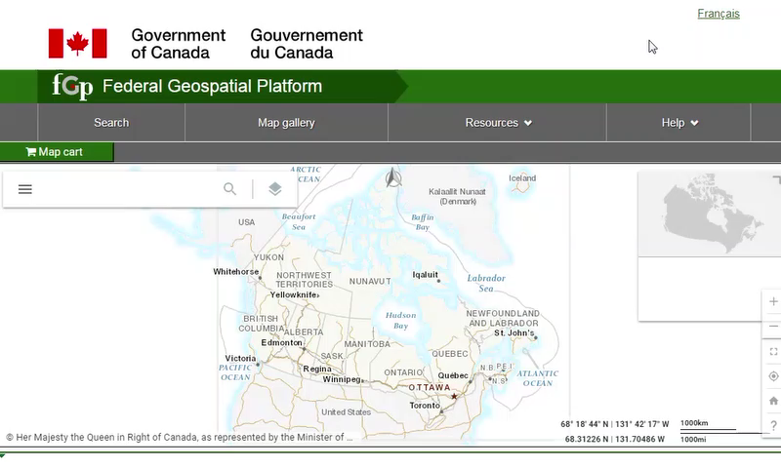
Demo: How to validate a WMS web service (generated from a MapServer) from the viewer
Notes:
The process is similar for a WMS service.
Click on the layer icon.
Click on the + sign.
Select "Import Service“.
Enter the WMS Service URL.
Here we have an address of a WMS service generated from a MapServer.
When the viewer recognizes the service, the compatible Service type "OGC Web Map Service" is displayed.
Click Continue .
The information entered for the Name of the layer has no impact on the operation of the service.
Enter the title that will appear in the legend.
Select a layer from the drop-down menu.
Click outside the drop-down menu and click Continue.
Check the legend and display information of the item.
For WMS, it is possible that the legend provided by the service does not appear as expected.
You will have access to additional features when the service is registered in the catalog.
Now select a Mercator projection basemap and redo the same procedure to ensure that the service is compatible with the two projections supported by the FGP.

Slide 5
Want to know more?
Contact the Customer Service Team
NRCan.fgp-pgf.RNCan@Canada.ca
Notes:
If you would like to know more about this topic, please contact the FGP customer service team

