Slide 1


Preparing for Publication
Checklist
Notes:
In this module, we will go over the checks that the Editor must perform before proceeding with publication.

Slide 2
Why validate before the publication request?
The purpose of the pre-publication check is to ensure compliance with departmental publication standards
A checklist is available in Help for contributors
http://gcgeo.gc.ca/en/publishingChecklist.html
Notes:
When a metadata record is published, it can be consulted by all government employees through the FGP catalogue, and possibly also by the public through Open Maps.
The Editor must therefore ensure that the data to be published meet the publication criteria and also the criteria of their own organization.
A basic checklist is provided in Help for contributors. The Content Reviewer should ensure that these checks have been made.
We will review this checklist, providing details as needed.

Slide 3
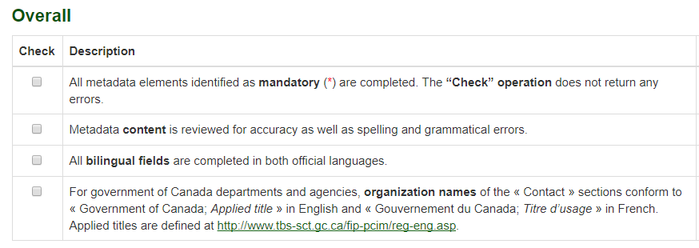

Checklist – Overall
Notes:
In the Overall section:
Has the “Check" operation, accessible in edit mode, been executed successfully?
Is the content of the metadata correct? Are there any spelling or grammatical errors?
Is the translation correct?
Does the organization name follow the rules of the HNAP standard?

Slide 4
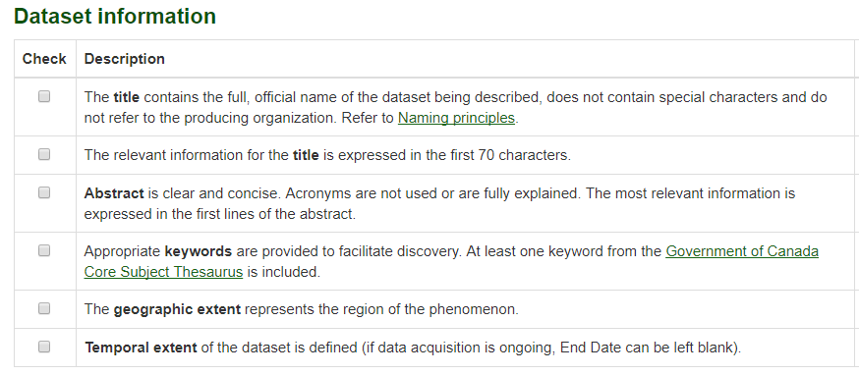
Checklist – Dataset information
Notes:
In the dataset information section:
Is the title significant? Does it respect the naming principles?
Is the abstract clear and concise? Do the first words or lines of the abstract describe the data well?
Are the keywords appropriate?
Do the geographic extent and temporal extent correspond to the data provided?

Slide 5
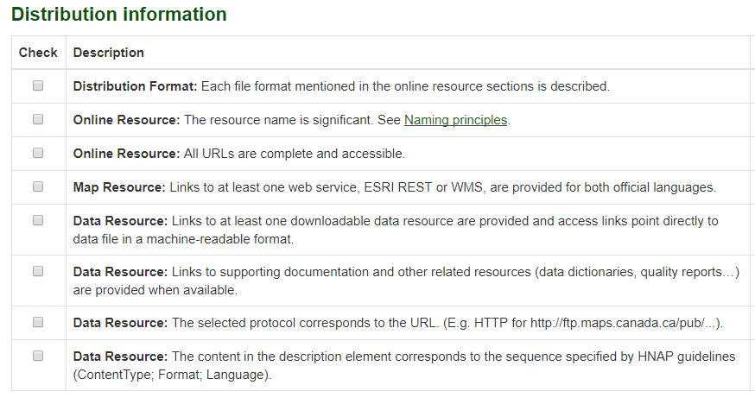
Checklist – Distribution information
Notes:
In the section for distribution information
Are the distribution formats all listed? These are mainly formats that relate to geospatial data.
Do the names of the resources respect the naming principles?
Are URL links for online resources all accessible? Do they point to the appropriate files or directories?
Has at least one Web map source been provided for each language?
For the online resources provided,
Do they give you access to geospatial data for download?
Do they provide access to supporting documentation and other related resources?
Does the protocol correspond to the URL address?
Does the description element, consisting of the content type, format, and language, correspond to the resource provided?

Slide 6
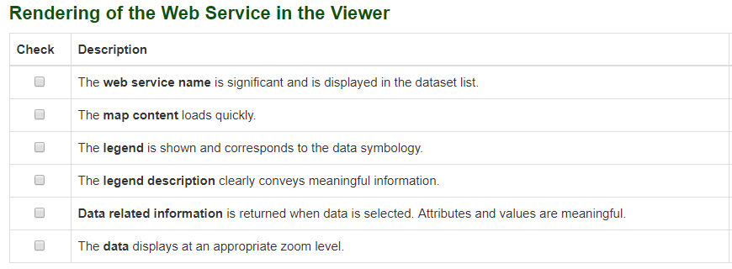
Checklist – Rendering of the Web Service in the Viewer
Notes:
When rendering the web service in the viewer, you must ensure that the service associated with the metadata is appropriate.
Add the service to the map cart and click Display on Map.
1- Are the data displayed?
2- Do they appear in a reasonable time?
3- Is the name of the layer meaningful?
4- Does the legend appear and correspond to the service symbology? Are the terms used correct and useful?
5- Does the data-related information display correctly? Are the values and attributes meaningful and understandable?

Slide 7
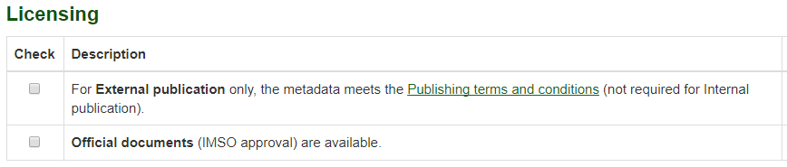
Checklist – Licensing
Notes:
In the Licensing section,
The approval of the Department’s Chief Information Officer will be required if an Open Maps publication is requested. It is recommended to use the Release Checklist provided in Quick Links to ensure compliance with the Open Maps Licence.
For publication in the FGP only, the approval process is the responsibility of each department.

Slide 8
Want to know more?
Contact the Customer Service Team
NRCan.fgp-pgf.RNCan@Canada.ca
Notes:
If you would like to know more about this topic, please contact the FGP customer service team

