Slide 1


Publishing
Notes:
In this module, we will publish a record from the catalogue

Slide 2
Conditions for initiating a publication request
Be the Editor “Author” of the recording or the Content Reviewer
Record status: Draft or Published and Draft
Valid metadata
Notes:
To initiate a publication request, the following conditions must be met:
1- Only the Editor “Author” of the metadata and the Content Reviewer of the workspace can initiate a publication request. The Publish operation is available only to these two users.
2- The record must be in the Draft or Published and Draft state
3- The metadata record must be valid.

Slide 3
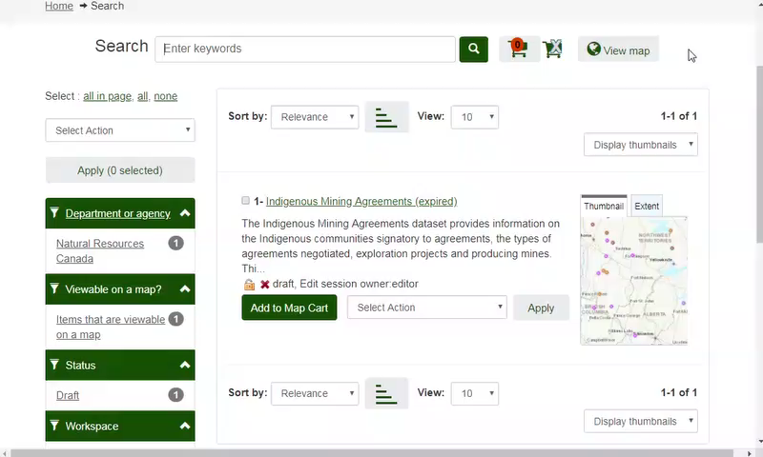
Demo: Publication request by the Editor
Notes:
Here is a metadata record in draft form, for which we are set as the owner.
As an editor, we then select Publish and Apply.
The Internal Publish location known as FGP-Internal is required by default.
We will also select the External Publish Location: OpenMaps-Training
and Submit the Publication Request.
Since a publication on Open Maps has been requested, Dataset Publishing Terms and Conditions must be met.
After reading, we must accept these terms and conditions.
Select the appropriate Content Reviewer Level 1, based on your department’s regulations.
Attach to the publication request your signed release check list as a PDF.
and Submit the request for publication.
The record status is now showing as publication in progress.
The Editor can view its current publication requests in the Administration menu under “My Publication Requests”.
The Editor may also cancel the publication request as long as a content reviewer has not taken action on the request.

Slide 4
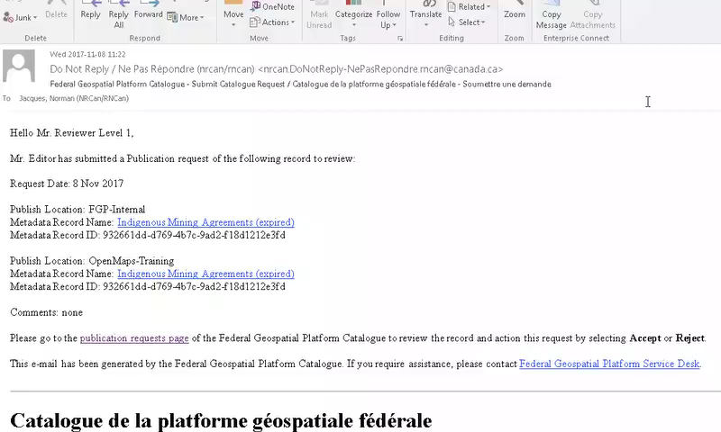
Demo: Approval by the Level 1 Content Reviewer
Notes:
As the Level 1 Content Reviewer, we will accept a publication request on the FGP and recommend the publication request in Open Maps.
The Content Reviewer Level 1 receives an email request for approval for both sites; FGP and Open Maps.
The email link takes them to the Publication request page.
Before proceeding, the content reviewer must ensure that the record meets the publication requirements.
A checklist is available in the FGP Catalogue Contributor help page.
Following verification, a Content Reviewer Level 1 must process a Publication Request for both the FGP and Open Maps.
For the Open Maps Publication Request , a Content Reviewer Level 2 must be selected from the drop-down list.
You can also add a comment that will be sent to them in the email.
The Content Reviewer Level 1 approves (or rejects) the FGP Publication Request and recommends it's publication to Open Maps.

Slide 5
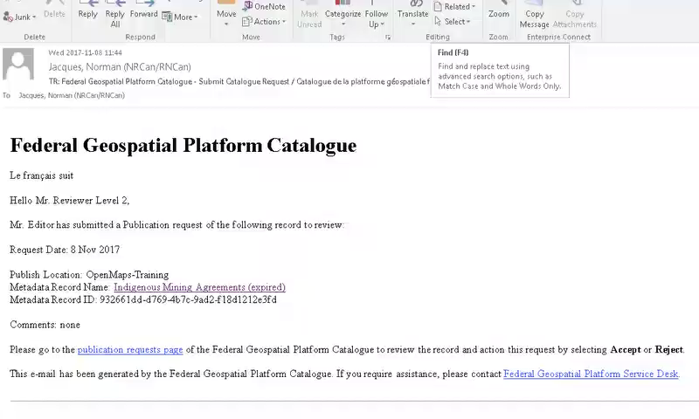
Demo: Approval by the Level 2 Content Reviewer – Part 1
Notes:
As the Level 2 Content Reviewer, we will accept a publication request in Open Maps.
For the Open Maps Publication Request, the Content Reviewer Level 2 receives an email for approval.
The Content Reviewer Level 2 performs the audit according to its own criteria.
As a Content Reviewer Level 2, we accept (or reject) the publication request.

Slide 6
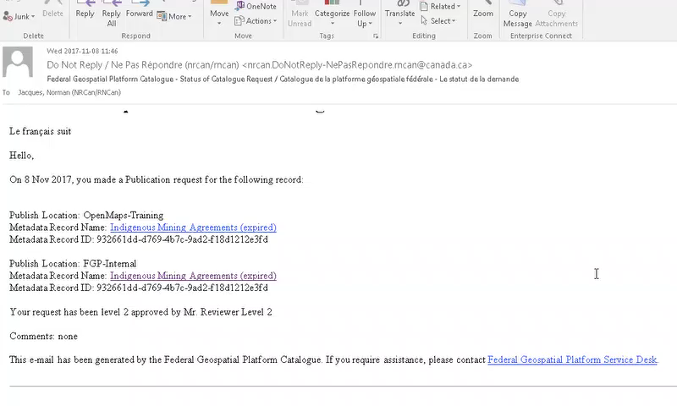
Demo: Approval by the Level 2 Content Reviewer – Part 2
Notes:
The Editor receives an email that indicates the status of their request: accepted or rejected.
The Content Reviewer Level 1 also receives the same message as a copy (that is, they are cc:ed on the email).
The publication request is completed. The record Status indicates the publication locations: FGP and Open Maps, if applicable.
The record is now discoverable and accessible through the FGP or by an unregistered user on Open Maps.
The record also becomes available on Open Maps within 5 minutes after acceptance.
If the metadata record does not appear on Open Maps, notify the FGP contributor support team.

Slide 7
Want to know more?
Contact the Customer Service Team
FGP-PGF@NRCan-RNCan.gc.ca
Notes:
If you would like to know more about this topic, please contact the FGP customer service team

