Slide 1
CGDI Knowledge Products
2020-2021

Slide 2
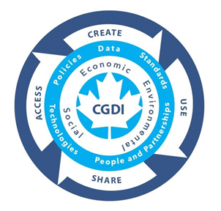
Table of Contents
Introduction
Overview of the:
  Flysheet/Factsheet
  Primer
  Cook Book and Recipes
  Engagement Testing Sessions, and Report
Starter Kits
  Climate
  Water Resources
  B.C.
  N.W.T.

Slide 3
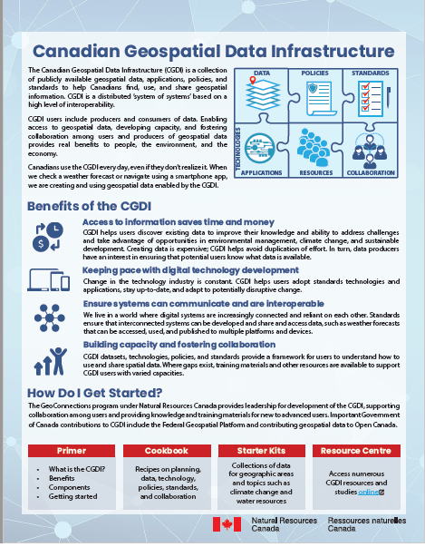
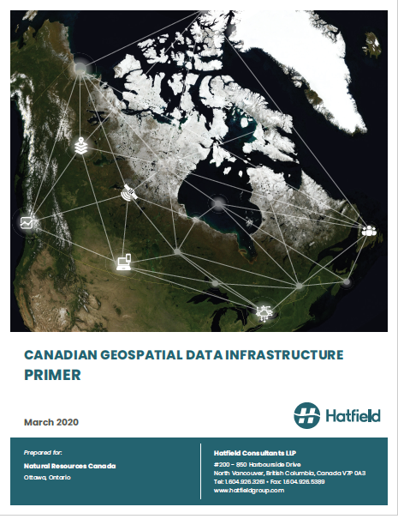
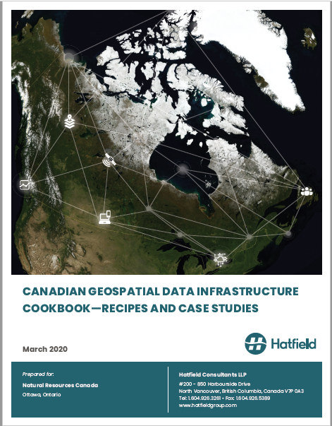
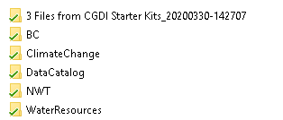

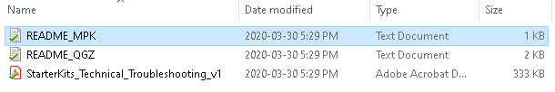
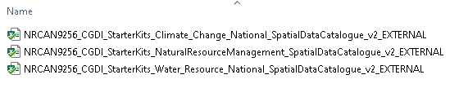
Introducing New & Existing Users to CGDI
Main Knowledge Products
Factsheet
Primer
Cook Book, Recipes & Case Studies
Starter Kits
Packages
Readmes
Catalogs

Slide 4
Introduction
Where did these products come from?
  They were a result of Phase 1 of the 2 part CGDI / ASDI User Needs Assessment
    Canadian stakeholder consultations
    Indigenous community and data need consultations, and the International Arctic Community
  Phase 1 successfully captured needs via the CGDI / ASDI User Needs Assessment, and so Phase 2 was invoked
    Phase 2 was further work undertaken by Hatfield under the direction of NRCan and the CGDI community to develop and communicate, engage and generate capacity building materials

Slide 5
Introduction
They were some of the suggested outcomes of the Phase 1 and the User Needs Assessment
  Identified needs
    Thematic Data Needs
      -----> Kits are organised this way (e.g., elevation, roads, basemaps)
          E.g., the climate kit at national level has coastal settlements, infrastructure, hydrology, climate, health, natural events, basemap layers etc.
      -----> Catalogs of the kits provide thematic sources of information for the user independent of the kit so the user can download data
    Technology, Applications tools
      -----> A need to move people away from single data access download to services and apis
      -----> The kits provide this advantage of loading services for the user
      -----> E.g., a recipe for an organisation to provide access to data via webservices

Slide 6
Introduction
They were some of the suggested outcomes of the Phase 1 and the User Needs Assessment
  Identified needs
    Policy, Standards, and Governance
      -----> Need for knowledge and access to open data
          The starter kits provide access to open data sources, the cookbook has a fullfill your data requirements recipe
    Training and Capacity Building
      -----> The CGDI primer and Cook book address all of this
      -----> Identified need: Create factsheets pg 11. of the UNA

Slide 7
Introduction
They were some of the suggested outcomes of the Phase 1 and the User Needs Assessment
  Identified needs
    Further Engagement Needed From Part B – Indigenous
      -----> The Knowledge products were further tested and refined with Indigenous and other communities in a two part assessment and provided final report
    Increase ease of access to thematic sources for Indigenous communities
      -----> The starter kits provide access to open data sources, the cookbook has a fullfill your data requirements recipe, addresses a key recommendation of UNA
      ----->Develop and implement jargon-free, user-friendly tools to facilitate Indigenous organizations use and engagement with CGDI; Developed a recipe on data sensitivities and intellectual property (OCAP ®, and an Indigenous portal case study)

Slide 8
Table of Contents
Introduction
Overview of the:
  Flysheet/Factsheet
  Primer
  Cook Book and Recipes
  Engagement Testing Sessions, and Report
Starter Kits
  Climate
  Water Resources
  B.C.
  N.W.T.

Slide 9
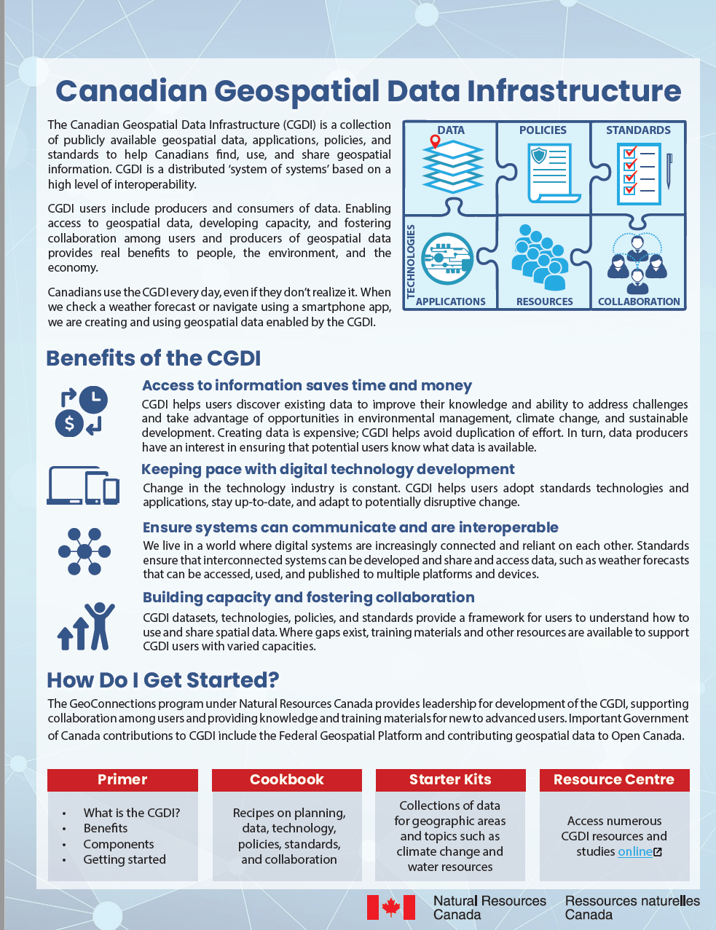
Flysheet (Quick, Factual)
Introduction to CGDI
  Data, Policies, Standards, Applications
  Resources, Collaboration
Benefits of CGDI
  Saving time and money
  Pace of technology
  Interoperability
  Capacity Building
Linkages to the other products
Gdrive Link

Slide 10
Table of Contents
Introduction
Overview of the:
  Flysheet/Factsheet
  Primer
  Cook Book and Recipes
  Engagement Testing Sessions, and Report
Videos of the Starter Kits
  Climate
  Water Resources
  B.C.
  N.W.T.

Slide 11
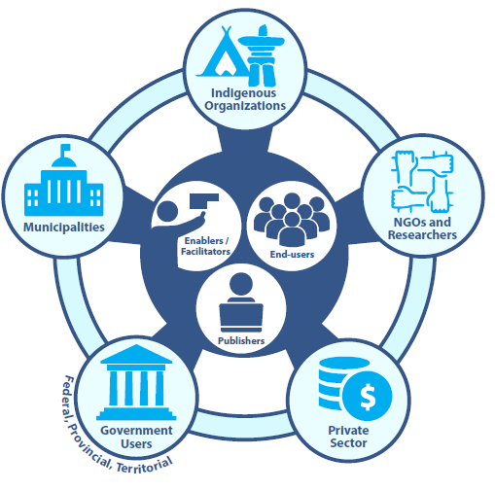
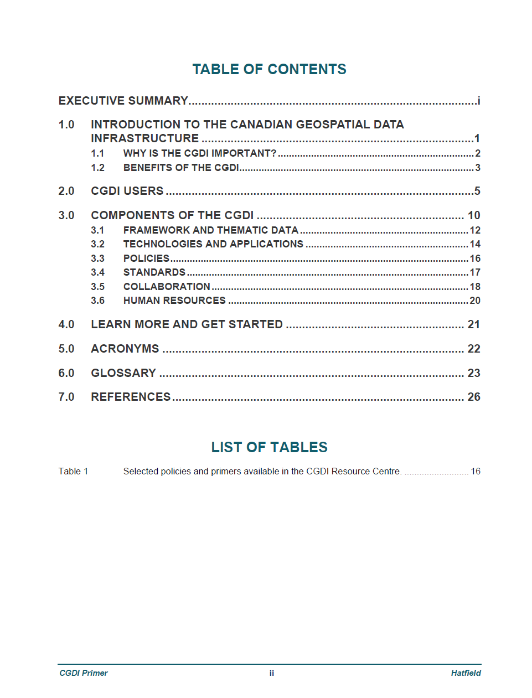
Primer
Executive Summary
Introduction
  Why is CGDI important?
  Benefits of the CGDI
Who are CGDI users
  Publishers, enablers, end users
CGDI Components
  Thematic data, Tech., Policies, Standards
Learn more and get started
  Links to the CookBook
GDrive Link

Slide 12
Primer
Contains indication of priorities
  Indigenous, Climate change etc.
Linkages
  Meteorological Service of Canada, OGC, AAFC, Tsilh’qotin National Government Portal, City of Edmonton, Ducks Unlimited
CGDI Guiding Principles
Open Canada
Standards Introduction
National Hydrometric Program
Landcover Program
Acronym and Glossary
GDrive Link

Slide 13
Table of Contents
Introduction
Overview of the:
  Flysheet/Factsheet
  Primer
  Cook Book and Recipes
  Engagement Testing Sessions, and Report
Videos of the Starter Kits
  Climate
  Water Resources
  B.C.
  N.W.T.

Slide 14
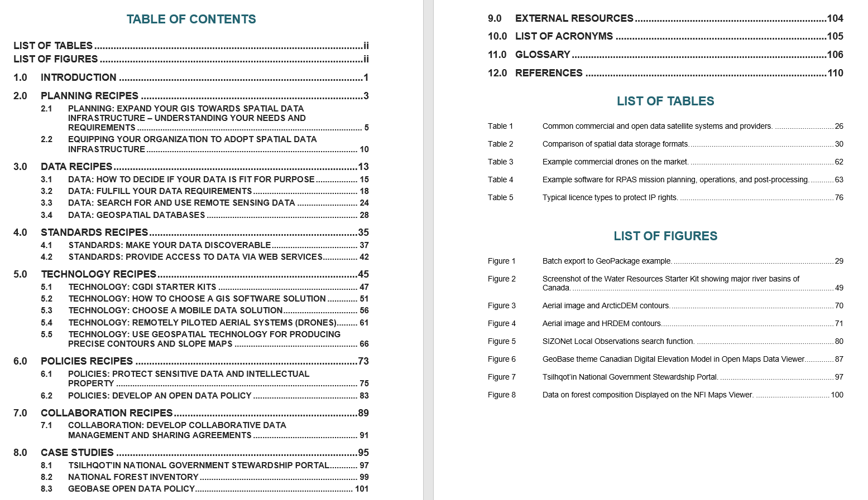
CookBook
Sizeable (114 pgs)
How to move from GIS to SDI
Recipes
  Data fit for purpose
  Data requirements
  Databases
Technology
  How to use starterkits
  Software
  Mobile solutions
  Drones
  Making contours from DEM
Policies, sensitivities related to data and property
  Open Data
Collaboration Agreement
Case Studies
  TNG, NFI, Geobase
GDrive Link

Slide 15
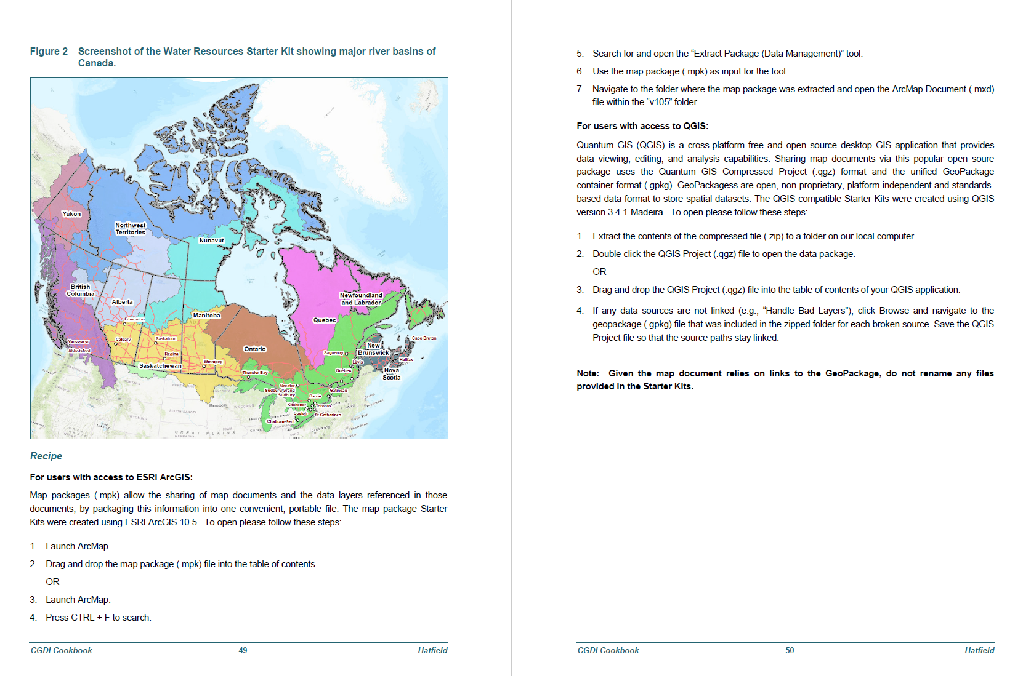
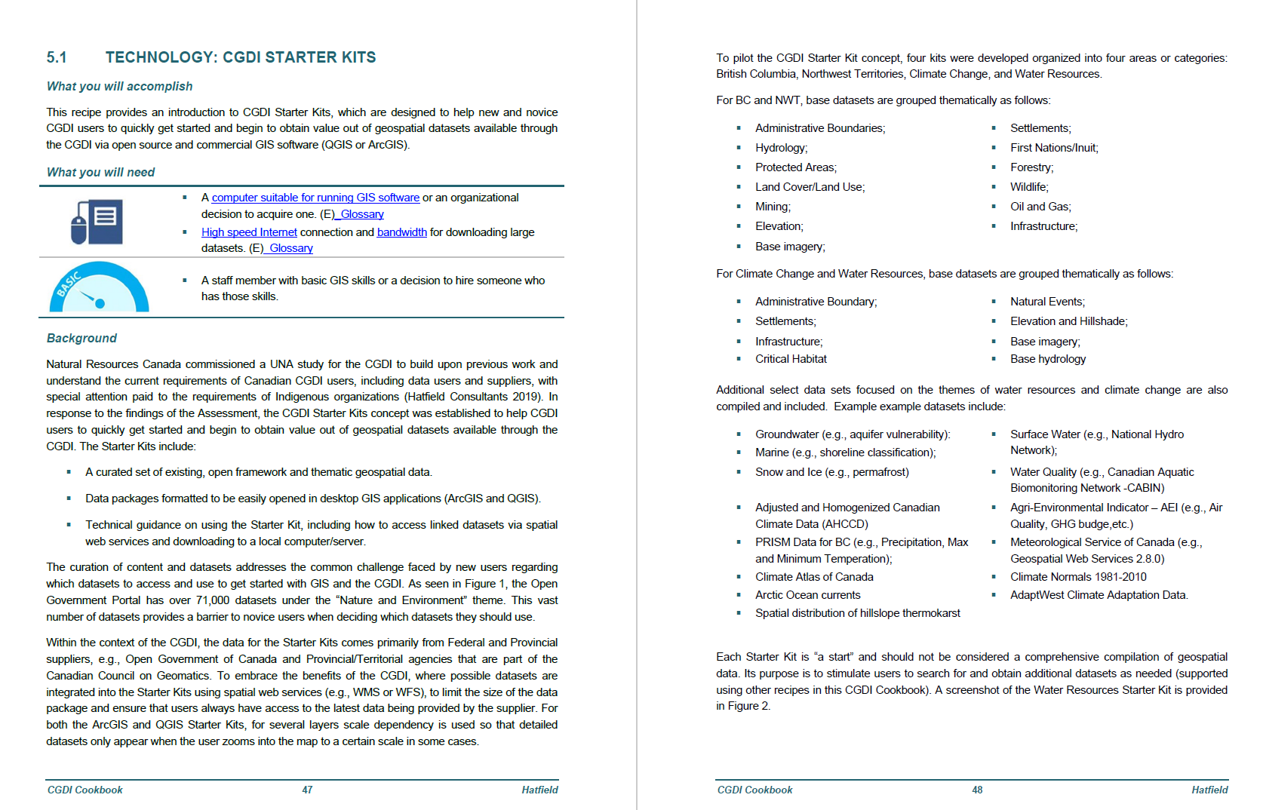
CookBook
Springboard to StarterKits
GDrive Link

Slide 16
Table of Contents
Introduction
Overview of the:
  Flysheet/Factsheet
  Primer
  Cook Book and Recipes
  Engagement Testing Sessions, and Report
Starter Kits
  Climate
  Water Resources
  B.C.
  N.W.T.

Slide 17
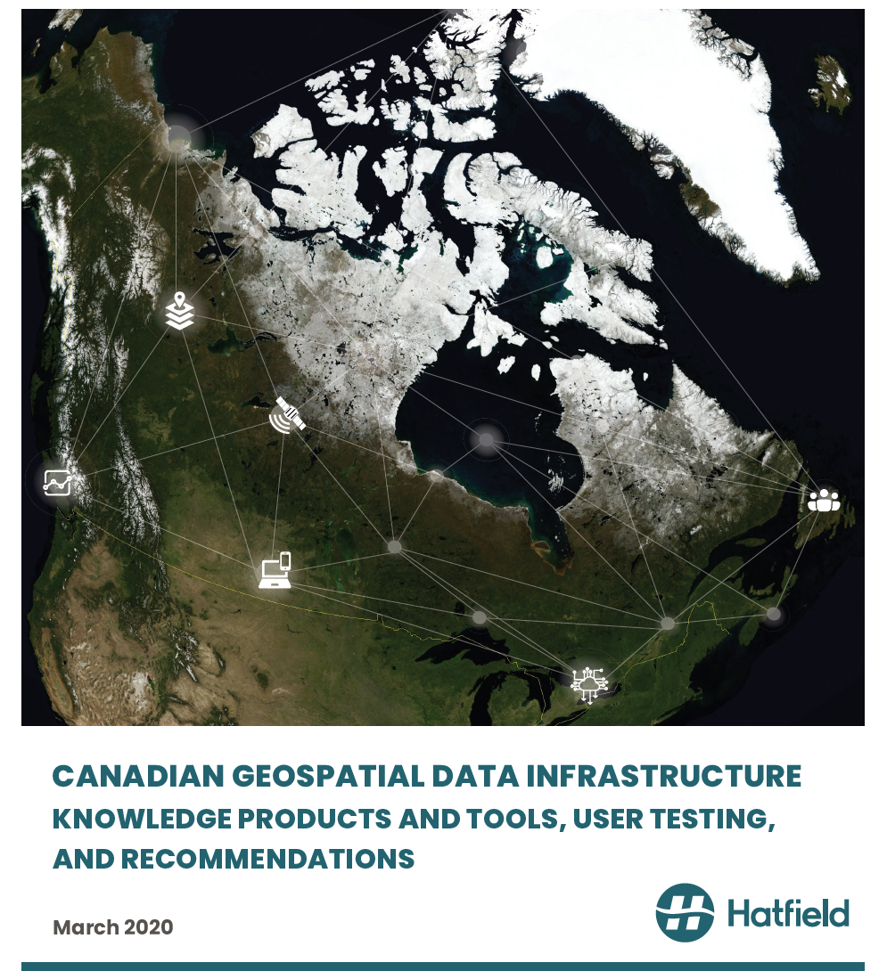
Knowledge Products Testing
To understand the utility of the products user testing was applied at the end of phase 2
44 page report
Intermediate to beginner knowledge
Indigenous groups and representatives
Local governments
Academics
Private Sector
B.C., Quebec, Nunavut, Labrador
Eeyou Istchee Cree (Eastern), and the Nunavik, Nunavut, and/or Labrador Inuit / Labrador Innu (Northern).
21 Participants.
1. Interviews (initial engagement, first interview, second interview),
  2. Workshops (laboratory like examination of materials), Terrace and Prince George B.C.
GDrive Link

Slide 18
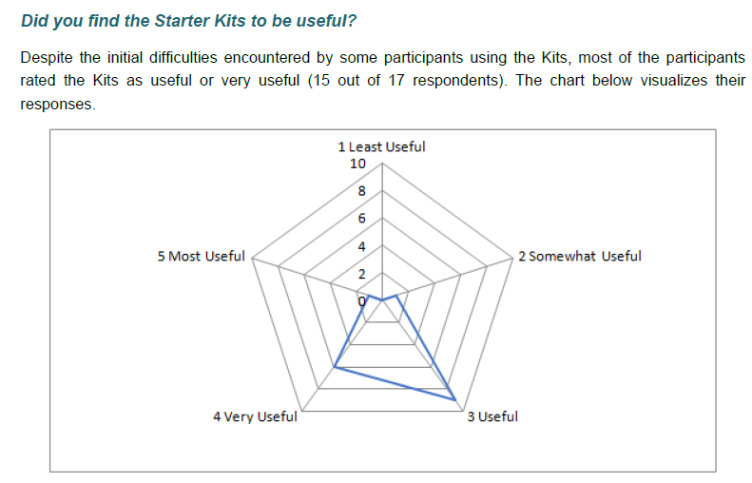
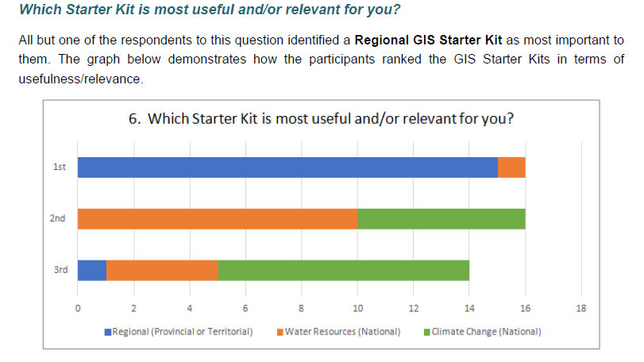
Knowledge Products Testing (Starterkits)

Slide 19
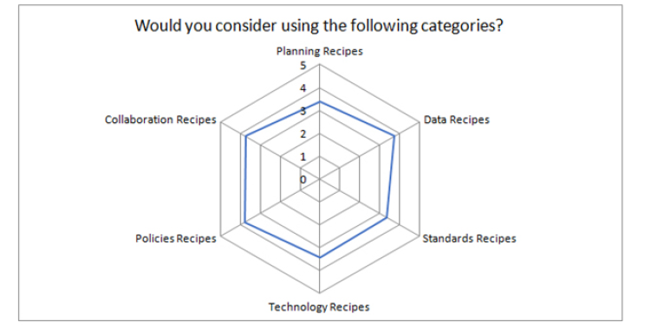
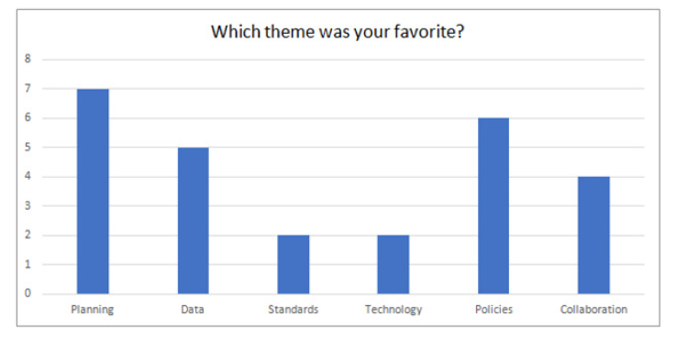
Knowledge Products Testing (Cookbook)
CookBook responses (5 likely, 0 unlikely to use)
Here we see something for everyone

Slide 20
Knowledge Products Testing
Catalogs
The overall response to the catalogues was very positive and they were deemed very useful resources which participants could consult efficiently to identify and download data to suit their needs.
Primer
  The Primer received mixed reviews from participants. The document was found to be a good introduction to the CGDI that would be important reading for any novice GIS user. As well both the content and layout of the Primer were praised.
  First, there was some confusion about the Primer's purpose. CGDI vs kits etc.
  Second, the Primer was deemed longer than many GIS users would want to read.
Factsheet
  The Factsheet was well received and praised informally for its brevity and clarity.

Slide 21
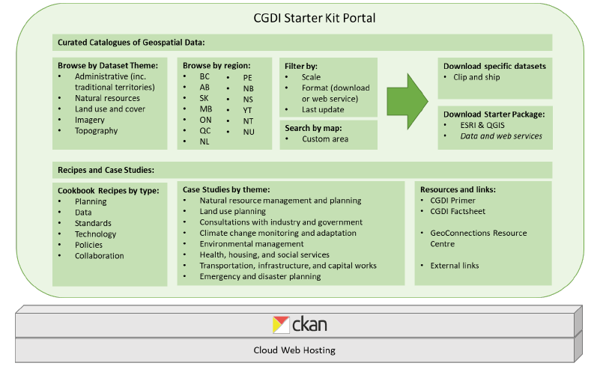
Knowledge Products Testing
Future Suggested Directions
CGDI Starter Kit Portal
  Kit catalog, packages, recipes, resources and links to CGDI resource centre
  The Portal’s focus would be helping new and novice CGDI users to quickly obtain value out of geospatial datasets available following standards support by the CGDI.
Data as a Service Proposal: Use programming interfaces (APIs) to provide access to open geospatial data on demand regardless of where geospatial data are stored, and application software that produce geospatial analysis-ready data (ARD). With each project that is funded, the opportunity exists to evaluate the contribution to the CGDI Starter Kits, particular to add “missing data” or to include more data as web services
Nation to Nation Capacity Building Pilot
The Indigenous Mapping Workshop brings together participants from various Indigenous groups and includes training sessions from the private sector and academia in technology such as Esri, Google, and Mapbox. A dedicated CGDI session could be arranged, as well asusing this as a forum to commence N2N collaboration.
CGDI Indigenous Resource Portal and Engaging Youth

Slide 22
Table of Contents
Introduction
Overview of the:
  Flysheet/Factsheet
  Primer
  Cook Book and Recipes
  Engagement Testing Sessions, and Report
Starter Kits
  Climate
  Water Resources
  B.C.
  N.W.T.

Slide 23
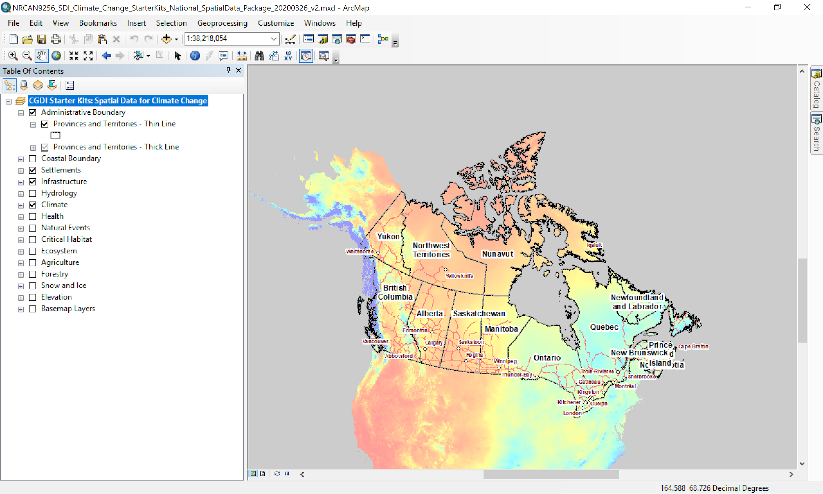
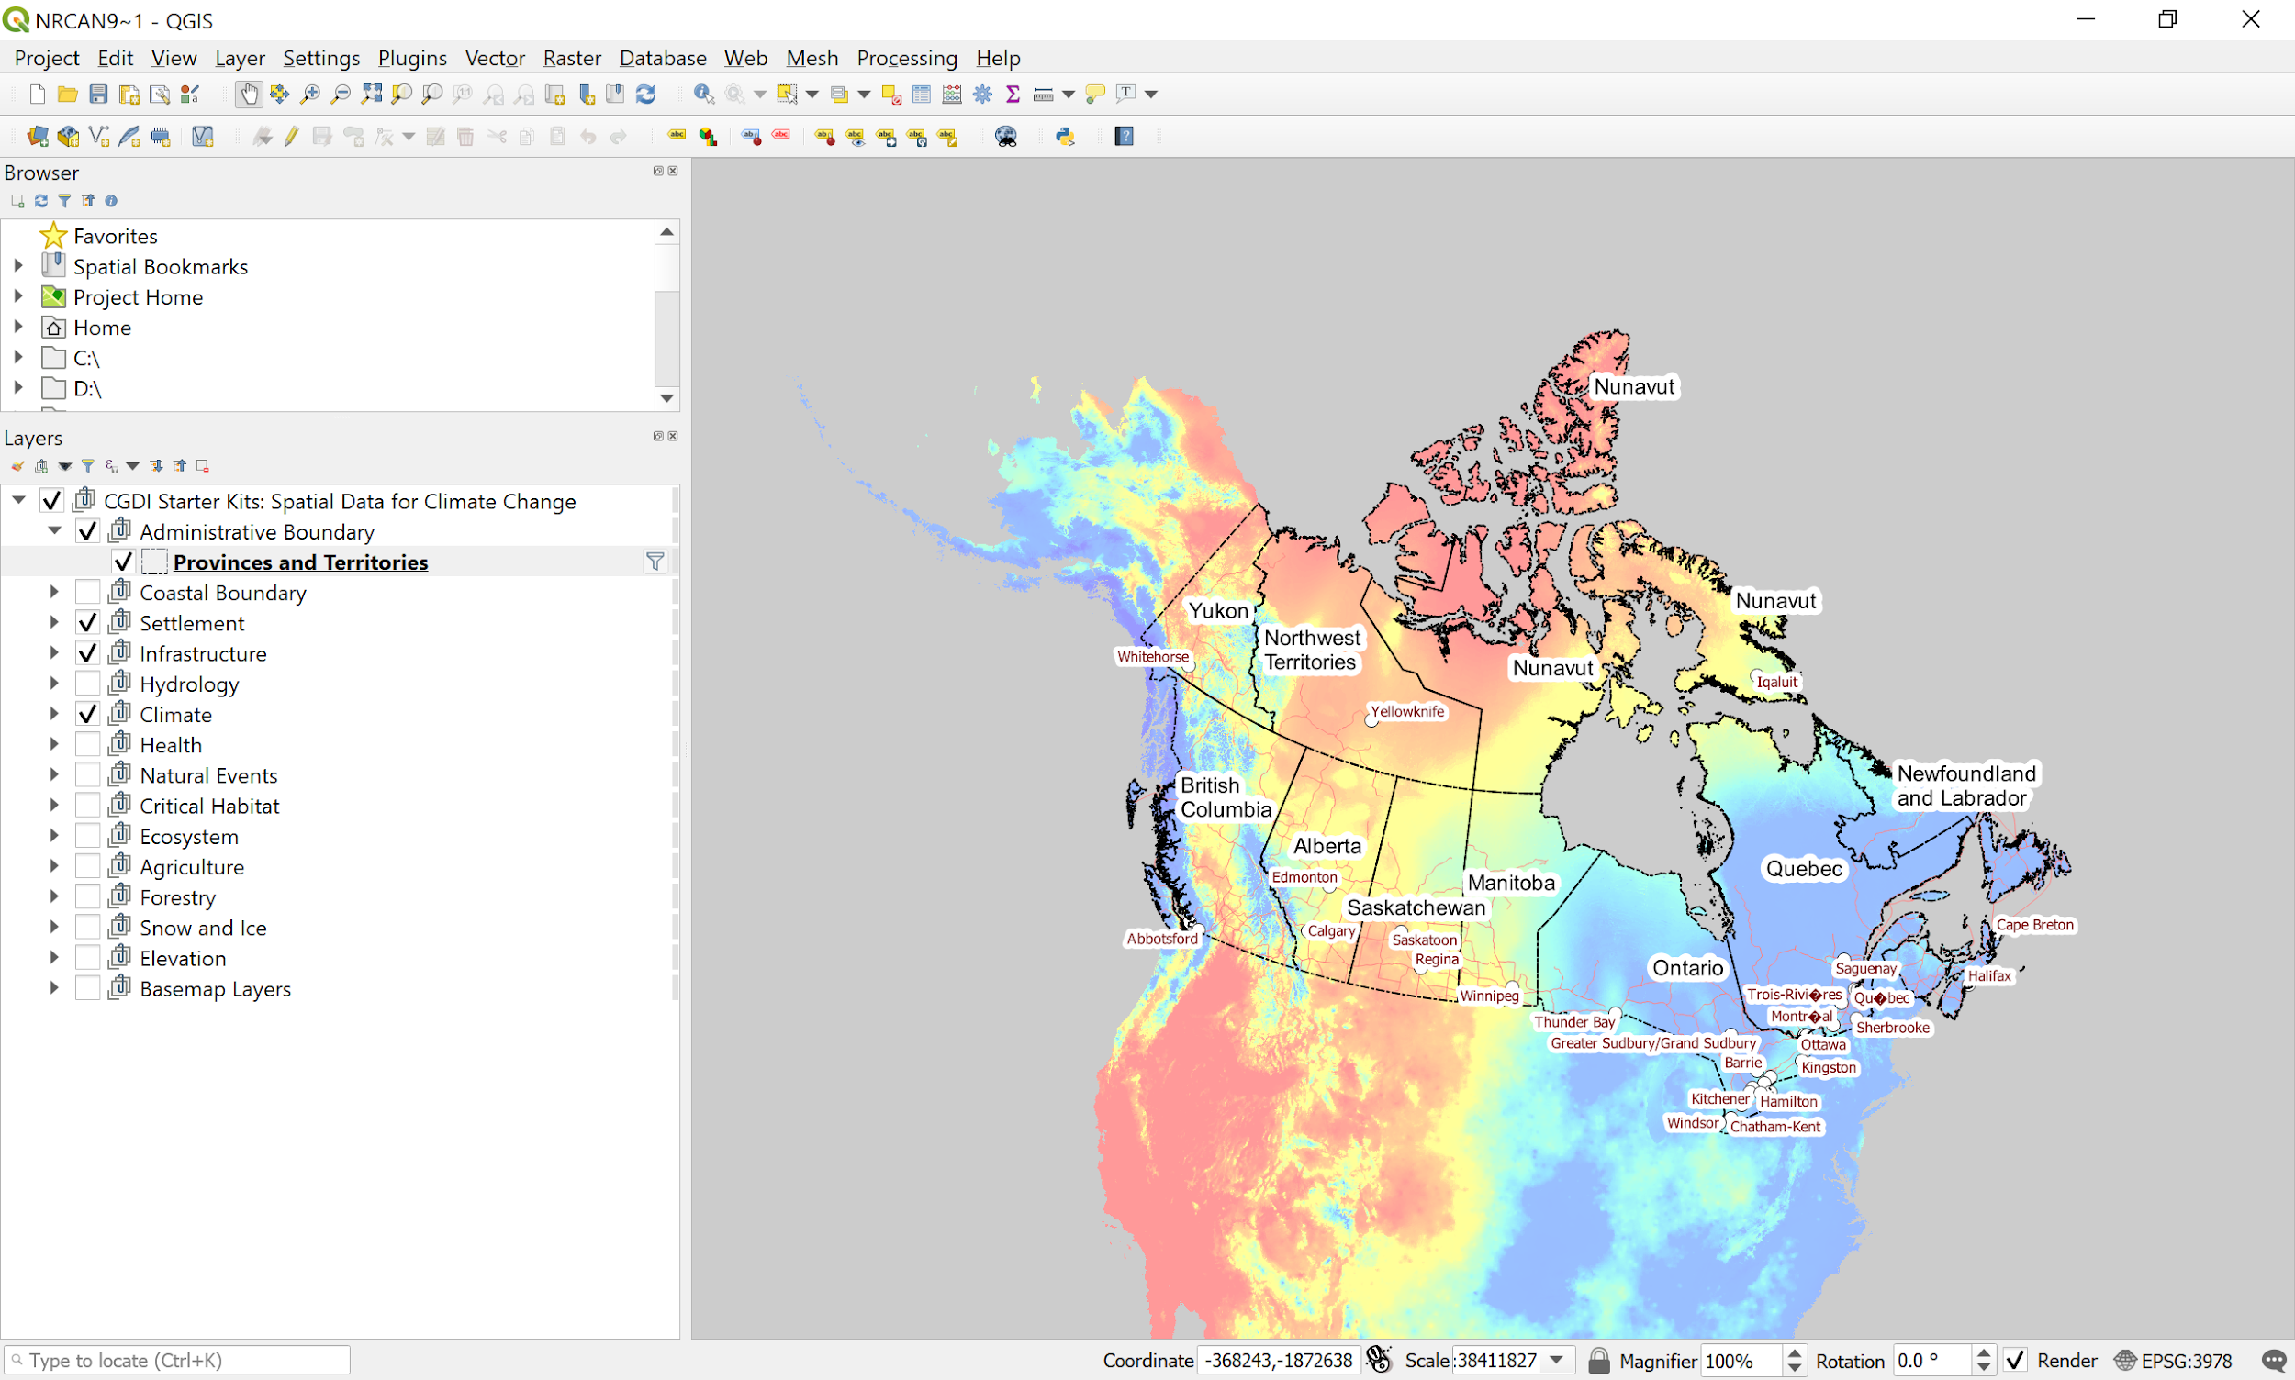
Starter Kit: Climate
MapPackage
GeoPackage
GDrive Kit Link
GDrive Kit Link

Slide 24
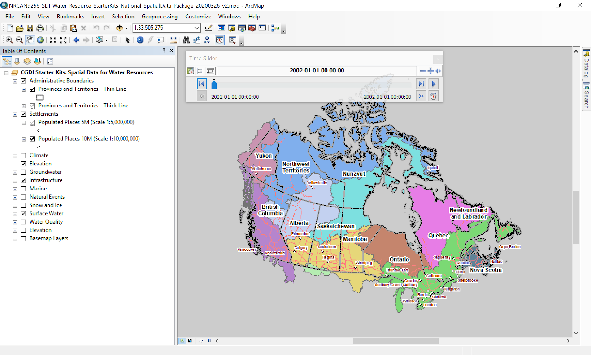
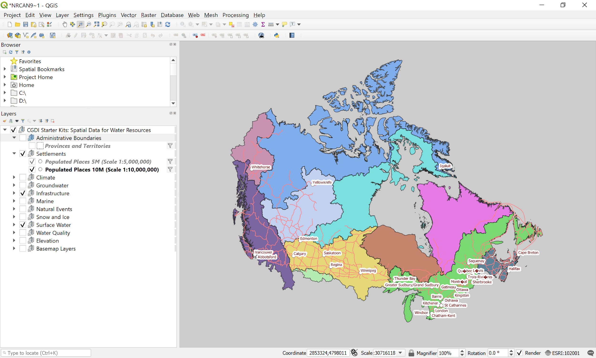
Starter Kit: Water Resources
MapPackage
GeoPackage
GDrive Kit Link
GDrive Kit Link

Slide 25
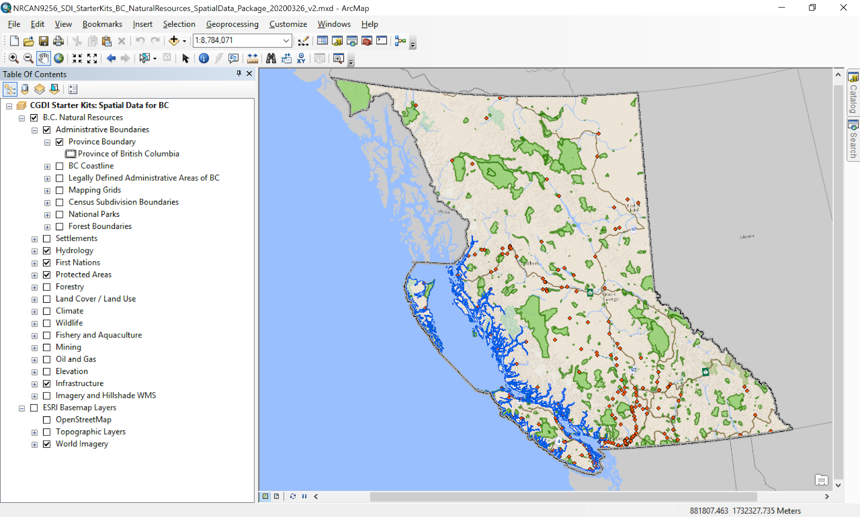
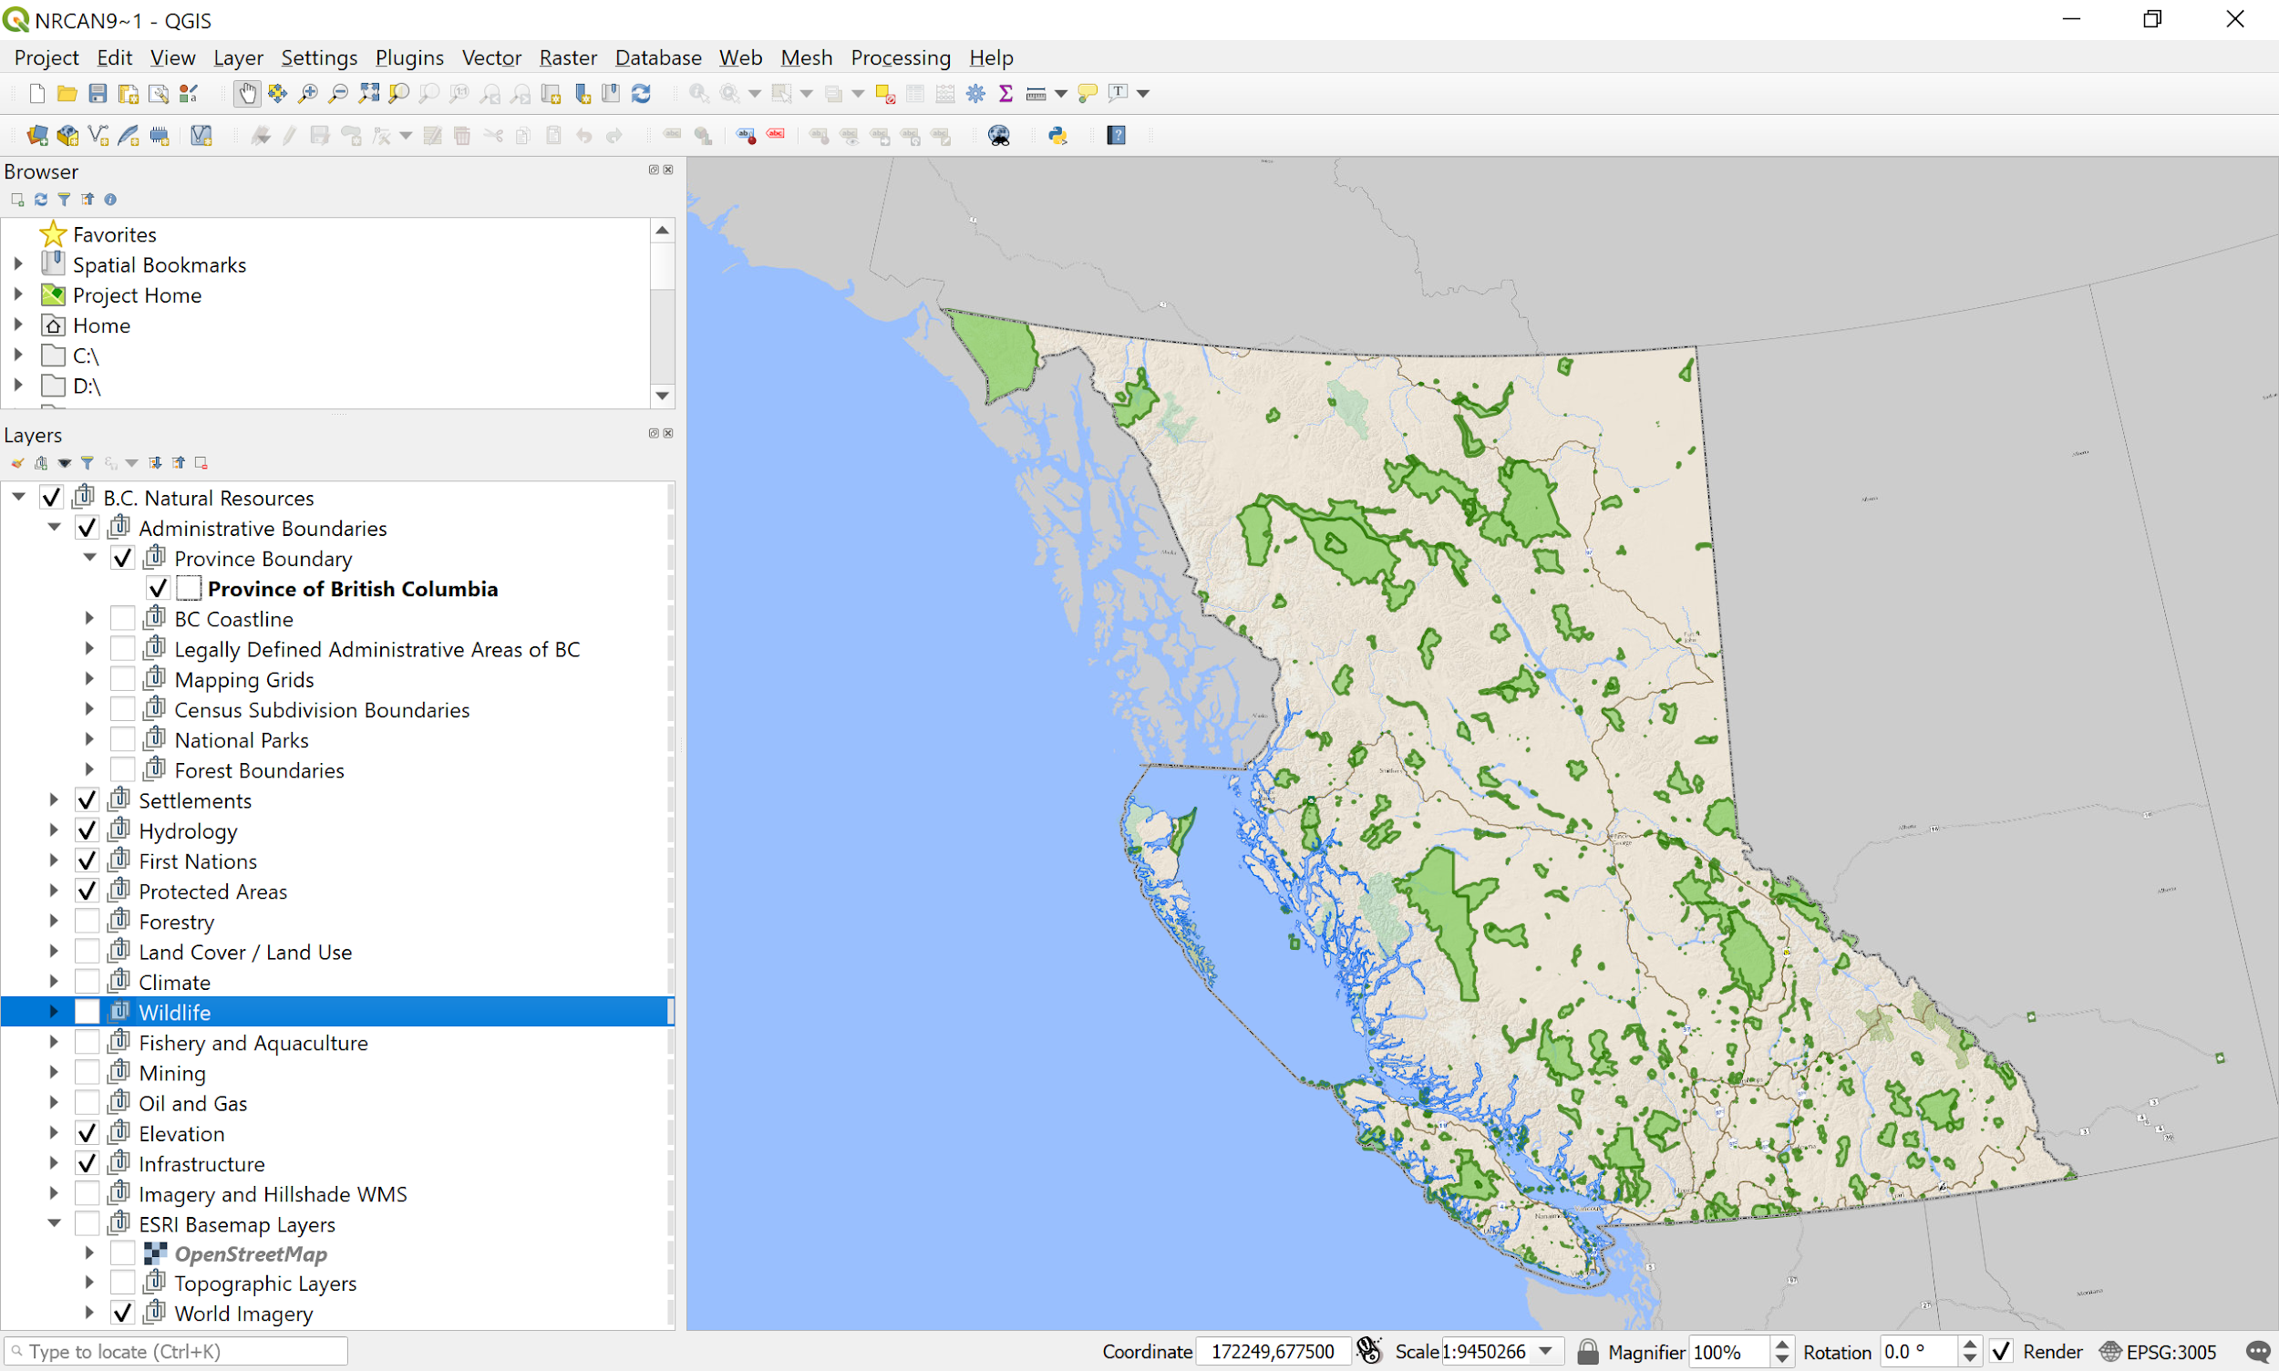
Starter Kit: Natural Resources, B.C.
MapPackage
GeoPackage
GDrive Kit Link
GDrive Kit Link

Slide 26
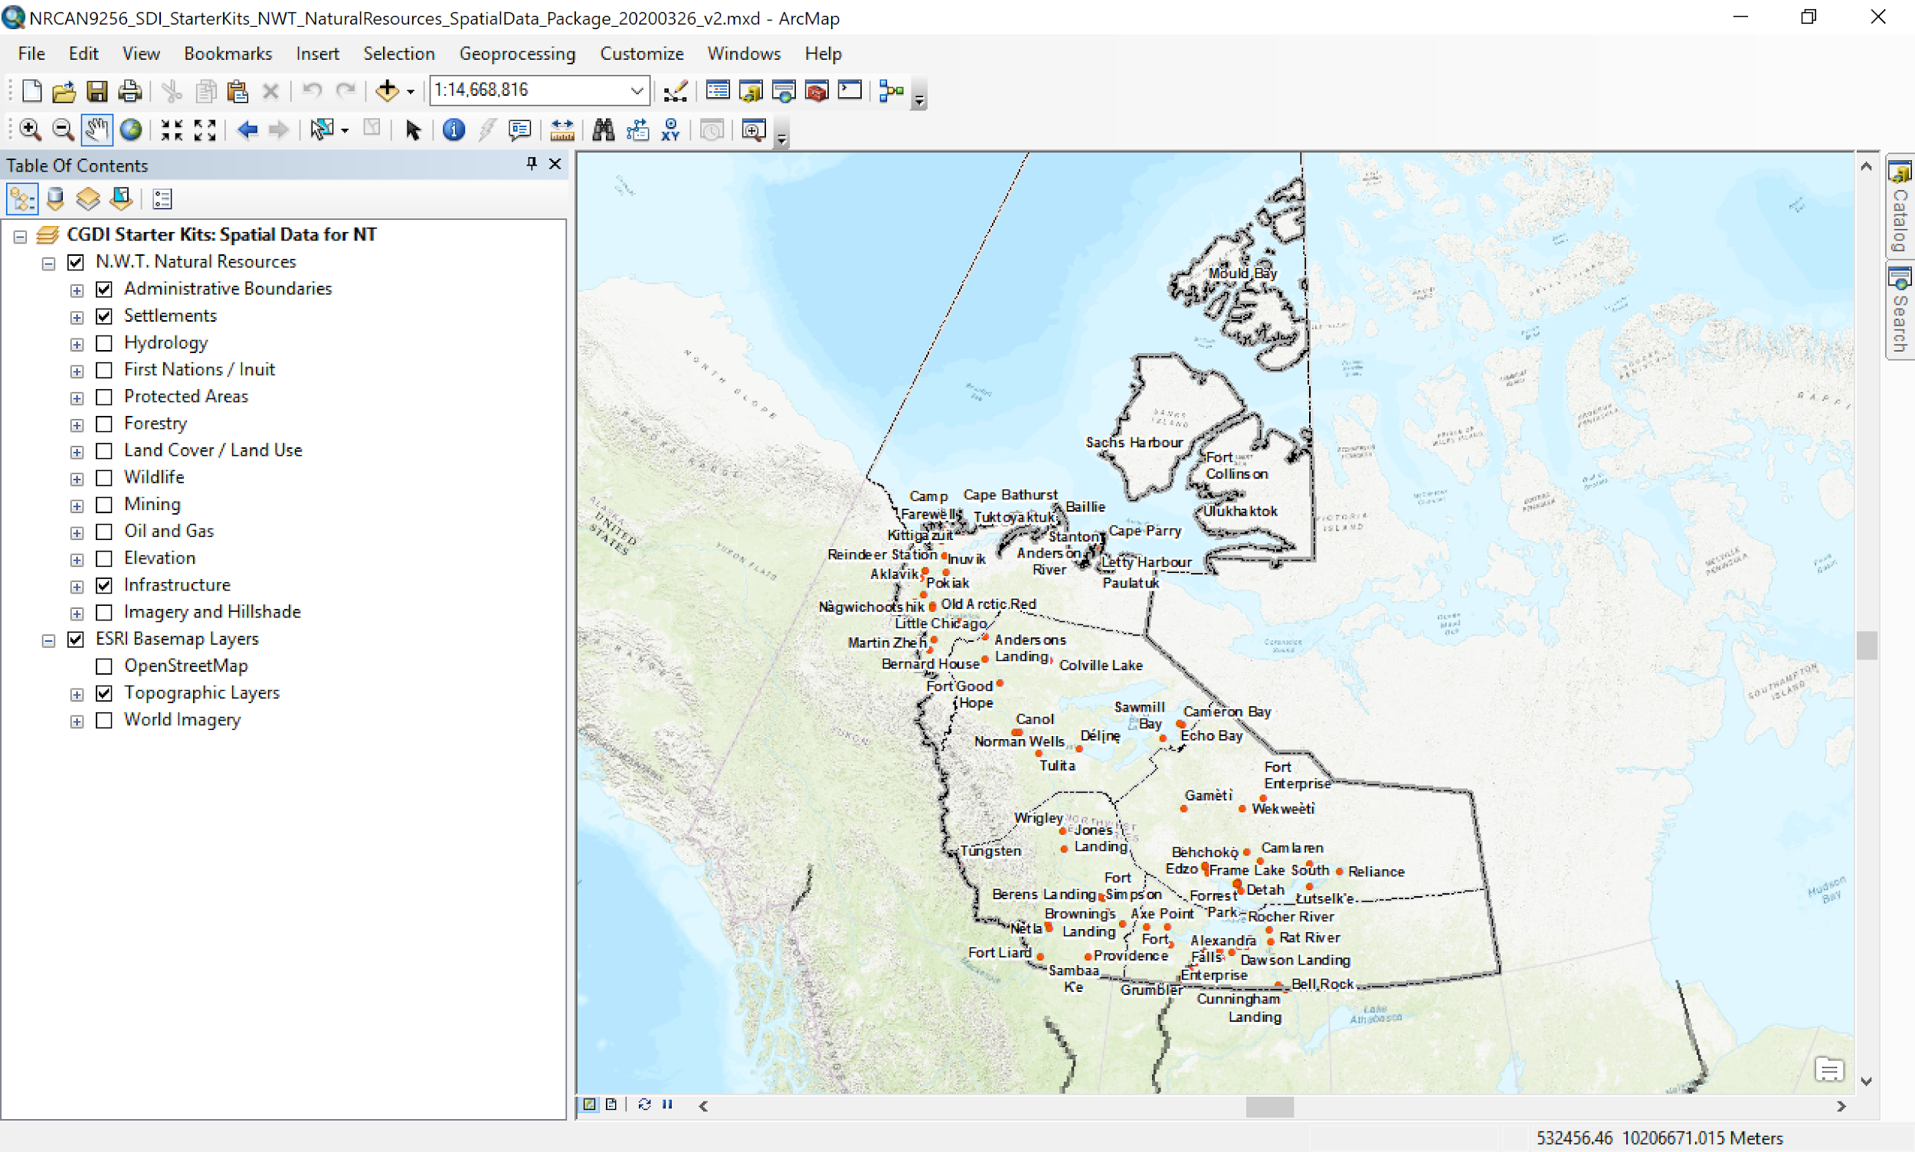
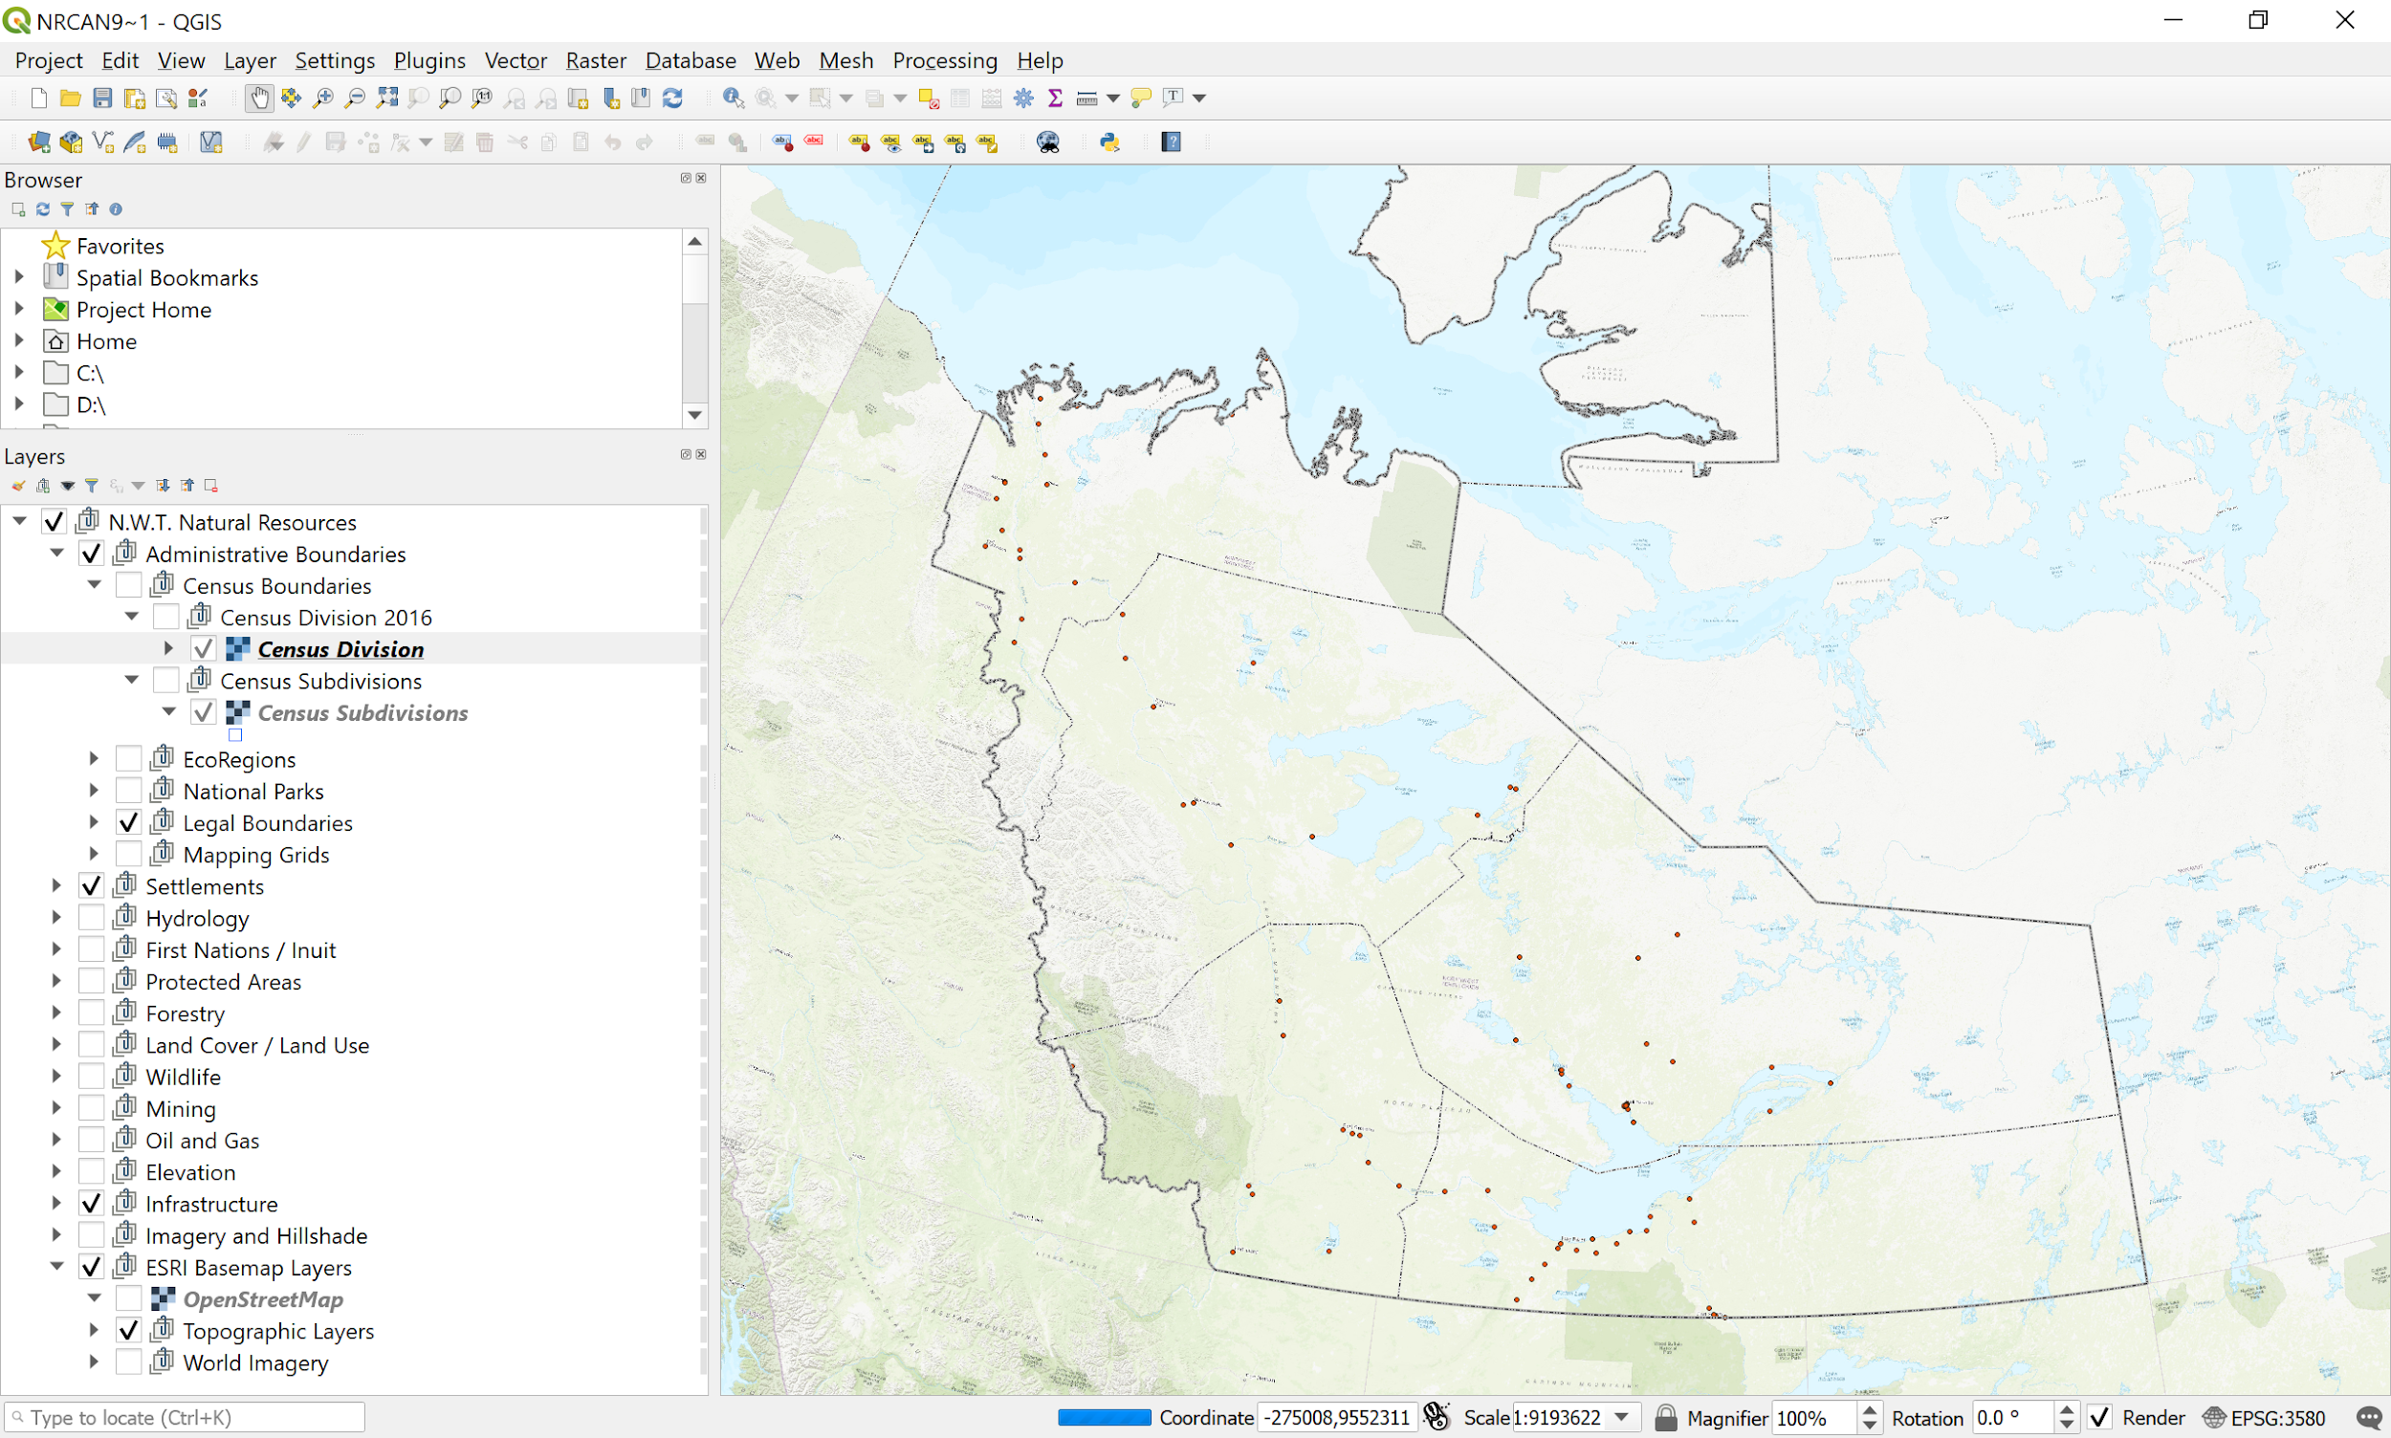
Starter Kit: Natural Resources, N.W.T.
MapPackage
GeoPackage
GDrive Kit Link
GDrive Kit Link

Slide 27
Catalogs:
Water Resources
Climate
NWT
BC

Slide 28
© Her Majesty the Queen in Right of Canada, as represented by the Minister of Natural Resources, 2020

